Slide 1
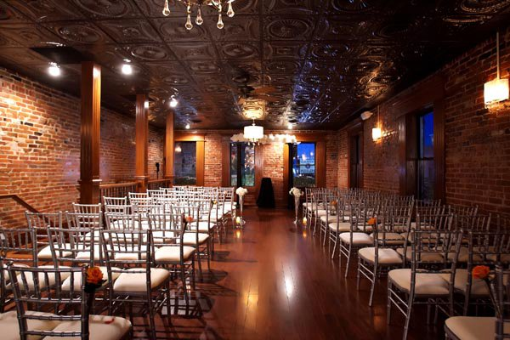
Lee’s Summit Church (pray for a name)
They have signed a
contract on a space in
downtown Lee’s Summit.
Pray for their meeting
this morning to discuss
mission and vision for
the church.
Pray for the leadership
team as they begin making
the vision practical.

Slide 2
Introduction
The letter was written by Paul from Corinth in 56 AD.
The letter was written in anticipation that he would be coming to Rome soon and wanted the people prepared for the doctrines he would be instilling.
We just finished Paul’s inspiring introduction that has now set in to motion the presentation of some important doctrinal information. ARE YOU READY?

Slide 3
Romans 1:17-21
Refusal in the Face of Revelation
Is every person in the world responsible for accepting the
terms of the Christian faith?

Slide 4
Revelation
Romans 1:16 For I am not ashamed of the gospel of Christ: for it is the power of God unto salvation to every one that believeth; to the Jew first, and also to the Greek. 17 For therein is the righteousness of God revealed from faith to faith: as it is written, The just shall live by faith

Slide 5
Revelation
17 For therein is the righteousness of God revealed from faith to faith: as it is written, The just shall live by faith
1. What is revealed? Gods Righteousness Revealed
2. How is it revealed? From faith to faith or from the words and actions of one faithful life to another.

Slide 6
Revelation
Romans 10:15 How then shall they call on him in whom they have not believed? and how shall they believe in him of whom they have not heard? and how shall they hear without a preacher? 16 And how shall they preach, except they be sent? as it is written, How beautiful are the feet of them that preach the gospel of peace, and bring glad tidings of good things!

Slide 7
Revelation
18 For the wrath of God is revealed from heaven against all ungodliness and unrighteousness of men, who hold the truth in unrighteousness;
1. What is revealed? God's Wrath from heaven
2. Why is it revealed? It's revealed in response to:
a) wicked actions - unrighteousness of men
b) wicked stewardship - neglect the truth

Slide 8
Revelation
In other words, mankind is responsible for how they regard and respond to God’s Words.
God’s wrath is the consequence for refusing to follow his call.

Slide 9
KEY QUESTION:
Are all people in the world accountable for accepting God??

Slide 10
Revelation
19 Because that which may be known of God is manifest in them; for God hath shewed it unto them

Slide 11
Revelation
19 Because that which may be known of God is manifest in them; for God hath shewed it unto them
Def “acquainted”
The world is held accountable because the world knows the truth

Slide 12
Revelation
19 Because that which may be known of God is manifest in them; for God hath shewed it unto them
This is a promise
{
How is mankind
acquainted with God?
Faith to faith or
Nature’s Wonder

Slide 13
Clearly Seen
20 For the invisible things of him from the creation of the world are clearly seen, being understood by the things that are made, even his eternal power and Godhead; so that they are without excuse:

Slide 14
Psalm 19: 1 The heavens declare the glory of God; and the firmament sheweth his handywork. 2 Day unto day uttereth speech, and night unto night sheweth knowledge. 3 There is no speech nor language, where their voice is not heard. 4 Their line is gone out through all the earth, and their words to the end of the world. In them hath he set a tabernacle for the sun, 5 Which is as a bridegroom coming out of his chamber, and rejoiceth as a strong man to run a race. 6 His going forth is from the end of the heaven, and his circuit unto the ends of it: and there is nothing hid from the heat thereof.

Slide 15
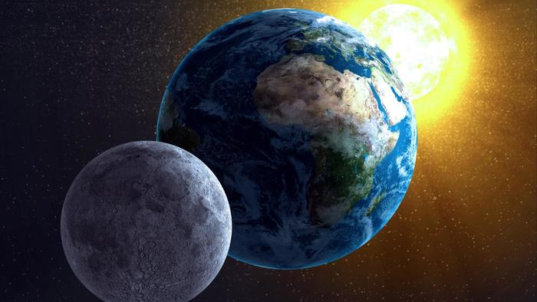
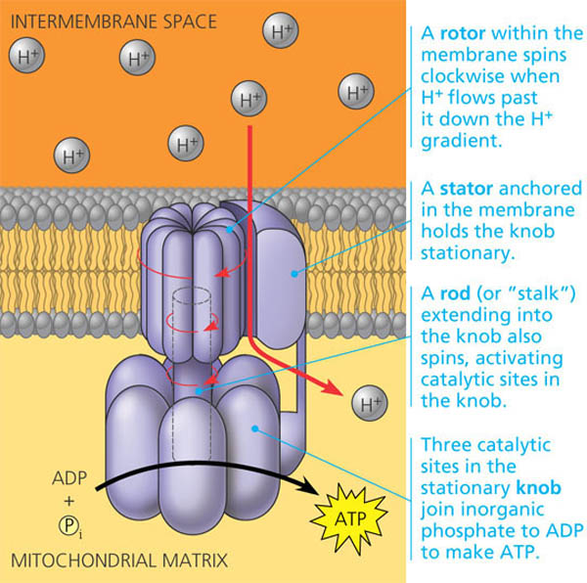
Without Excuse
20 For the invisible things of him
from the creation of the world are
clearly seen, being understood by
the things that are made,even his
eternal Power and Godhead; so
that they are without excuse:
[1]
[2]
[1] idrenaline.net
[2] Biology-forums.com

Slide 16
KEY POINT #1:
God holds us accountable for the truth we HAVE been given, not for what we have NOT been given.
Mat. 25:14-29; John 15:22

Slide 17
KEY POINT #2:
Your spiritual growth is contingent on how you respond to the faith proposition you are facing right now. 1 Pet. 2:2;
Heb. 5:11-14; John 16:12

Slide 18
Without Excuse
1 Cor. 3:1 And I, brethren, could not speak unto you as unto spiritual, but as unto carnal, even as unto babes in Christ. 2. I have fed you with milk, and not with meat: for hitherto ye were not able to bear it, neither yet now are ye able.

Slide 19
Without Excuse
Luke 12:48 But he that knew not, and did commit things worthy of stripes, shall be beaten with few stripes. For unto whomsoever much is given, of him shall be much required: and to whom men have committed much, of him they will ask the more.

Slide 20
Will you be faithful with the measure of truth God has committed to you?

Slide 21
Job 21: 26 If I beheld the sun when it shined, or the moon walking in brightness;
27 And my heart hath been secretly enticed, or my mouth hath kissed my hand:
28 This also were an iniquity to be punished by the judge: for I should have denied the God that is above.

