Slide 1
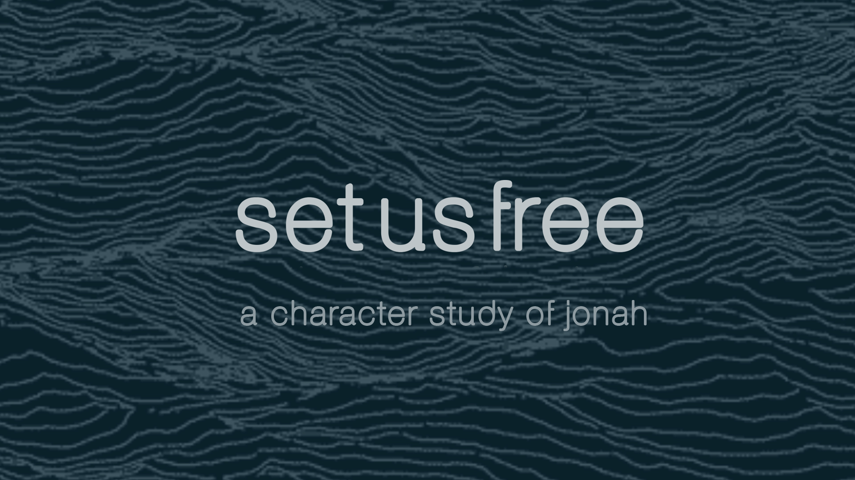

Slide 2

What Do We Need from Jonah?
God is on a rescue mission to save Jonah…
Type to enter a caption.

Slide 3
What Do We Need from Jonah?
God is on a rescue mission to save Jonah…
not from his circumstances but from his thought life.
Type to enter a caption.

Slide 4
KEY POINT:
All of our best and worst moments of faith begin with our thoughts.
Type to enter a caption.

Slide 5
What Do We Need from Jonah?
A life of meaning and purpose begins with learning how to agree with God even when it’s hard.
Type to enter a caption.

Slide 6
1) Free Us from Selfishness
Jon 1:1 Now the word of the LORD came unto Jonah the son of Amittai, saying, 2 Arise, go to Nineveh, that great city, and cry against it; for their wickedness is come up before me.
Type to enter a caption.

Slide 7
KEY PRAYER:
Set me free from selfish motives and mindsets that undermine
your Word.
Type to enter a caption.

Slide 8
2) Free Us from Escape & Isolation
3 But Jonah rose up to flee unto Tarshish from the presence of the LORD, and went down to Joppa; and he found a ship going to Tarshish: so he paid the fare thereof, and went down into it, to go with them unto Tarshish from the presence of the LORD.
Type to enter a caption.

Slide 9
2) Free Us from Escape & Isolation
How to fight our tendency to flee…
Type to enter a caption.

Slide 10
2) Free Us from Escape & Isolation
How to fight our tendency to flee…
Remember that our circumstances are not greater than our Savior's sufficiency
Type to enter a caption.

Slide 11
2) Free Us from Escape & Isolation
How to fight our tendency to flee…
Remember that our circumstances are not greater than our Savior's sufficiency
Resolve ourselves to gain God’s perspective on every situation.
Type to enter a caption.

Slide 12
2) Free Us from Escape & Isolation
How to fight our tendency to flee…
Remember that our circumstances are not greater than our Savior's sufficiency
Resolve ourselves to gain God’s perspective on every situation.
      Seek biblical friendships
Type to enter a caption.

Slide 13
2) Free Us from Escape & Isolation
How to fight our tendency to flee…
Remember that our circumstances are not greater than our Savior's sufficiency
Resolve ourselves to gain God’s perspective on every situation.
      Seek biblical friendships
      Seek the words of God
Type to enter a caption.

Slide 14
2) Free Us from Escape & Isolation
How to fight our tendency to flee…
Remember that our circumstances are not greater than our Savior's sufficiency
Resolve ourselves to gain God’s perspective on every situation.
      Seek biblical friendships
      Seek the words of God
      Seek God in prayer
Type to enter a caption.

Slide 15
KEY PRAYER:
Set me free from the tendency to isolate and escape when things get hard or confusing.
Type to enter a caption.

