Slide 1
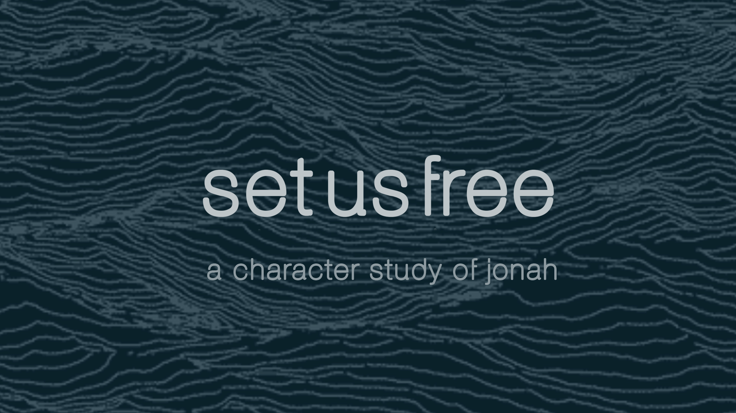

Slide 2

Our Way vs God’s Way
Jon 4:1 But it displeased Jonah exceedingly, and he was very angry.2 And he prayed unto the LORD, and said, I pray thee, O LORD, [was] not this my saying, when I was yet in my country? 3 Therefore now, O LORD, take, I beseech thee, my life from me; for [it is] better for me to die than to live.
Type to enter a caption.

Slide 3
KEY POINT #1:
When we magnify our personal desires
over God’s we enter a path of displeasure.
Type to enter a caption.

Slide 4
Doest thou well?
4 Then said the LORD, Doest thou well to be angry? 5 So Jonah went out of the city, and sat on the east side of the city, and there made him a booth, and sat under it in the shadow, till he might see what would become of the city.
Type to enter a caption.

Slide 5
10) Free Us from Our Idolatry of Heart
Type to enter a caption.

Slide 6
10) Free Us from Our Idolatry of Heart
Rom 1:24 Wherefore God also gave them up to uncleanness through the lusts of their own hearts, to dishonour their own bodies between themselves: 25 Who changed the truth of God into a lie, and worshipped and served the creature more than the Creator, who is blessed for ever. Amen. ... 28 And even as they did not like to retain God in [their] knowledge, God gave them over to a reprobate mind, to do those things which are not convenient;
Type to enter a caption.

Slide 7
KEY POINT #2:
When we worship our feelings,
we set ourselves on a path of destruction.
Type to enter a caption.

Slide 8
10) Free Us from Our Idolatry of Heart
The Gourd
6 And the LORD God prepared a gourd, and made [it] to come up over Jonah, that it might be a shadow over his head, to deliver him from his grief. So Jonah was exceeding glad of the gourd.
Type to enter a caption.

Slide 9
10) Free Us from Our Idolatry of Heart
The Worm
7 But God prepared a worm, when the morning rose the next day, and it smote the gourd that it withered.
Type to enter a caption.

Slide 10
10) Free Us from Our Idolatry of Heart
The Wind
8 And it came to pass, when the sun did arise, that God prepared a vehement east wind; and the sun beat upon the head of Jonah, that he fainted, and wished in himself to die, and said, [It is] better for me to die than to live. 9 And God said to Jonah, Doest thou well to be angry for the gourd? And he said, I do well to be angry, [even] unto death.
Type to enter a caption.

Slide 11
KEY PRAYER:
God, please set me free from
the worship of my own
feelings and fixations.
Type to enter a caption.

Slide 12
10) Free Us to Have Your Heart
10 Then said the LORD, Thou hast had pity on the gourd, for the which thou hast not laboured, neither madest it grow; which came up in a night, and perished in a night: 11 And should not I spare Nineveh, that great city, wherein are more than sixscore thousand persons that cannot discern between their right hand and their left hand; and [also] much cattle?
Type to enter a caption.

Slide 13
10) Free Us to Have Your Heart
10 Then said the LORD, Thou hast had pity on the gourd, for the which thou hast not laboured, neither madest it grow;
Type to enter a caption.

Slide 14
10) Free Us to Have Your Heart
10 Then said the LORD, Thou hast had pity on the gourd, for the which thou hast not laboured, neither madest it grow;
We are obsessed with things that were never ours to obsess about.
Type to enter a caption.

Slide 15
10) Free Us to Have Your Heart
10 Then said the LORD, Thou hast had pity on the gourd, for the which thou hast not laboured, neither madest it grow; which came up in a night, and perished in a night:
We are obsessed with things that were never ours to obsess about.
Type to enter a caption.

Slide 16
Jas 4:14 Whereas ye know not what [shall be] on the morrow. For what [is] your life? It is even a vapour, that appeareth for a little time, and then vanisheth away.
Psa 39:5 Behold, thou hast made my days [as] an handbreadth; and mine age [is] as nothing before thee: verily every man at his best state [is] altogether vanity. Selah.
1Pe 1:24 For all flesh [is] as grass, and all the glory of man as the flower of grass. The grass withereth, and the flower thereof falleth away:
1Jo 2:17 And the world passeth away, and the lust thereof: but he that doeth the will of God abideth for ever.
Type to enter a caption.

Slide 17
10) Free Us to Have Your Heart
10 Then said the LORD, Thou hast had pity on the gourd, for the which thou hast not laboured, neither madest it grow; which came up in a night, and perished in a night:
We are obsessed with things that were never ours to obsess about.
Our lives should not revolve around unstable fixations and perishable dreams.
Type to enter a caption.

Slide 18
KEY POINT #3:
Life is short and fragile and easily wasted in the vanity of our own thoughts and emotions.
Type to enter a caption.

Slide 19
10) Free Us to Have Your Heart
11 And should not I spare Nineveh, that great city, wherein are more than sixscore thousand persons that cannot discern between their right hand and their left hand; and [also] much cattle?
Type to enter a caption.

Slide 20
KEY POINT #4:
God cares for souls and so should we.
Type to enter a caption.

Slide 21
1Co 3:9 For we are labourers together with God: ye are God's husbandry, [ye are] God's building. 10 According to the grace of God which is given unto me, as a wise masterbuilder, I have laid the foundation, and another buildeth thereon. But let every man take heed how he buildeth thereupon. 11 For other foundation can no man lay than that is laid, which is Jesus Christ. 12 Now if any man build upon this foundation gold, silver, precious stones, wood, hay, stubble; 13 Every man's work shall be made manifest: for the day shall declare it, because it shall be revealed by fire; and the fire shall try every man's work of what sort it is. 14 If any man's work abide which he hath built thereupon, he shall receive a reward. 15 If any man's work shall be burned, he shall suffer loss: but he himself shall be saved; yet so as by fire.
Type to enter a caption.

Slide 22
KEY POINT #5:
Life is short and fragile but gratifying when we learn to love and care for what he does.
Type to enter a caption.

Slide 23
KEY PRAYER:
God, please set me free to feel,
think and act just like you.
Type to enter a caption.

