Slide 1
Work of the Ministry
4 Trips coming up, details in your bulletin
  Fall retreat, money due by Sep 11
  LFBI Israel Discovery Mission Trip on Nov 18-28, 2017
  Tampa Missions Trip Oct27-Nov3, 2017
  Taiwan Mission Trip June 30- July 14, 2017
  Nepal Discipleship Trip w/ Marc Heckman May 18-31, 2017

Slide 2
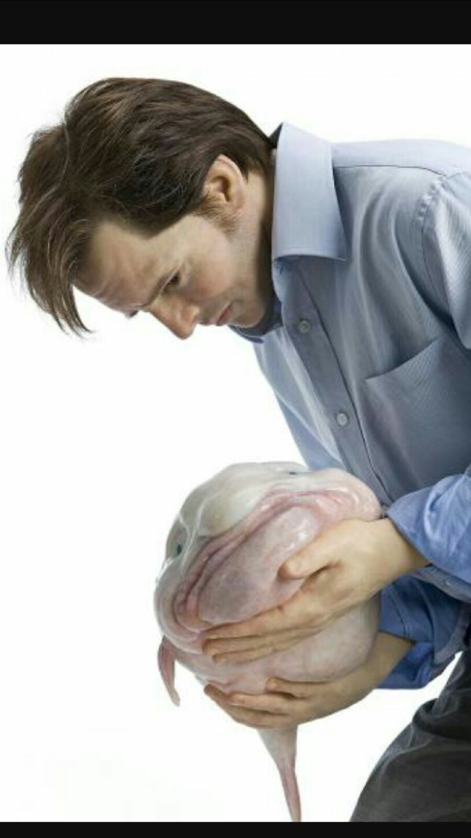

Slide 3
THE ABUNDANT ENTRANCE
2 Peter 1:1-11

Slide 4
REWARDS and CONSEQUENCES
Revelation 3:17-18
Because thou sayest, I am rich, and increased with goods, and have need of nothing; and knowest not that thou art wretched, and miserable, and poor, and blind, and naked: 18 I counsel thee to buy of me gold tried in the fire, that thou mayest be rich; and white raiment, that thou mayest be clothed, and [that] the shame of thy nakedness do not appear; and anoint thine eyes with eyesalve, that thou mayest see.
2 Timothy 4:8
Henceforth there is laid up for me a crown of righteousness, which the Lord, the righteous judge, shall give me at that day: and not to me only, but unto all them also that love his appearing.

Slide 5
I AM FIRST A SERVANT OF GOD
Greek word, “Doulos” = slave
One who gives up their own will for the advancement of another.
What are you enslaved to?

Slide 6
I AM SECONDLY AN APOSTLE
A “sent one”. A missionary.
Where are you going?
  Or better yet, where is God sending you?
  And have you obeyed his leading?

Slide 7
THE ABUNDANT ENTRANCE
2 Peter 1:1-11

Slide 8
OBTAINED LIKE PRECIOUS FAITH
KEY POINT #1
Faith comes by hearing God speak.
Romans 10:17
So then faith [cometh] by hearing, and hearing by the word of God.
Acts 10 – Cornelius heard from God and then exercised his faith.
Acts 16:44 – Lydia’s eyes were opened. It does not say she was given faith to receive God in her heart.

Slide 9
OBTAINED LIKE PRECIOUS FAITH
KEY POINT #2
What you do with the revelation of God will determine the potency and timeliness of future revelation.
Matthew 8:5-10, 13 – Jesus marvels at the Centurion’s faith.
How can Jesus marvel at someone’s faith if he was the one who gave it to him?
  It’s like throwing a surprise birthday party for yourself.
John 6:44

Slide 10
IRONSIDE COMMENTARY
The very righteousness of God demands that faith be extended to all men. This is the very opposite of what some High Calvinists teach. They would have us believe that faith itself is a gift which God grants only to a limited number; that all men have not faith because it is not the will of God that they should have it. This is the very opposite of the teaching of the Holy Scriptures. God desires that all men should be saved and come to the knowledge of the truth. The reason that some men have not faith is that they will not give heed to the Word, and “faith cometh by hearing, and hearing by the Word of God” (Romans 10:17). Where men are ready to hear, God can be depended upon to see that they obtain this precious gift of faith. It would be unrighteous in Him to do otherwise.

Slide 11
MAKING YOUR WITNESS POWERFUL
Our faith is activated by the Word of God.
It is the Word of God that awakens the deadness of man’s heart.
It is at the hearing of God’s Word that men can believe in his Son.
It is where faith is born!
And my faith will grow as I hear God speak more.
Are you listening?

