Slide 1
Serving Single
Keeping the Lord our Focus.

Slide 2
the key is contentment.
We exist for God’s glory! Not our wants.
If you cannot come to the place of contentment AS a single, while BEING single, then you’ll not only miss out on how God wants to use you, you’ll miss out on the joy OF God USING you!

Slide 3

the reason you are single.

Slide 4

the reason you are single.
God wants to use you as a single!
KEY: Being single should never mean that you are stuck on the second string ministry team!
Singles have the capacity to be undistracted from God’s mission!
Work your advantage!
Single is better.

Slide 5

the guidelines for singleness.
Don’t touch.
Don’t add rules on top of Bible instruction.
Beware burnout!
You are not the answer
to every question over every need in our church.

Slide 6
the key of contentment.
Contentment is an inward expression of faith despite your OUTWARD circumstances.
If you are not at peace as a single, then you’re not really ready to be married.
God has ALREADY given you everything you need to live for Him and thrive in your present circumstance!

Slide 7
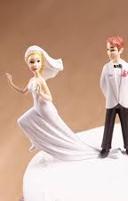
how to boot the burning.
Marry

Slide 8

GRACE

