Slide 1
LOVE & MARRIAGE
Keeping the Lord our Focus.

Slide 2
the key is contentment.
We exist for God’s glory! Not our wants.
If you cannot come to the place of contentment in your marriage, in the midst of your matrimonial mess, then you’ll not only miss out on how God wants to use you in your marriage, but you’ll also miss out on the joy of Him using your marriage for His glory!

Slide 3
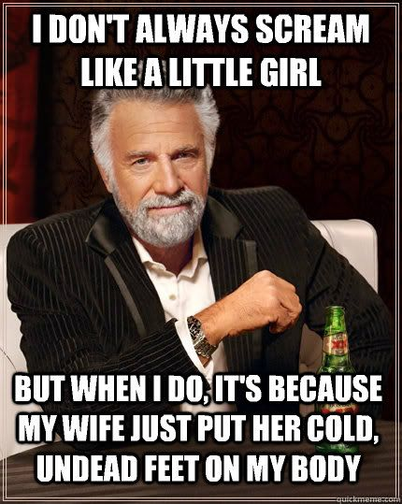
the reason you are married.

Slide 4
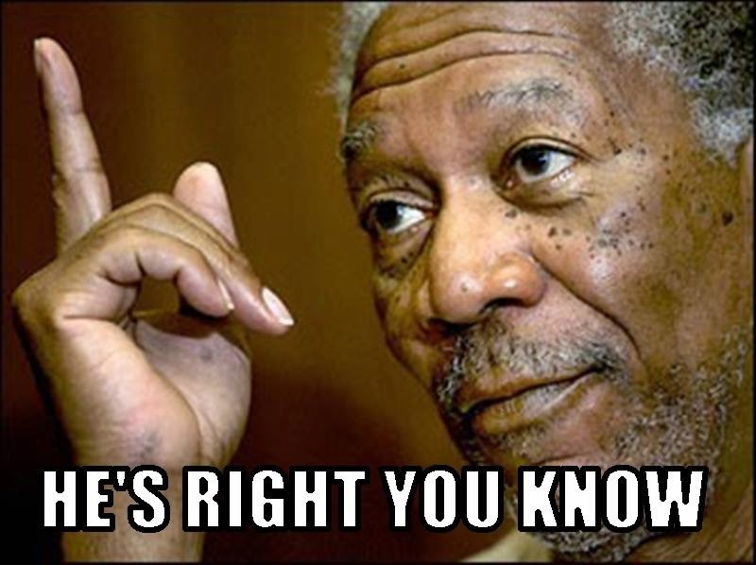
the reason you are married.
God loves you and wants good for you.
Your marriage is designed to help you fulfill your mission!
Marriage enables you to
invest in others in ways
that you cannot as a
single.

Slide 5

you get to raise your kids right!
Adam and Eve.
(Gen 4:25-26)
  Seth
Amram and Jochebed. (Exo 6:20)
  Moses
Boaz and Ruth.
Zacharias and Elizabeth. (Luke 1)
  John the Baptist.

Slide 6

the reason you are married.
God loves you and
wants good for you.
You couldn’t make it
as a single.
Do not SETTLE for
someone just because
they make you tingle.

Slide 7

what if you picked wrong?

Slide 8
keeping your marriage 100.
Be the mate God called you to be.
Trust your mate to the Master.
Never allow your mate to hinder your obedience to Christ.
Never stop investing in your marriage.

Slide 9

INVEST!

