Slide 1
Battling spiritual warfare
Joshua 10:1-14

Slide 2
Gen 15:7 And he said unto him, I am the LORD that brought thee out of Ur of the Chaldees, to give thee this land to inherit it.………..16 But in the fourth generation they shall come hither again: for the iniquity of the Amorites is not yet full.
Objection: Why would God sanction destroying the Amorites?
    Lev 18:1-25
    Deut 18:9-14
Psa106:34 They did not destroy the nations, concerning whom the LORD commanded them: 35 But were mingled among the heathen, and learned their works. 36 And they served their idols: which were a snare unto them. 37 Yea, they sacrificed their sons and their daughters unto devils, 38 And shed innocent blood, even the blood of their sons and of their daughters, whom they sacrificed unto the idols of Canaan: and the land was polluted with blood.

Slide 3
Question for unbelievers? How are you going to respond when you have clearly heard the good of Jesus Christ and the warning of impending judgment?
Question for believers? How are you going to respond when you have clearly heard the good of Jesus Christ and the warning of impending judgment?

Slide 4
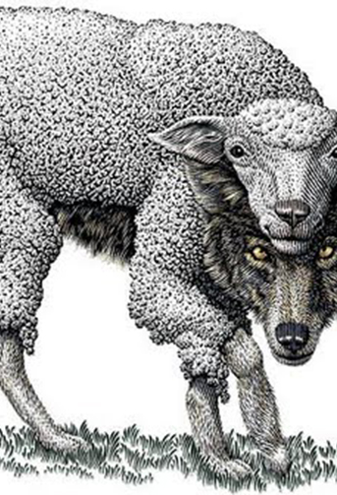
Adonizedek – Lord of Righteousness
King of Jerusalem - Peace
Who are the 5 kings?
Ringleader of all the kings
This king is after your peace so that fear disarm your faith
Leads people to false peace, fear, guilt and ultimately depression

Slide 5
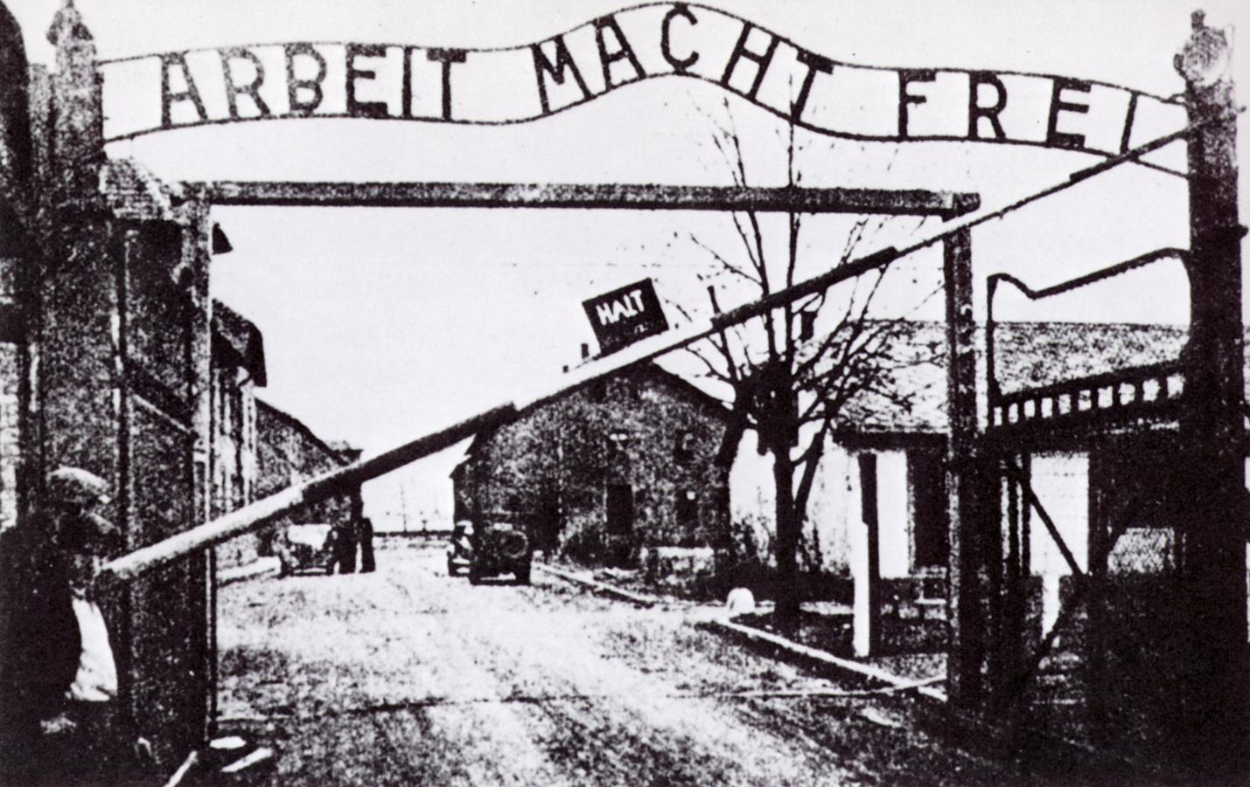
Hoham – Jehovah impels
King of Hebron – Binding friendship or association
Spirit of religion that gives a sense of belongingness through works
The spirit cause people to think or feel they are only accepted by the family, their friends their church if they are good enough, smart enough, good looking enough and so forth
It impels people to have a performance based mindset

Slide 6
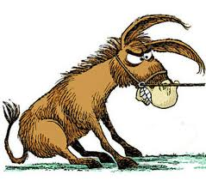
Piram – Like a wild ass
King ofJarmuth – High
This king propagates a spirit of rebellion
Leads people to be wild, unbridled, too proud to submit
It causes one not to be submitted and find their own way of righteousness

Slide 7
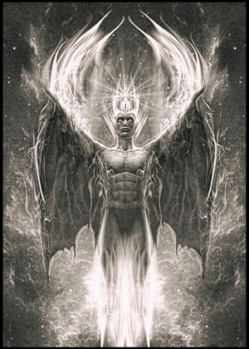
Japhiath – Shinning thyself
King of Laschish- Invincible
This spirit of pride cause people to seek attention and praises for themselves
Leads people to think themselves more important than they really are
The person ends up taking God’s glory for themselves

Slide 8
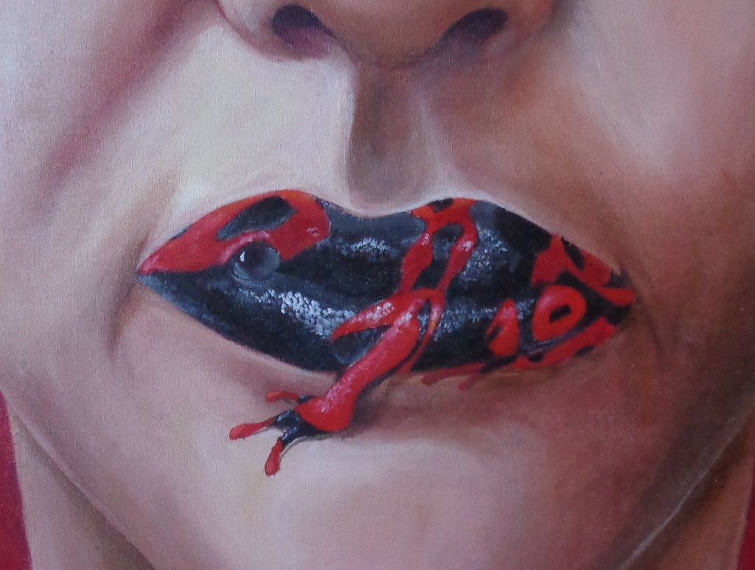
Debir – Oracle or Sanctuary
King of Eglon – Bull like, calf Ex32:4,24)
Spirit of strange teaching
Manifest in lies, slander, accusation, discrediting leaders of God, WOG
Leads to division in the church and opting for alternative truth

Slide 9
KP: Our reaction to spiritual attacks has to always be prayer (to call upon the Lord)
    Psa_18:3 I will call upon the LORD, who is worthy to be praised: so shall I be saved from mine enemies.
    Psa_55:16 As for me, I will call upon God; and the LORD shall save me.
    Psa_99:6 Moses and Aaron among his priests, and Samuel among them that call upon his name; they called upon the LORD, and he answered them.

Slide 10
KP: Recognize spiritual battle is going to be difficult and long!
Requires others to battle alongside with you v7
Requires en-couragement from the Lord to go battle for yourself and others
  Eph 6:13 Wherefore take unto you the whole armour of God, that ye may be able to withstand in the evil day, and having done all, to stand. Eph 6:14 Stand therefore, having your loins girt about with truth, and having on the breastplate of righteousness; Eph 6:15 And your feet shod with the preparation of the gospel of peace; Eph 6:16 Above all, taking the shield of faith, wherewith ye shall be able to quench all the fiery darts of the wicked. Eph 6:17 And take the helmet of salvation, and the sword of the Spirit, which is the word of God:
  Rom 15:1 We then that are strong ought to bear the infirmities of the weak, and not to please ourselves.
Requires endurance v9
  2Ti 2:3 Thou therefore endure hardness, as a good soldier of Jesus Christ.

Slide 11
Like Joshua we need to ascend from Gilgal
Jos 5:8 And it came to pass, when they had done circumcising all the people, that they abode in their places in the camp, till they were whole. 5:9 And the LORD said unto Joshua, This day have I rolled away the reproach of Egypt from off you. Wherefore the name of the place is called Gilgal unto this day.
Col 2:11 In whom also ye are circumcised with the circumcision made without hands, in putting off the body of the sins of the flesh by the circumcision of Christ: 2:12 Buried with him in baptism, wherein also ye are risen with him through the faith of the operation of God, who hath raised him from the dead.
Rom 8:13 For if ye live after the flesh, ye shall die: but if ye through the Spirit do mortify the deeds of the body, ye shall live.
KP: The death, burial and resurrection allowed us to HAVE VICTORY in spiritual warfare. We need to live in the newness of life through the Holy Spirit

Slide 12
      In dealing with the spirit of fear
        2Ti 1:7 For God hath not given us the spirit of fear; but of power, and of love, and of a sound mind.
        Col 3:15 And let the peace of God rule in your hearts, to the which also ye are called in one body; and be ye thankful. 16 Let the word of Christ dwell in you richly in all wisdom; teaching and admonishing one another in psalms and hymns and spiritual songs, singing with grace in your hearts to the Lord.
      In dealing with spirit of religion.
        Gal 3:2 This only would I learn of you, Received ye the Spirit by the works of the law, or by the hearing of faith? 3 Are ye so foolish? having begun in the Spirit, are ye now made perfect by the flesh? ….....6 Even as Abraham believed God, and it was accounted to him for righteousness.
      In dealing with spirit of pride
        Jas 4:10 Humble yourselves in the sight of the Lord, and he shall lift you up.
        Jas 4:6 But he giveth more grace. Wherefore he saith, God resisteth the proud, but giveth grace unto the humble
      In dealing with spirit of rebellion
        1Sa 15:23 For rebellion is as the sin of witchcraft, and stubbornness is as iniquity and idolatry. Because thou hast rejected the word of the LORD, he hath also rejected thee from being king.
      In dealing with spirit of poisonous words
        Eph 4:29 Let no corrupt communication proceed out of your mouth, but that which is good to the use of edifying, that it may minister grace unto the hearers.
        Pro 18:21 Death and life are in the power of the tongue: and they that love it shall eat the fruit thereof.
        Mat 12:36 But I say unto you, That every idle word that men shall speak, they shall give account thereof in the day of judgment.

Slide 13
KP: Be encouraged because the real battle belongs to the Lord
2Ch 20:15 And he said, Hearken ye, all Judah, and ye inhabitants of Jerusalem, and thou king Jehoshaphat, Thus saith the LORD unto you, Be not afraid nor dismayed by reason of this great multitude; for the battle is not yours, but God’s.
Psa 20:7 Some trust in chariots, and some in horses: but we will remember the name of the LORD our God.
Job 38:22 Hast thou entered into the treasures of the snow? or hast thou seen the treasures of the hail, 23 Which I have reserved against the time of trouble, against the day of battle and war?

