Slide 1
Characteristics of a Mighty Man or Woman of God
2 Sam. 23:8-12

Slide 2
Characteristics of a Mighty Man or
Woman of God
Exo 17:11 And it came to pass, when Moses held up his hand, that Israel prevailed: and when he let down his hand, Amalek prevailed. 12 But Moses' hands were heavy; and they took a stone, and put it under him, and he sat thereon; and Aaron and Hur stayed up his hands, the one on the one side, and the other on the other side; and his hands were steady until the going down of the sun. 13 And Joshua discomfited Amalek and his people with the edge of the sword.

Slide 3
Key truths about prayer
Prayer is the difference between winning or losing in battle.
Prayer must be continual.
Prayer must be corporate.

Slide 4
Key truths about prayer
“The church has many organizers, but few agonizers; many who pay, but few who pray; many resters, but few wrestlers; many who are enterprising, but few who are interceding. People who are not praying and praying. The secret of praying is praying in secret. A worldly Christian will stop praying and a praying Christian will stop worldliness. Tithes may build a church, but tears will give it life. That is the difference between the modern church and the early church. In the matter of effective praying, never have so many left so much to so few. Brethren, let us pray”.

Slide 5
Characteristics of a Mighty Man or
Woman of God
Observation 1: Mighty Men and Women of God are Mighty in Prayer.
1 Tim 2:8 I will therefore that men pray every where, lifting up holy hands, without wrath and doubting.
As a fellowship, CAYA must be a holy fellowship.

Slide 6
Characteristics of a Mighty Man or
Woman of God
Gen 2:24 Therefore shall a man leave his father and his mother, and shall cleave unto his wife: and they shall be one flesh.
Observation 2: Mighty Men and Women of God are One with the Word of God.

Slide 7
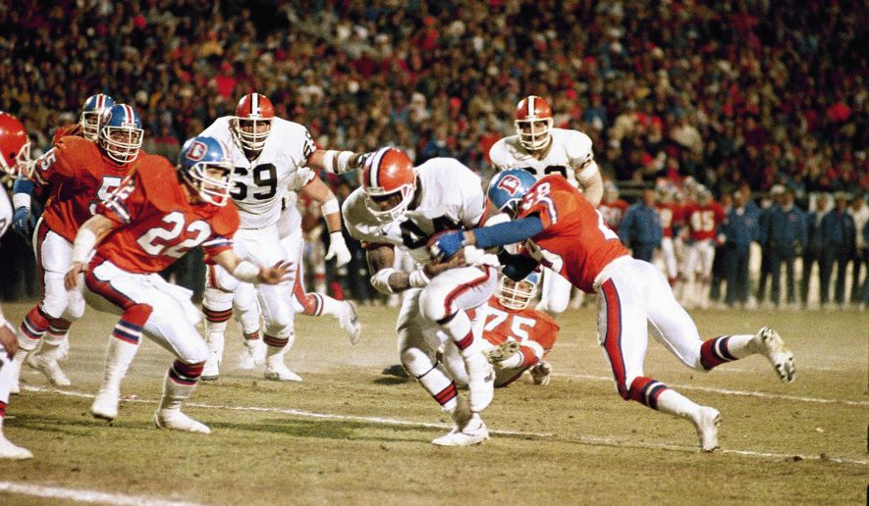

Slide 8
Characteristics of a Mighty Man or
Woman of God
2 Tim. 1:13 Hold fast the form of sound words, which thou hast heard of me, in faith and love which is in Christ Jesus.
1 Cor. 2:16 For who hath known the mind of the Lord, that he may instruct him? But we have the mind of Christ.
Php 2:5 Let this mind be in you, which was also in Christ Jesus:
1 Pet. 4:1 Forasmuch then as Christ hath suffered for us in the flesh, arm yourselves likewise with the same mind: for he that hath suffered in the flesh hath ceased from sin; 2 That he no longer should live the rest of his time in the flesh to the lusts of men, but to the will of God.

Slide 9
Characteristics of a Mighty Man or
Woman of God
Observation 2: Mighty Men and Women of God are One with the Word of God.
There can be no cleaving without leaving.
You have to leave your mind and cleave to His mind.

Slide 10
Characteristics of a Mighty Man or
Woman of God
Eph 4:20 But ye have not so learned Christ; 21 If so be that ye have heard him, and have been taught by him, as the truth is in Jesus: 22 That ye put off concerning the former conversation the old man, which is corrupt according to the deceitful lusts; 23 And be renewed in the spirit of your mind; 24 And that ye put on the new man, which after God is created in righteousness and true holiness.

Slide 11
Characteristics of a Mighty Man or
Woman of God
Observation 1: Mighty Men and Women of God are Mighty in Prayer.
Observation 2: Mighty Men and Women of God are One with the Word of God.
Observation 3: Mighty Men and Women of God are Unconditionally Faithful to the Work.
Pro 20:6 Most men will proclaim every one his own goodness: but a faithful man who can find?

