Slide 1
John 9:1-7
Vision = Mission

Slide 2
John 9:1-7 ¶ And as Jesus passed by, he saw a man which was blind from his birth. And his disciples asked him, saying, Master, who did sin, this man, or his parents, that he was born blind? Jesus answered, Neither hath this man sinned, nor his parents: but that the works of God should be made manifest in him. I must work the works of him that sent me, while it is day: the night cometh, when no man can work. As long as I am in the world, I am the light of the world.
When he had thus spoken, he spat on the ground, and made clay of the spittle, and he anointed the eyes of the blind man with the clay,
And said unto him, Go, wash in the pool of Siloam, (which is by interpretation, Sent.) He went his way therefore, and washed, and came seeing.

Slide 3
God is to be manifest in this world.
Whether we assist or not, ultimately he will appear in full glory.
Definition : “Display or show (a quality or feeling) by one’s acts or appearance; demonstrate

Slide 4
The Christian who fails to see the mission will perish.
Proverbs 29:18 Where there is no vision, the people perish: but he that keepeth the law, happy is he
2 Peter 1:9 But he that lacketh these things is blind, and cannot see afar off, and hath forgotten that he was purged from his old sins.

Slide 5
Jesus facilitates the means to your sight.
(Provision) The Work.

Slide 6
John 9:6 When he had thus spoken, he spat on the ground, and made clay of the spittle, and he anointed the eyes of the blind man with clay,
Everything begins with Christ. This is a christ-centered message. Christ who is all, before all, preeminent, our hope of glory.

Slide 7
He spat on the ground
Spit:
Lev 15:8 And if he that hath the issue spit upon him that is clean; then he shall wash his clothes, and bathe himself in water, and be unclean until the even.
Isaiah 50:6 I gave my back to the smiters, and my cheeks to them that plucked off the hair: I hid not my face from shame and spitting.
Matt 27:30 Then did they spit in his face, and buffeted him; and others smote him with the palms of their hands,
Ground:
Gen 2:7 And the LORD God formed man of the dust of the ground, and breathed into his nostrils the breath of life; and man became a living soul.
Gen 3:19 In the sweat of thy face shalt thou eat bread, till thou return unto the ground; for out of it wast thou taken: for dust thou art, and unto dust shalt thou return.
The Ground is what we’re from. It represents creation.

Slide 8
He made clay of the spittle
The act of taking those two things and mixing it, forming and creating. It is the very thing God the Father did with creation. It pictures Christ as the potter. He is molding perfection back into the dust.
Jer 18: 2-6 Arise, and go down to the potter's house, and there I will cause thee to hear my words. Then I went down to the potter's house, and, behold, he wrought a work on the wheels. And the vessel that he made of clay was marred in the hand of the potter: so he made it again another vessel, as seemed good to the potter to make it. Then the word of the LORD came to me, saying, O house of Israel, cannot I do with you as this potter? saith the LORD. Behold, as the clay is in the potter's hand, so are ye in mine hand, O house of Israel.

Slide 9
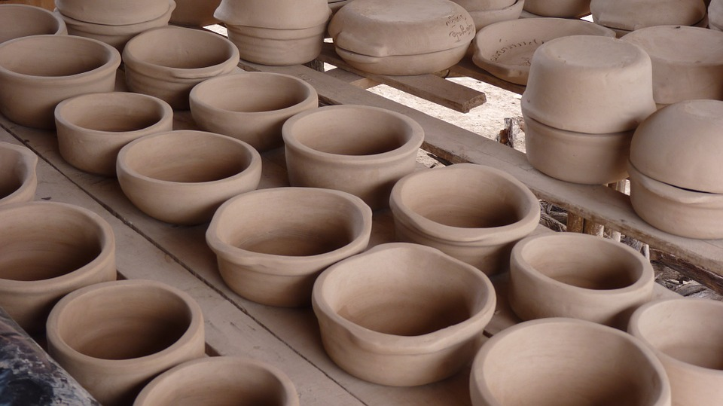

Slide 10
He anointed the eyes of the blind man
Rev 3:18 I counsel thee to buy of me gold tried in the fire, that thou mayest be rich; and white raiment, that thou mayest be clothed, and that the shame of thy nakedness do not appear; and anoint thine eyes with eyesalve, that thou mayest see.

Slide 11
Christ is preparing to use this man.
How has He/is He preparing you?

Slide 12
2. Jesus sets instruction before you.
(Proposition) The way.

Slide 13
And He said unto him, Go
God has a commission for his Christian. He has a plan for your life, a direction, and will always enlighten you, just maybe not how you would prefer.
Psalm 119:105 Thy word is a lamp unto my feet, and a light unto my path.
Proverbs 6:23 For the commandment is a lamp; and the law is light; and reproofs of instruction are the way of life:
The task given is to gauge the man’s obedience.

Slide 14
Wash in the pool of Siloam
When the man responded in obedience, he found God had already done the heavy lifting.

Slide 15
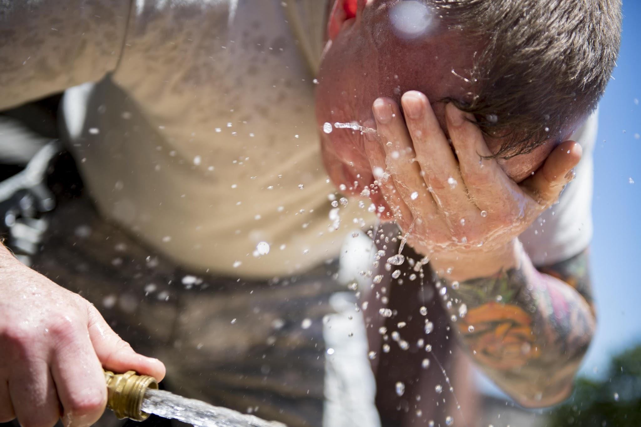

Slide 16
(Which is by interpretation Sent)
CURVEBALL!
The spirit interprets
The mission is how he cleanses his eyes

Slide 17
Jesus is to be glorified
(Presentation) The Worship.

Slide 18
He went.
He washed.
He came seeing.

Slide 19
The man of God who obeys Him, shows that beauty in his face.
Acts 6:15 And all that sat in the council, looking stedfastly on him, saw his face as it had been the face of an angel.

Slide 20
Faith and obedience lead to sight.
Eph 3:9 And to make all men see what is the fellowship of the mystery, which from the beginning of the world hath been hid in God, who created all things by Jesus Christ:

Slide 21
Is Christ’s work in your life simply to make you whole?

Slide 22
What is keeping you from receiving?
What is keeping you from obeying?
What is keeping you from preaching?

