Slide 1

Our need for God’s power.

Slide 2

Matt 9:37-38 Then saith he unto his disciples, The harvest truly is plenteous, but the labourers are few; 38 Pray ye therefore the Lord of the harvest, that he will send forth labourers into his harvest.
What did the early church have that enabled her to be used of God to…
See people AMAZED. Acts 2:7
Be filled with WONDER. Acts 3:10
See a work so STRONG. Acts 17:6
Notes:
© Copyright Showeet.com – Free PowerPoint Templates

Slide 3
What enabled the incredible church growth?
Three thousand souls. Acts 2:41
About five thousand. Acts 4:4
Multitudes. Acts 5:14
Notes:
© Copyright Showeet.com – Free PowerPoint Templates

Slide 4
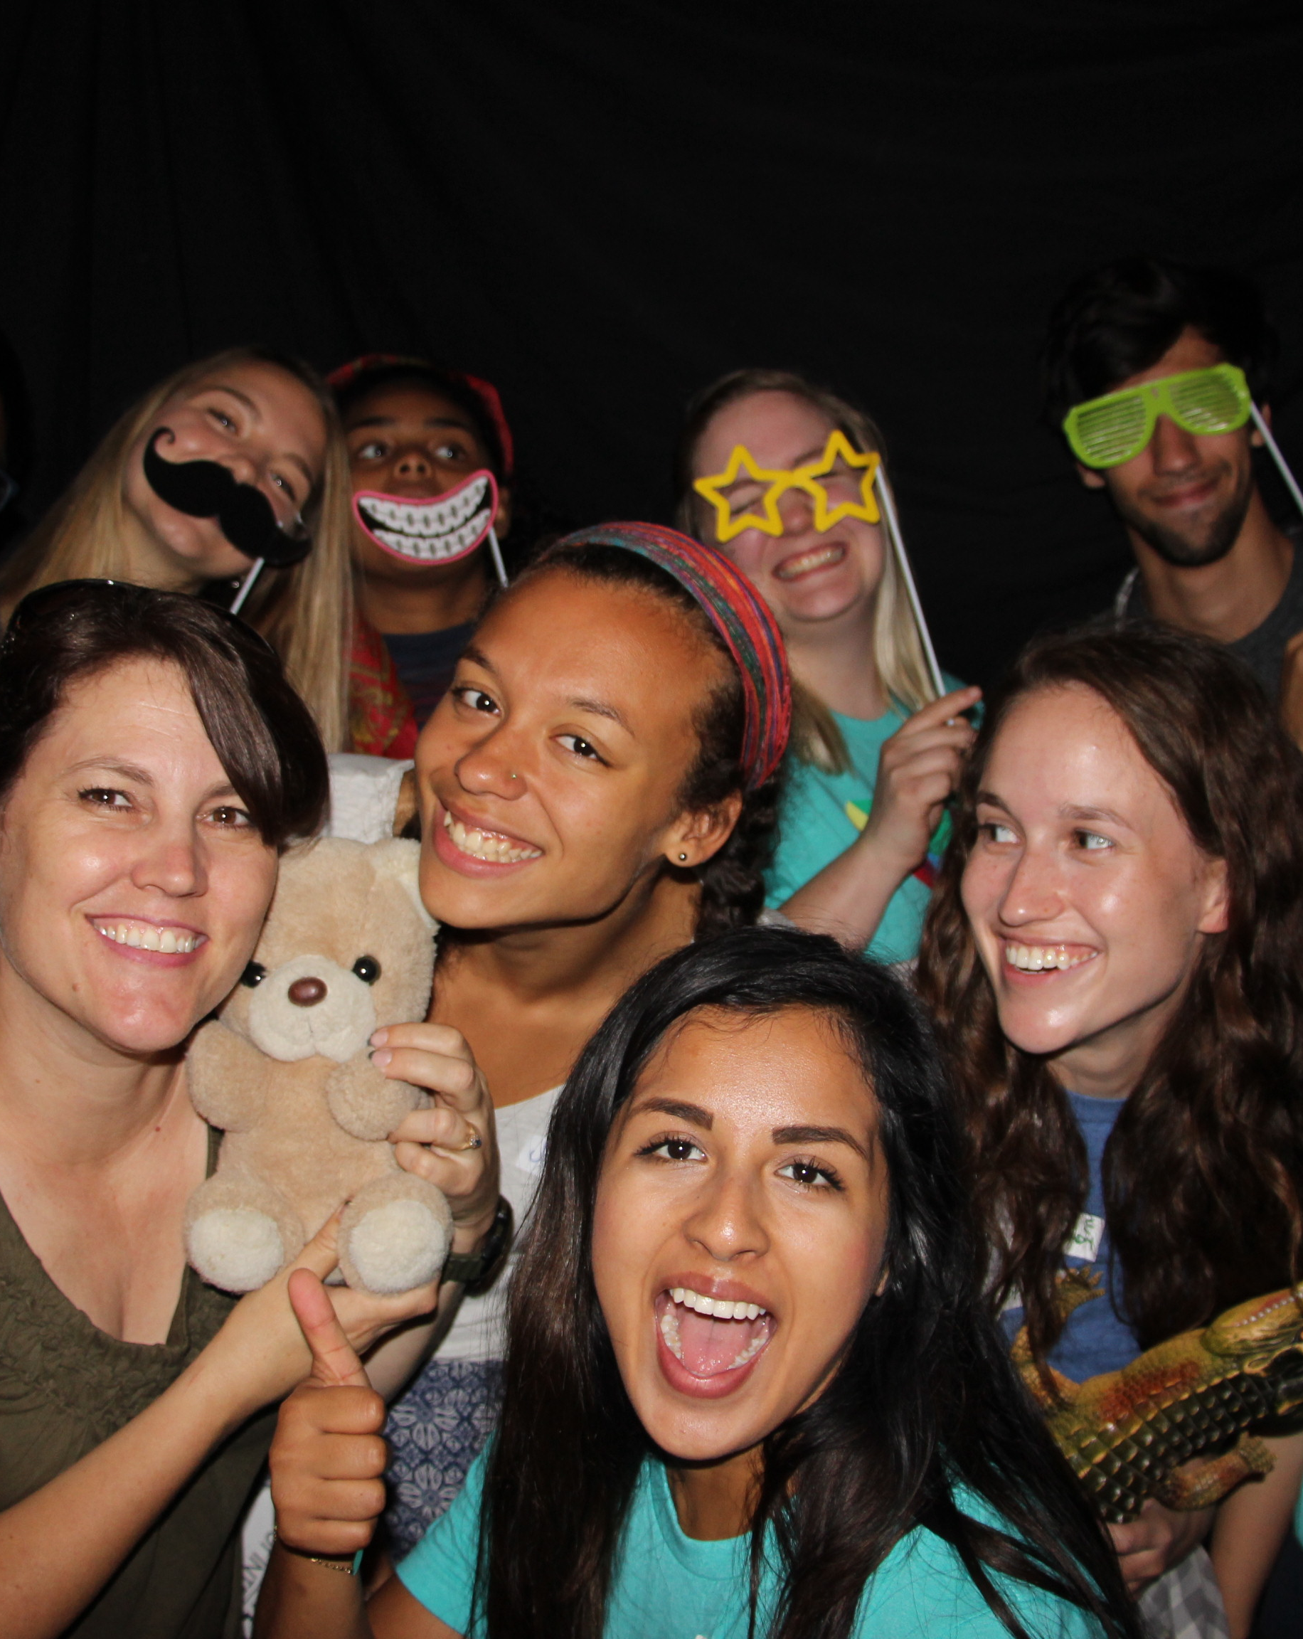
We need God’s power.
Matt 28:18-20 “all power is given unto me in heaven and in earth. Go ye therefore,
Power KEY 1: There is power in Christ’s authority.
1 Timothy 6:15 Which in his times he shall shew, who is the blessed and only Potentate, the King of kings, and Lord of lords;
Notes:
© Copyright Showeet.com – Free PowerPoint Templates

Slide 5
Luke 4:18-19 The Spirit of the Lord is upon me, because he hath anointed me to preach the gospel to the poor; he hath sent me to heal the brokenhearted, to preach deliverance to the captives, and recovering of sight to the blind, to set at liberty them that are bruised, 19 To preach the acceptable year of the Lord.
Notes:
© Copyright Showeet.com – Free PowerPoint Templates

Slide 6
Philippians 1:19 For I know that this shall turn to my salvation through your prayer, and the supply of the Spirit of Jesus Christ,
Ephesians 3:17 That Christ may dwell in your hearts by faith; that ye, being rooted and grounded in love,
Notes:
© Copyright Showeet.com – Free PowerPoint Templates

Slide 7
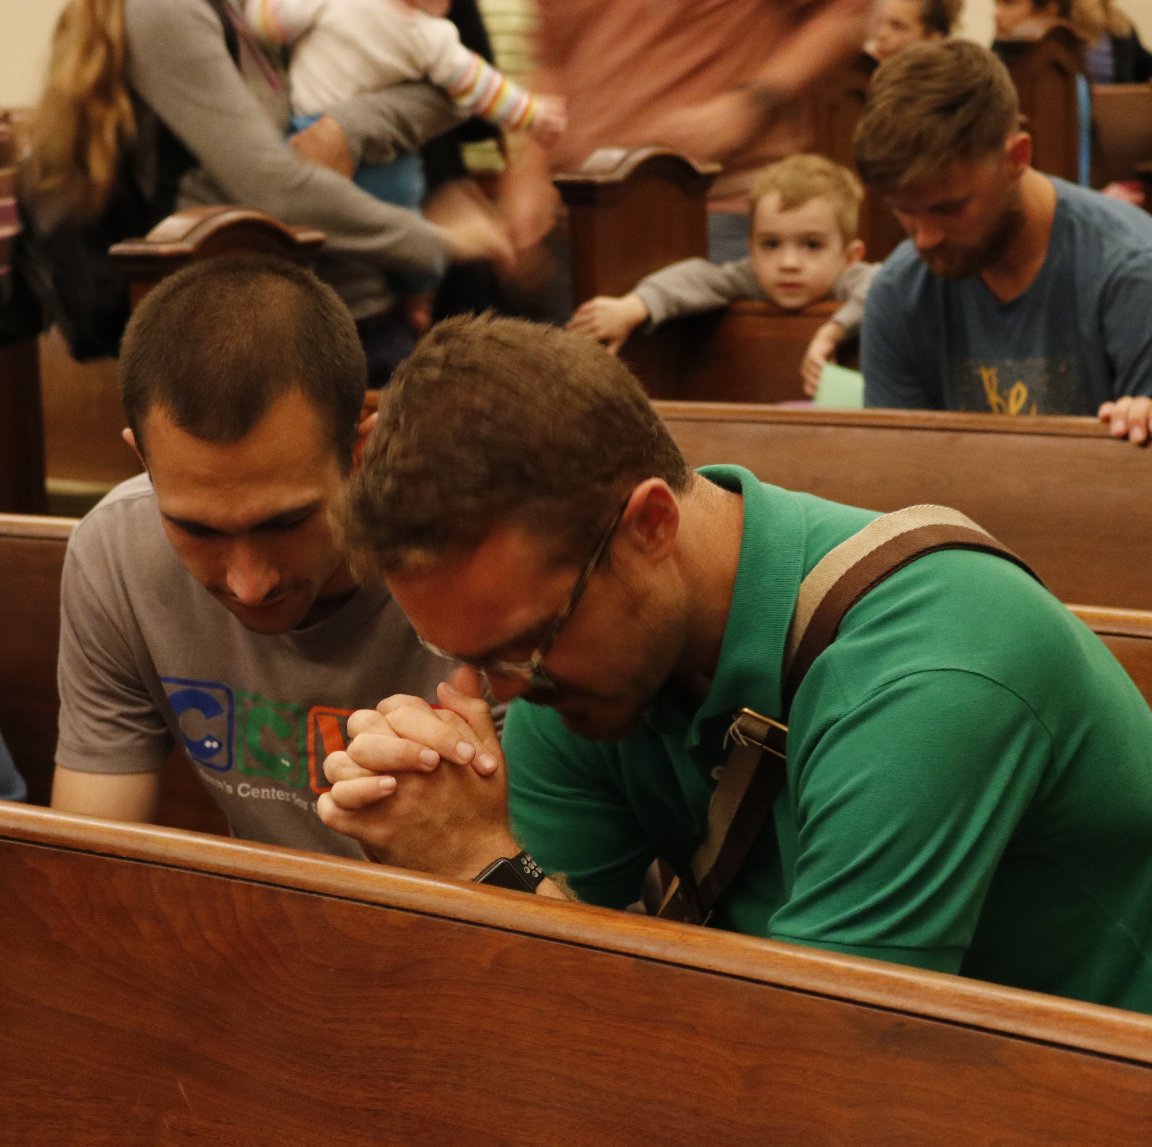
The command: wait.
Their response: prayer.
1 Pet 4:7 But the end of all things is at hand: be ye therefore sober, and watch unto prayer.
Col 4:2 Continue in prayer, and watch in the same with thanksgiving;
Power key 2: There is great power in prayer! God gives opportunities as we move in prayer.
Power key 3: The Holy Ghost is the power for our witness. (Acts 2)
Notes:
© Copyright Showeet.com – Free PowerPoint Templates

Slide 8

The lost cannot help themselves.
You see God’s salvation is unsolicited, but it is offered.
Romans 3:10-12 As it is written, There is none righteous, no, not one: 11 There is none that understandeth, there is none that seeketh after God. 12 They are all gone out of the way, they are together become unprofitable; there is none that doeth good, no, not one.
You have to BELIEVE and RECEIVE the message. Rom 10:17.
Notes:
© Copyright Showeet.com – Free PowerPoint Templates

Slide 9
Power key 4: There is POWER in the name of Jesus!
Eph 2:8 – “for by grace are ye saved through faith”
Rom 10:13 For whosoever shall call upon the name of the Lord shall be saved.
Notes:
© Copyright Showeet.com – Free PowerPoint Templates

Slide 10
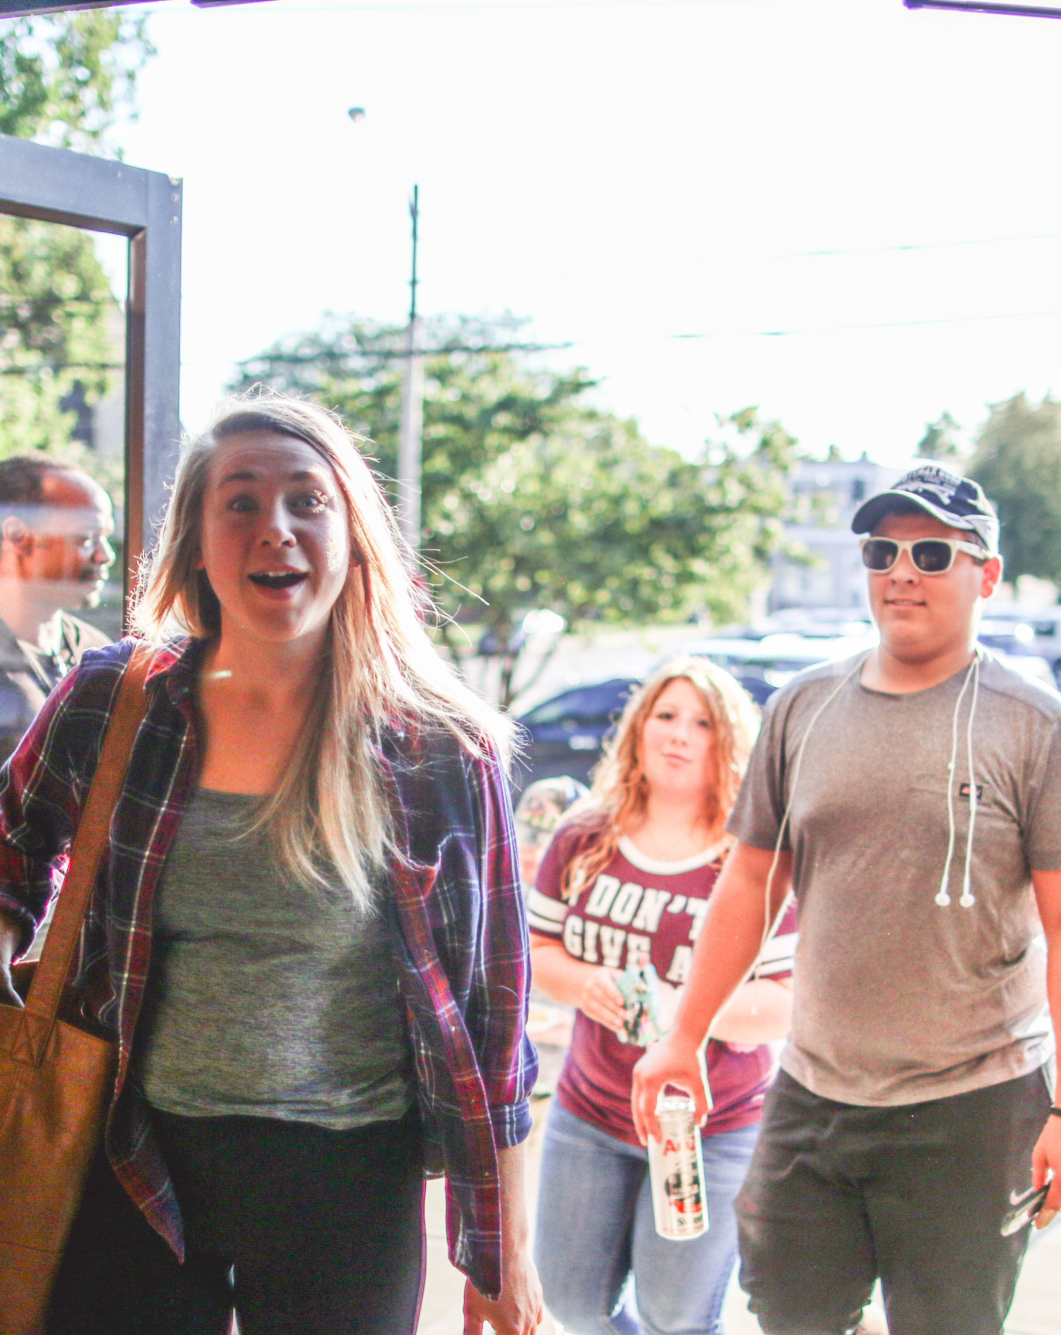
The results of believing in Jesus’ name.
Acts 3:8-11 vs Acts 4:7-18
By what power?
By what name?
Faith in Christ’s name changes
  You
  Others
Notes:
© Copyright Showeet.com – Free PowerPoint Templates

Slide 11
The proper response to persecution.
  Report.
  Pray!
Notes:
© Copyright Showeet.com – Free PowerPoint Templates

Slide 12
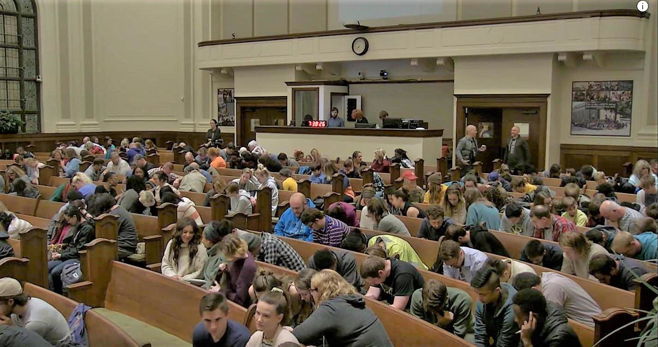
Large Image slide
The proper response to persecution from others.
Notes:
© Copyright Showeet.com – Free PowerPoint Templates

Slide 13
Power key 5: There is power in our witness!
Notes:
© Copyright Showeet.com – Free PowerPoint Templates

