Slide 1
2 Corinthians 10:3-5
Uriah Guenther

Slide 2
Thesis
God doesn’t have a “plan” for you life:
He wants your obedience, your heart.

Slide 3
2 Cor 10:3
For though we walk in the flesh,
We do not war after the flesh

Slide 4
Key Point 1:
We as christians are present in this world,
but do not live by the same standards as the world.

Slide 5
John 15:19
If ye were of the world, the world would love his own: but because ye are not of the world, but I have chosen you out of the world, therefore the world hateth you
John 17: 14-16
I have given them thy word; and the world hath hated them, because they are not of the world, even as I am not of the world. I pray not that thou shouldest take them out of the world, but that thou shouldest keep them from the evil. They are not of the world, even as I am not of the world.

Slide 6
The world is desperate for you to be conformed to it’s system, or at the very least become content in a christian life of confusion.
Psalm 71:1-2 ¶ In thee, O LORD, do I put my trust: let me never be put to confusion. Deliver me in thy righteousness, and cause me to escape: incline thine ear unto me, and save me.
1 Corinthians 14:33 For God is not the author of confusion, but of peace, as in all churches of the saints.

Slide 7
2 Cor 10:4
For the weapons of our warfare are not carnal, but mighty through God to the pulling down of strongholds;

Slide 8
Key Point 2:
Our weapons as christians are only powerful through God; our victory and sight is provided in Him

Slide 9
Rom 7:18 For I know that in me (that is, in my flesh,) dwelleth no good thing: for to will is present with me; but how to perform that which is good I find not.
“No good thing” only reproduces “no good thing” We need another variable.

Slide 10
Only a fool neglects his most powerful weapon
Phil 1:6 Being confident of this very thing, that he which hath begun a good work in you will perform it until the day of Jesus Christ:
Galatians 3:1 O foolish Galatians, who hath bewitched you, that ye should not obey the truth, before whose eyes Jesus Christ hath been evidently set forth, crucified among you?
Galatians 3:3 Are ye so foolish? having begun in the Spirit, are ye now made perfect by the flesh?

Slide 11
Be patient. You have been given every tool for every season. Your God loves you.

Slide 12
When you are asking for answers, which weapons are you using?
(Prayer, Church, Word) or (World, Internet, your Thoughts)

Slide 13
2 Cor 10:5
Casting down imaginations, and every high thing that exalteth itself against the knowledge of God, and bringing into captivity every thought
to the obedience of Christ

Slide 14
Key Point 3:
Everything in our heads must be brought through Christ,
who is the answer to all.

Slide 15
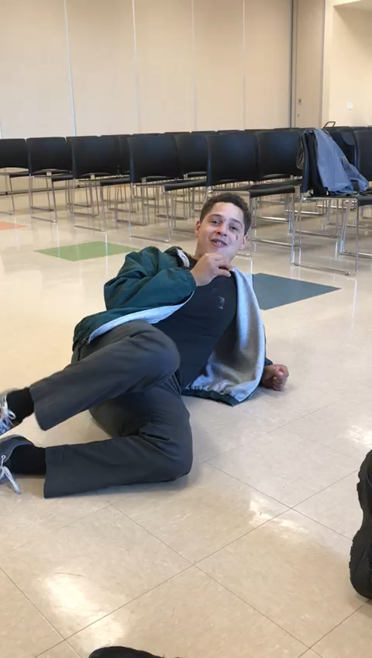

Slide 16
Sheep are for the shepherd,
not the other way around.
The shepherd protects the sheep
because they are His.

Slide 17
Proverbs 119:105 Thy word is a lamp unto my feet, and a light unto my path.
Romans 12:1-3 I beseech you therefore, brethren, by the mercies of God, that ye present your bodies a living sacrifice, holy, acceptable unto God, which is your reasonable service. And be not conformed to this world: but be ye transformed by the renewing of your mind, that ye may prove what is that good, and acceptable, and perfect, will of God. For I say, through the grace given unto me, to every man that is among you, not to think of himself more highly than he ought to think; but to think soberly, according as God hath dealt to every man the measure of faith.

Slide 18
God desires the heart of man. It satisfies Him deeper than sacrifices, offerings. Your heart to obey his Word in free-will is a true place of blessing.

