Slide 1
What Do You Love More Than Jesus?
Bible Basics #2
“The Cost: Discipleship”

Slide 2
Review
SALVATION

Slide 3

Lock #1: Where Does salvation Come From?
Key Answer #1: Salvation can only come from God. No other god or person can give us true salvation.

Slide 4
Lock #2: How does salvation apply to us this morning?
Key Answer #2: Our sin has earned us eternal separation from God. Our sin puts us in need of salvation.

Slide 5
Lock #3: What does God think about this sin problem?
Key Answer #3: God wants everyone to be saved.

Slide 6
Lock #4: How do we approach God for salvation?
Key Answer #4: Like any other gift, salvation is something that we can accept, but it isn’t on our terms; it is on God’s terms.

Slide 7
Lock #5: How do we accept salvation?
Key Answer #5: We receive salvation by grace through faith. Our belief is the path by which the Holy Spirit enters us.

Slide 8
Lock #6: What do we do with our salvation?
Key Answer #6: We celebrate and confess our salvation before men, women, and children in our lives.
Lock #7: How does my life approach change?
Key Answer #7: I can approach every part of life boldly, proclaiming who God is because of what he has done for me.

Slide 9

If sharing the Gospel and making disciples is the most important thing we have to do as Christians, how do we go through seasons where we rarely think about it?

Slide 10
What Do You Love More Than Jesus?
BIBLE BASICS #2
“THE COST: DISCIPLESHIP”

Slide 11
WHO WE ARE AT SALVATION
2 Corinthians 5:17 “Therefore if any man be in Christ, he is a new creature: old things are passed away; behold, all things become new.”
1 Corinthians 3:1 “And I, brethren, could not speak unto you as unto spiritual, but as unto carnal, even as unto babes in Christ.”
Romans 6:18 “Being then made free from sin, ye became the servants of righteousness.”

Slide 12
THE STRUGGLE OF THE FLESH
Romans 7:18 “For I know that in me (that is, in my flesh,) dwelleth no good thing: for to will is present with me; but how to perform that which is good I find not.”
1 Corinthians 6:19-20 “What? Know ye not that your body is the temple of the Holy Ghost which is in you, which ye have of God, and ye are not your own? 20 For ye are bought with a price: therefore glorify God in your body, and in your spirit, which are God’s.”
Galatians 5:17 “For the flesh lusteth against the Spirit, and the Spirit against the flesh: and these are contrary the one to the other: so that ye cannot do the things that ye would.”

Slide 13
Joshua 24:1-4
1 And Joshua gathered all the tribes of Israel to Shechem, and called for the elders of Israel, and for their heads, and for their judges, and for their officers; and they presented themselves before God.
2 And Joshua said unto all the people, Thus saith the LORD God of Israel, Your fathers dwelt on the other side of the flood in old time, even Terah, the father of Abraham, and the father of Nachor: and they served other gods.
3 And I took your father Abraham from the other side of the flood, and led him throughout all the land of Canaan, and multiplied his seed, and gave him Isaac.
4 And I gave unto Isaac Jacob and Esau: and I gave unto Esau mount Seir, to possess it; but Jacob and his children went down into Egypt.

Slide 14
Joshua 24:5-9
5 I sent Moses also and Aaron, and I plagued Egypt, according to that which I did among them: and afterward I brought you out.
6 And I brought your fathers out of Egypt: and ye came unto the sea; and the Egyptians pursued after your fathers with chariots and horseman unto the Red sea. 7 And when they cried unto the LORD, he put darkness between you and the Egyptians, and brought the sea upon them, and covered them; and your eyes have seen what I have done in Egypt: and ye dwelt in the wilderness a long season.
8 And I brought you into the land of the Amorites, which dwell on the other side Jordan; and they fought with you: and I gave them into your hand, that ye might possess their land; and I destroyed them from before you.
9 Then Balak the son of Zippor, king of Moab, arose and warred against Israel, and sent and called Balaam the son of Beor to curse you:

Slide 15
Joshua 24:11-13
10 But I would not hearken unto Balaam; therefore he blessed you still: so I delivered you out of his hand.
11 And ye went over Jordan, and came unto Jericho: and the men of Jericho fought against you, the Amorites, and the Perizzites, and the Canaanites, and the Hittites, and the Girgashites, the Hivites, and the Jebusites; and I delivered them into your hand.
12 And I sent the hornet before you, which drave them out from before you, even the two kings of the Amorites; but not with thy sword, nor with thy bow.
13 And I have given you a land for which ye did not labour, and cities which ye built not, and ye dwell in them; of the vineyards and oliveyards which ye planted not do ye eat.

Slide 16
Key Point #1
A relationship with God is not salvation and then done. It is active, God is active in it, and we are to be as well.

Slide 17
Key Point #2
Despite what you or your family did in the past, where you were at, or what it looked like, YOU can be used mightily by God.

Slide 18
Key Point #3
God does the work of saving us “I brought you out,” and He forges the path forward, but there will always be opposition to us walking with Him.

Slide 19
Key Point #4
The resistance to following God will only increase as we keep going, but God’s provision remains consistent and incredible.

Slide 20
  First, the people of Israel were asked to trust.
    Vs. 5 Follow Moses and Aaron out.
  Second, the people are asked to walk.
    Vs. 6 Right towards the Red sea.
  Third, they must endure through a wilderness.
    Vs. 7 For 40 years.
  Fourth, they have to go to war.
    Vs. 8-9 For the rest of their lives.

Slide 21
Joshua 24:13 And I have given you a land for which ye did not labour, and cities which ye built not, and ye dwell in them; of the vineyards and oliveyards which ye planted not do ye eat.
Ephesians 2:8-9 “For by grace are ye saved through faith; and that not of yourselves: it is the gift of God: 9 Not of works, lest any man should boast.”

Slide 22
Key Point #5
A life that pleases God is a life where we consistently choose and PRIORITIZE Him.

Slide 23
JOSHUA 24:15
Key Verse
15 And if it seem evil unto you to serve the LORD, choose you this day whom ye will serve; whether the gods which your fathers served that were on the other side of the flood, or the gods of the Amorites, in whose land ye dwell: but as for me and my house, we will serve the LORD.

Slide 24
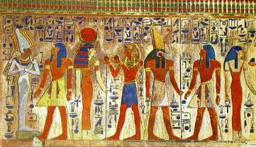




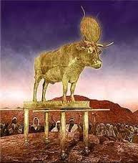

The gods which your fathers served

Slide 25


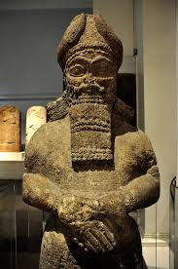
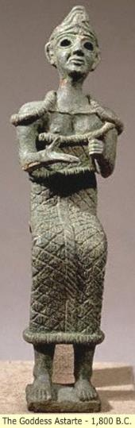
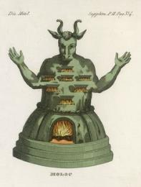



The gods of the Amorites

Slide 26
The LORD

Slide 27
WHAT WE ARE TEMPTED TO LOVE MORE THAN JESUS
Chicken Nuggets, Pizza, Chipotle, Starbucks, Girls, Boys, Drugs, Alcohol, Soccer, Fame, Basketball, Football, Movies, Entertainment, Video Games, KC Chiefs, KC Royals, NBA, NFL, Shoes, Clothes, Success, Sleep, TV, School, Work, Friends, Sex, Ourselves, Relationships, Food, Hobbies, Knowledge, Recognition, Music, Friends, Career, Social Media
The thing you love but isn’t on here and isn’t Jesus

Slide 28
THE RESULT
Pleasure for a short season.
Emptiness.
Depression.
Loneliness.
Broken Relationships.
Without Purpose.
Without Satisfaction.
Without Peace.
Death.

Slide 29
Luke 16:13 “No servant can serve two masters: for either he will hate the one, and love the other; or else he will hold to the one, and despise the other. Ye cannot serve God and mammon.”

Slide 30
Key Point #6
We will prioritize the things that we love.

