Slide 1
Nehemiah
Part two
Chapters 6-13

Slide 2
Review
Nehemiah 1- a burden is backed by prayer
Nehemiah 2- A burden has movement
Nehemiah 3- A mind to work/you are not alone
Nehemiah 4- The enemy wants to discredit and discourage
Nehemiah 5- The enemy wants to distract

Slide 3
Nehemiah chapter six

Slide 4
God’s great work
Nehemiah 6:3 translates to “I am a great work!”
Romans 4:17 (As it is written, I have made thee a father of many nations,) before him whom he believed, [even] God, who quickeneth the dead, and calleth those things which be not as though they were.
Romans 8:29-30 For whom he did foreknow, he also did predestinate [to be] conformed to the image of his Son, that he might be the firstborn among many brethren. 30 Moreover whom he did predestinate, them he also called: and whom he called, them he also justified: and whom he justified, them he also glorified.
Jude 1:20-21 But ye, beloved, building up yourselves on your most holy faith, praying in the Holy Ghost, 21 Keep yourselves in the love of God, looking for the mercy of our Lord Jesus Christ unto eternal life.

Slide 5
When the enemy tries to get you to come down from your place of blessing, remember your identity.

Slide 6
Positional Truth vs Experiential Truth
Jesus asks us to trust our position. (Romans 8:1)
Satan wants us to trust our experience. (Romans 7:14-20)

Slide 7
Nehemiah Chapter seven

Slide 8
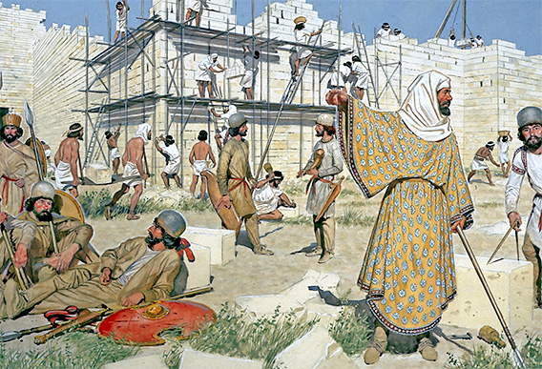
The wall is complete

Slide 9
Nehemiah chapter eight

Slide 10
The word of God is present and the word of God is real
1 Ho, every one that thirsteth, come ye to the waters, and he that hath no money; come ye, buy, and eat; yea, come, buy wine and milk without money and without price. 2 Wherefore do ye spend money for [that which is] not bread? and your labour for [that which] satisfieth not? hearken diligently unto me, and eat ye [that which is] good, and let your soul delight itself in fatness. 3 Incline your ear, and come unto me: hear, and your soul shall live; and I will make an everlasting covenant with you, [even] the sure mercies of David. ... 6 Seek ye the LORD while he may be found, call ye upon him while he is near: 7 Let the wicked forsake his way, and the unrighteous man his thoughts: and let him return unto the LORD, and he will have mercy upon him; and to our God, for he will abundantly pardon. 8 For my thoughts [are] not your thoughts, neither [are] your ways my ways, saith the LORD.

