Slide 1
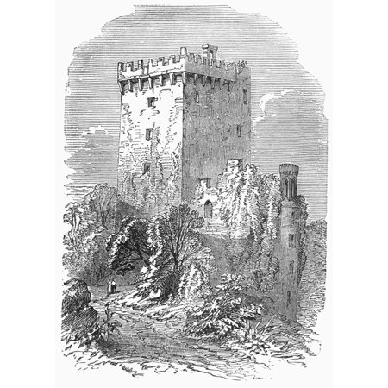
The
Weapons
of our
Warfare
2 Corinthians 10:3-6

Slide 2
Key Point 1
Allowing the enemy to keep strongholds in your life will hinder your growth AND hinder the ministry you are a part of.

Slide 3
Key Point 2
If you are going to tear down strongholds in your life, you’re going to need a Bible and a prayer journal.

Slide 4
Key Point 3
Anything higher than Jesus Christ in our hearts must be cast down.

Slide 5
Key Point 4
Any thought that goes against what God has said must be brought into captivity to the obedience of what He has said.

Slide 6
Key Point 5
We can only deal with the thoughts of our minds after we’ve first dealt with with the imaginations of our hearts.

Slide 7
Key Point 6
You are not a factor in the sufficiency of your weapons, but your belief is a factor in their efficiency.

Slide 8
Key Point 7
Taking strongholds in Jesus’ name brings great glory to God.

