Slide 1
A Sanctified Minister, Pt. 2
1 Thessalonians 2:7-9

Slide 2
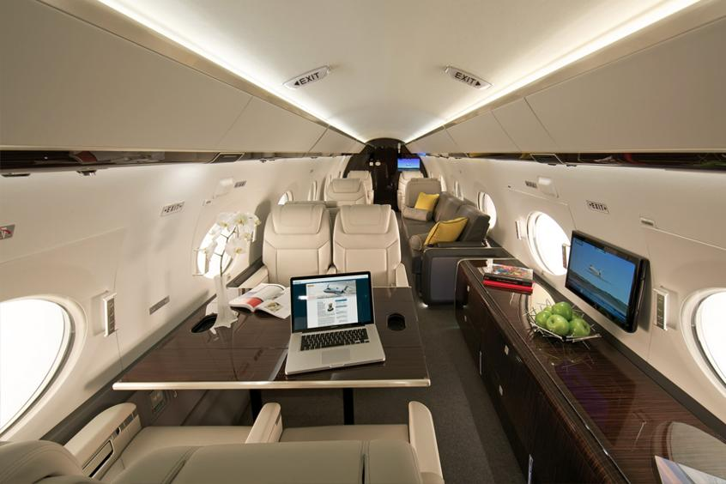
A Sanctified Minister
“A long-range, high-speed, intercontinental jet aircraft is a tool that is necessary in order to fulfill the mission of the ministry,”

Slide 3
A Sanctified Minister
“We respectfully request that those who are not involved respect our right to practice what we believe, and only ask of the press that they report facts, and not fictional reports or biased perspectives. We encourage our community, and our pastors, to dream big, because we know that God loves us just that much,”

Slide 4
A Sanctified Minister
“For all of us involved in preaching the gospel, performing music, publishing Christian materials, and all the rest, there is an uncomfortable message here: Jesus is not terribly impressed with religious commercialism (Mark 11:15-18). I am dismayed by the contracts required by some contemporary musical groups. To perform a concert at your church, the stated fee will be so much (in either four or five figures) plus round trip airfare--often first class, not coach. Every detail of the accommodations is spelled out, down to "sushi for twenty persons" waiting at the hotel, in one case. All this is done so that the group can stand before an inner-city audience and exhort the people to "just trust the Lord for all your needs."

Slide 5
A Sanctified Minister
Rev 2:6 But this thou hast, that thou hatest the deeds of the Nicolaitans, which I also hate.
Rev 2:15 So hast thou also them that hold the doctrine of the Nicolaitans, which thing I hate.
2 Cor. 13:10 Therefore I write these things being absent, lest being present I should use sharpness, according to the power which the Lord hath given me to edification, and not to destruction.

Slide 6
A Sanctified Minister
1. Possesses a Burden for the Gospel.
2. Possesses a Burden for the Glory of God.
3. Possesses a Burden for Giving.
2 Cor. 12:14 Behold, the third time I am ready to come to you; and I will not be burdensome to you: for I seek not yours, but you: for the children ought not to lay up for the parents, but the parents for the children. 12:15 And I will very gladly spend and be spent for you; though the more abundantly I love you, the less I be loved.

Slide 7
A Sanctified Minister
1. Possesses a Burden for the Gospel.
2. Possesses a Burden for the Glory of God.
3. Possesses a Burden for Giving.
1 Tim. 5:17 Let the elders that rule well be counted worthy of double honour, especially they who labour in the word and doctrine.
Php 2:17 Yea, and if I be offered upon the sacrifice and service of your faith, I joy, and rejoice with you all.

Slide 8
A Sanctified Minister
1. Possesses a Burden for the Gospel.
2. Possesses a Burden for the Glory of God.
3. Possesses a Burden for Giving.
Acts 6:2 Then the twelve called the multitude of the disciples unto them, and said, It is not reason that we should leave the word of God, and serve tables. 6:3 Wherefore, brethren, look ye out among you seven men of honest report, full of the Holy Ghost and wisdom, whom we may appoint over this business. 6:4 But we will give ourselves continually to prayer, and to the ministry of the word.

Slide 9
A Sanctified Minister
1. Possesses a Burden for the Gospel.
2. Possesses a Burden for the Glory of God.
3. Possesses a Burden for Giving.
“Nothing causes a congregation to dry up like carelessness in the feeding of the sheep.”
Dr. Weldon Adams

