Slide 1
A Sanctified Minister, Pt. 3
1 Thessalonians 2:10-12

Slide 2
A Sanctified Minister
Mark 10:45 For even the Son of man came not to be ministered unto, but to minister, and to give his life a ransom for many.
Pro. 15:3 The eyes of the LORD are in every place, beholding the evil and the good.

Slide 3
A Sanctified Minister
2 Cor. 4:2 But have renounced the hidden things of dishonesty, not walking in craftiness, nor handling the word of God deceitfully; but by manifestation of the truth commending ourselves to every man's conscience in the sight of God.
2 Cor. 5:11 Knowing therefore the terror of the Lord, we persuade men; but we are made manifest unto God; and I trust also are made manifest in your consciences.
2 Cor. 11:11 Wherefore? because I love you not? God knoweth.
2 Cor. 11:31 The God and Father of our Lord Jesus Christ, which is blessed for evermore, knoweth that I lie not.

Slide 4
A Sanctified Minister
When it comes to my life, God is ALWAYS in the audience.
Psa. 121:4 Behold, he that keepeth Israel shall neither slumber nor sleep.
Holily – piously.

Slide 5
A Sanctified Minister
Mal 1:6 A son honoureth his father, and a servant his master: if then I be a father, where is mine honour? and if I be a master, where is my fear? saith the LORD of hosts unto you, O priests, that despise my name. And ye say, Wherein have we despised thy name? 1:7 Ye offer polluted bread upon mine altar; and ye say, Wherein have we polluted thee? In that ye say, The table of the LORD is contemptible. 1:8 And if ye offer the blind for sacrifice, is it not evil? and if ye offer the lame and sick, is it not evil? offer it now unto thy governor; will he be pleased with thee, or accept thy person? saith the LORD of hosts.

Slide 6
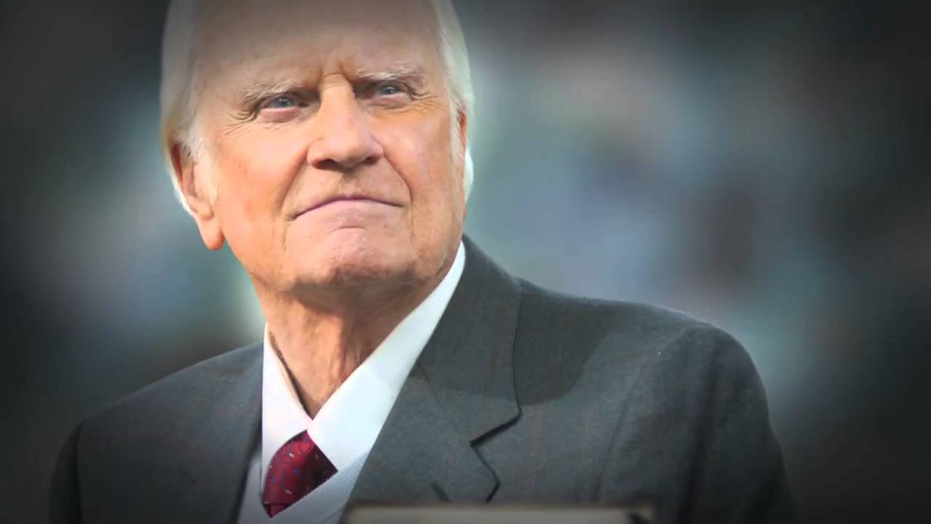
A Sanctified Minister
"He was the evangelist who did not rip off millions or run with prostitutes or build a megachurch or run for president or run a Christian political lobby."

Slide 7
A Sanctified Minister
1. Possesses a Burden for the Gospel.
2. Possesses a Burden for the Glory of God.
3. Possesses a Burden for Giving.
4. Possesses a Burden for Godliness.
1 Cor. 4:15 For though ye have ten thousand instructors in Christ, yet have ye not many fathers: for in Christ Jesus I have begotten you through the gospel.
1 John 2:13 I write unto you, fathers, because ye have known him that is from the beginning. I write unto you, young men, because ye have overcome the wicked one. I write unto you, little children, because ye have known the Father.

Slide 8
A Sanctified Minister
1. Possesses a Burden for the Gospel.
2. Possesses a Burden for the Glory of God.
3. Possesses a Burden for Giving.
4. Possesses a Burden for Godliness.
Heb 13:17 Obey them that have the rule over you, and submit yourselves: for they watch for your souls, as they that must give account, that they may do it with joy, and not with grief: for that is unprofitable for you.

Slide 9
A Sanctified Minister
1. Possesses a Burden for the Gospel.
2. Possesses a Burden for the Glory of God.
3. Possesses a Burden for Giving.
4. Possesses a Burden for Godliness.
Eph 4:1 I therefore, the prisoner of the Lord, beseech you that ye walk worthy of the vocation wherewith ye are called,
Col 1:10 That ye might walk worthy of the Lord unto all pleasing, being fruitful in every good work, and increasing in the knowledge of God;

