Slide 1
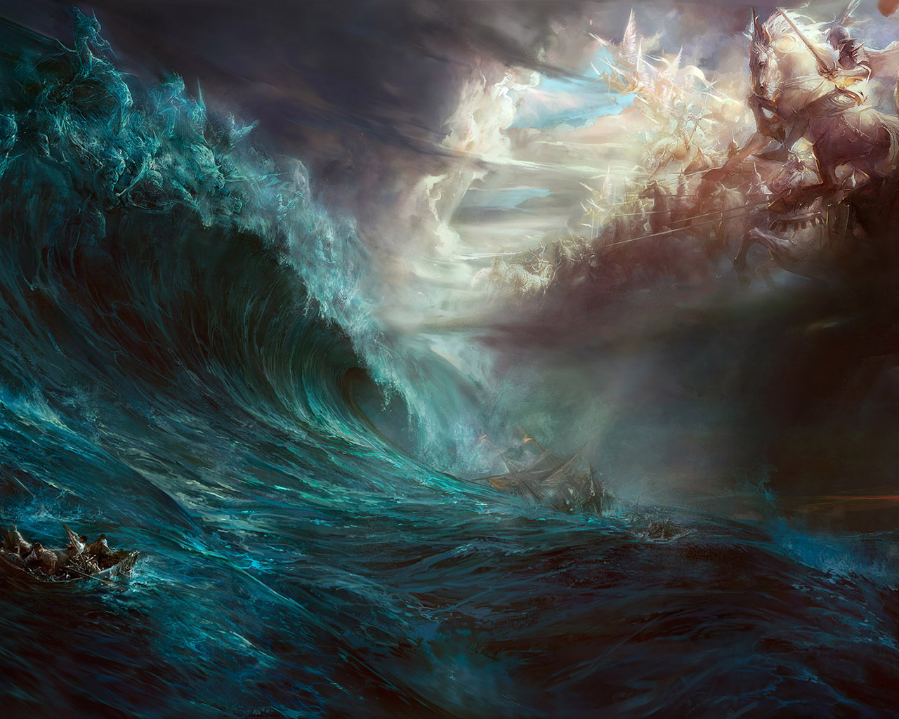
A Shielded Church
1 Thes. 5:1-11
Ch 1: A Sold-out Church
Ch 2: A Sanctified Minister
Ch 3: A Stablished Church
Ch 4: A Set-Apart Church
Ch 5: A Shielded Church

Slide 2
A Shielded Church
1. What is the Day of the Lord?
Isa 13:9 Behold, the day of the LORD cometh, cruel both with wrath and fierce anger, to lay the land desolate: and he shall destroy the sinners thereof out of it. 10 For the stars of heaven and the constellations thereof shall not give their light: the sun shall be darkened in his going forth, and the moon shall not cause her light to shine. 11 And I will punish the world for their evil, and the wicked for their iniquity; and I will cause the arrogancy of the proud to cease, and will lay low the haughtiness of the terrible.

Slide 3
A Shielded Church
1. What is the Day of the Lord?
Amos 5:18 Woe unto you that desire the day of the LORD! to what end is it for you? the day of the LORD is darkness, and not light. 19 As if a man did flee from a lion, and a bear met him; or went into the house, and leaned his hand on the wall, and a serpent bit him. 20 Shall not the day of the LORD be darkness, and not light? even very dark, and no brightness in it?

Slide 4
A Shielded Church
1. What is the Day of the Lord?
Zep 1:15 That day is a day of wrath, a day of trouble and distress, a day of wasteness and desolation, a day of darkness and gloominess, a day of clouds and thick darkness, 16 A day of the trumpet and alarm against the fenced cities, and against the high towers. 17 And I will bring distress upon men, that they shall walk like blind men, because they have sinned against the LORD: and their blood shall be poured out as dust, and their flesh as the dung. 18 Neither their silver nor their gold shall be able to deliver them in the day of the LORD'S wrath; but the whole land shall be devoured by the fire of his jealousy: for he shall make even a speedy riddance of all them that dwell in the land.

Slide 5
A Shielded Church
1. What is the Day of the Lord?
2 Pet. 3:10 But the day of the Lord will come as a thief in the night; in the which the heavens shall pass away with a great noise, and the elements shall melt with fervent heat, the earth also and the works that are therein shall be burned up.

Slide 6
A Shielded Church
1. What is the Day of the Lord?
Rev 6:15 And the kings of the earth, and the great men, and the rich men, and the chief captains, and the mighty men, and every bondman, and every free man, hid themselves in the dens and in the rocks of the mountains; 16 And said to the mountains and rocks, Fall on us, and hide us from the face of him that sitteth on the throne, and from the wrath of the Lamb: 17 For the great day of his wrath is come; and who shall be able to stand?

Slide 7
A Shielded Church
1. What is the Day of the Lord?
The Day of Lord encompasses God’s dealings with and judgment of the nation of Israel and the Gentile nations.

Slide 8
A Shielded Church
1. What is the Day of the Lord?
2. Who does the Day of the Lord Involve?
Acts 1:7 And he said unto them, It is not for you to know the times or the seasons, which the Father hath put in his own power.
John 1:11 He came unto his own, and his own received him not.

Slide 9
A Shielded Church
1. What is the Day of the Lord?
2. Who does the Day of the Lord Involve?
Mat 24:22 And except those days should be shortened, there should no flesh be saved: but for the elect's sake those days shall be shortened.
Hos 1:11 Then shall the children of Judah and the children of Israel be gathered together, and appoint themselves one head, and they shall come up out of the land: for great shall be the day of Jezreel.

Slide 10
A Shielded Church
1. What is the Day of the Lord?
2. Who does the Day of the Lord Involve?
Zec 14:12 And this shall be the plague wherewith the LORD will smite all the people that have fought against Jerusalem; Their flesh shall consume away while they stand upon their feet, and their eyes shall consume away in their holes, and their tongue shall consume away in their mouth.

Slide 11
A Shielded Church
1. What is the Day of the Lord?
2. Who does the Day of the Lord Involve?
3. When does the Day of the Lord Initiate?

Slide 12
Dan 9:24 Seventy weeks are determined upon thy people and upon thy holy city, to finish the transgression, and to make an end of sins, and to make reconciliation for iniquity, and to bring in everlasting righteousness, and to seal up the vision and prophecy, and to anoint the most Holy. 25 Know therefore and understand, that from the going forth of the commandment to restore and to build Jerusalem unto the Messiah the Prince shall be seven weeks, and threescore and two weeks: the street shall be built again, and the wall, even in troublous times. 26 And after threescore and two weeks shall Messiah be cut off, but not for himself: and the people of the prince that shall come shall destroy the city and the sanctuary; and the end thereof shall be with a flood, and unto the end of the war desolations are determined. 27 And he shall confirm the covenant with many for one week: and in the midst of the week he shall cause the sacrifice and the oblation to cease, and for the overspreading of abominations he shall make it desolate, even until the consummation, and that determined shall be poured upon the desolate.

Slide 13
A Shielded Church
1. What is the Day of the Lord?
2. Who does the Day of the Lord Involve?
3. When does the Day of the Lord Initiate?
4. Where does the Day of the Lord Initiate?
Zec 14:16 And it shall come to pass, that every one that is left of all the nations which came against Jerusalem shall even go up from year to year to worship the King, the LORD of hosts, and to keep the feast of tabernacles.

Slide 14
A Shielded Church
1. What is the Day of the Lord?
2. Who does the Day of the Lord Involve?
3. When does the Day of the Lord Initiate?
4. Where does the Day of the Lord Initiate?
5. Why is the Day of the Lord Important?

Slide 15
A Shielded Church
5. Why is the Day of the Lord Important?
Rev 19:15 And out of his mouth goeth a sharp sword, that with it he should smite the nations: and he shall rule them with a rod of iron: and he treadeth the winepress of the fierceness and wrath of Almighty God. 16 And he hath on his vesture and on his thigh a name written, KING OF KINGS, AND LORD OF LORDS.

Slide 16
A Shielded Church
1. What is the Day of the Lord?
2. Who does the Day of the Lord Involve?
3. When does the Day of the Lord Initiate?
4. Where does the Day of the Lord Initiate?
5. Why is the Day of the Lord Important?
6. How long does the Day of the Lord Last?

Slide 17
A Shielded Church
6. How long is the Day of the Lord Last?
Zec 14:17 And it shall be, that whoso will not come up of all the families of the earth unto Jerusalem to worship the King, the LORD of hosts, even upon them shall be no rain. 18 And if the family of Egypt go not up, and come not, that have no rain; there shall be the plague, wherewith the LORD will smite the heathen that come not up to keep the feast of tabernacles. 19 This shall be the punishment of Egypt, and the punishment of all nations that come not up to keep the feast of tabernacles.

Slide 18
A Shielded Church
1. What is the Day of the Lord?
2. Who does the Day of the Lord Involve?
3. When does the Day of the Lord Initiate?
4. Where does the Day of the Lord Initiate?
5. Why is the Day of the Lord Important?
6. How long does the Day of the Lord Last?

