Slide 1
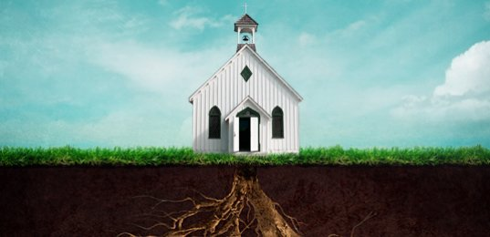
A Stablished Church
1Thes. 3:1-6

Slide 2
John 10:11 I am the good shepherd: the good shepherd giveth his life for the sheep. 12 But he that is an hireling, and not the shepherd, whose own the sheep are not, seeth the wolf coming, and leaveth the sheep, and fleeth: and the wolf catcheth them, and scattereth the sheep. 13The hireling fleeth, because he is an hireling, and careth not for the sheep.
A Stablished Church
1 Thes. 3:1-6

Slide 3
A Stablished Church
1 Thes. 3:1-6
Established Stablish
Establish deals with a person or people being fixed in a position.
Stablish deals with someone or something being fixed.
Gen 6:18 But with thee will I establish my covenant; and thou shalt come into the ark, thou, and thy sons, and thy wife, and thy sons' wives with thee.
2 Sam 7:13 He shall build an house for my name, and I will stablish the throne of his kingdom for ever.

Slide 4
I. God uses Authority to Stablish Believers.
A Stablished Church
1 Thes. 3:1-6
Mar 10:45 For even the Son of man came not to be ministered unto, but to minister, and to give his life a ransom for many.
Mat 7:29 For he taught them as one having authority, and not as the scribes.
1 Cor. 11:1 Be ye followers of me, even as I also am of Christ.

Slide 5
I. God uses Authority to Stablish Believers.
A Stablished Church
1 Thes. 3:1-6
Eph 4:12 For the perfecting of the saints, for the work of the ministry, for the edifying of the body of Christ:
Heb 9:27 And as it is appointed unto men once to die, but after this the judgment:

Slide 6
I. God uses Authority to Stablish Believers.
A Stablished Church
1 Thes. 3:1-6
II. God uses Afflictions to Stablish Believers.
Afflictions - pressure
1 Pet. 1:6 Wherein ye greatly rejoice, though now for a season, if need be, ye are in heaviness through manifold temptations: 1:7 That the trial of your faith, being much more precious than of gold that perisheth, though it be tried with fire, might be found unto praise and honour and glory at the appearing of Jesus Christ:

Slide 7
I. God uses Authority to Stablish Believers.
A Stablished Church
1 Thes. 3:1-6
II. God uses Afflictions to Stablish Believers.
Afflictions - pressure
1 Pet. 5:10 But the God of all grace, who hath called us unto his eternal glory by Christ Jesus, after that ye have suffered a while, make you perfect, stablish, strengthen, settle you.

Slide 8
I. God uses Authority to Stablish Believers.
A Stablished Church
1 Thes. 3:1-6
II. God uses Afflictions to Stablish Believers.
III. God uses Announcements to Stablish Believers.
John 16:33 These things I have spoken unto you, that in me ye might have peace. In the world ye shall have tribulation: but be of good cheer; I have overcome the world.

Slide 9
I. God uses Authority to Stablish Believers.
A Stablished Church
1 Thes. 3:1-6
II. God uses Afflictions to Stablish Believers.
III. God uses Announcements to Stablish Believers.
IV. God uses Affirmation to Stablish Believers.
1 Thes. 1:7 So that ye were ensamples to all that believe in Macedonia and Achaia.

