Slide 1
Between Now and Then, Pt. 2
Phil. 4:6-9

Slide 2
Between Now and Then, Pt. 2
Unmovable in the Lord – 4:1
Unified in the Lord – 4:2
Unselfish in the Lord – 4:3
Unabashed in the Lord – 4:4
Unfastened in the Lord – 4-5
Unconcerned in the Lord – 4:6
God is insulted by our worry and anxiety. Because worry and anxiety communicate to God that He is somehow untrustworthy.

Slide 3
Between Now and Then, Pt. 2
Unmovable in the Lord – 4:1
Unified in the Lord – 4:2
Unselfish in the Lord – 4:3
Unabashed in the Lord – 4:4
Unfastened in the Lord – 4-5
Unconcerned in the Lord – 4:6
Psa 92:15 To shew that the LORD is upright: he is my rock, and there is no unrighteousness in him.

Slide 4

Between Now and Then, Pt. 2

Slide 5
Between Now and Then, Pt. 2
Unmovable in the Lord – 4:1
Unified in the Lord – 4:2
Unselfish in the Lord – 4:3
Unabashed in the Lord – 4:4
Unfastened in the Lord – 4-5
Unconcerned in the Lord – 4:6
Unceasing to the Lord – 4:6
“All our failures are prayer failures.”

Slide 6
Between Now and Then, Pt. 2
Unmovable in the Lord – 4:1
Unified in the Lord – 4:2
Unselfish in the Lord – 4:3
Unabashed in the Lord – 4:4
Unfastened in the Lord – 4-5
Unconcerned in the Lord – 4:6
Unceasing to the Lord – 4:6
Undrunk in the Lord – 4:8
“A mind is a terrible thing to waste.”
–Arthur Fletcher

Slide 7
Between Now and Then, Pt. 2
Unmovable in the Lord – 4:1
Unified in the Lord – 4:2
Unselfish in the Lord – 4:3
Unabashed in the Lord – 4:4
Unfastened in the Lord – 4-5
Unconcerned in the Lord – 4:6
Unceasing to the Lord – 4:6
Undrunk in the Lord – 4:8
Your thought life is a declaration of your maturity.

Slide 8
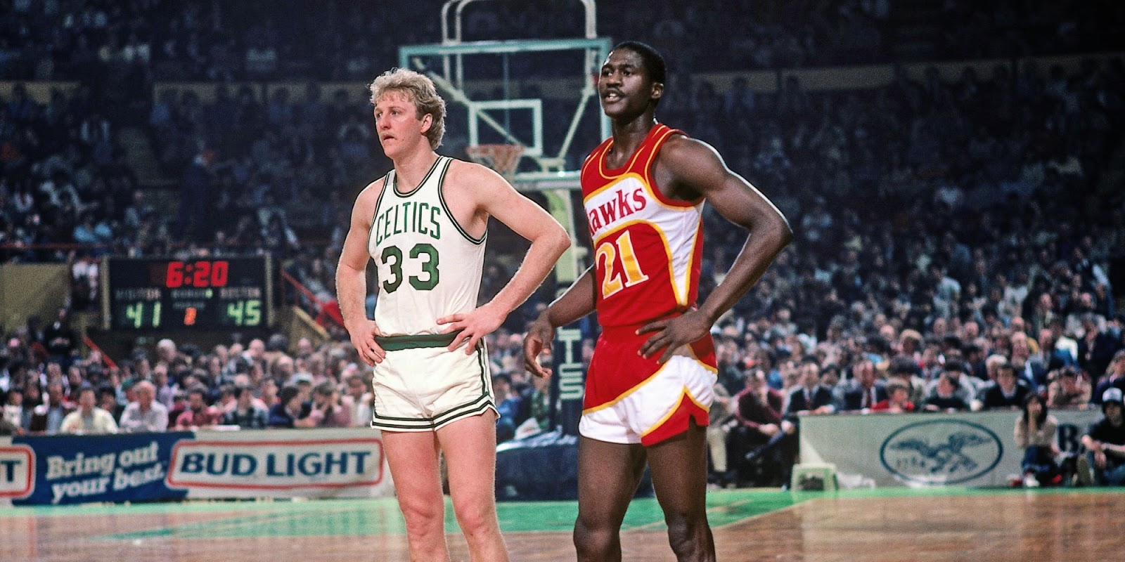
Between Now and Then, Pt. 2

Slide 9
Between Now and Then, Pt. 2
Unmovable in the Lord – 4:1
Unified in the Lord – 4:2
Unselfish in the Lord – 4:3
Unabashed in the Lord – 4:4
Unfastened in the Lord – 4-5
Unconcerned in the Lord – 4:6
Unceasing to the Lord – 4:6
Undrunk in the Lord – 4:8
Unresisting in the Lord – 4-9

