Slide 1

The Four Goals
1. Established in Worship.
2. Established in the Word of God.
3. Established in the Local Church.
4. Established in Ministry.

Slide 2
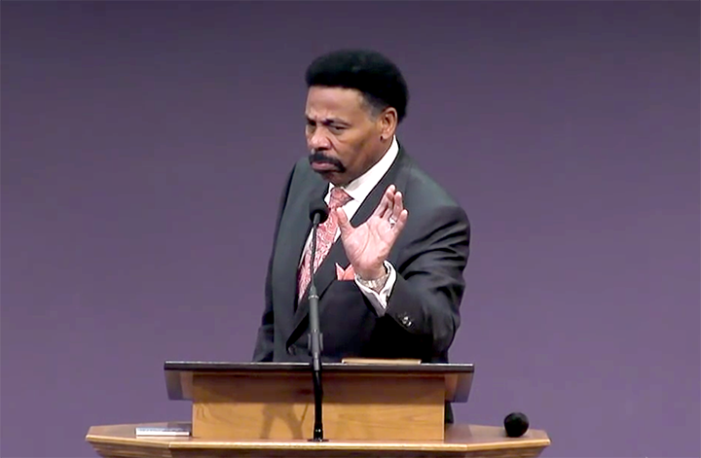
“What we believe about ecclesiology is very important, because in God’s economy, the church is the most important institution on earth…Thus, as the church goes, so goes everything else…When the church is strong, the culture is impacted positively – even if the powers that be in a particular place don’t realize that impact and seek to marginalize and persecute the church. But when the church is weak, its influence deteriorates and so does the culture.” -Dr. Tony Evans

Slide 3
The Four Goals
Peter = Petros (a rock).
Refers to a piece of a rock.
Rock = Petra (a rock).
Refers to a mass of rock.
1 Cor. 10:4 And did all drink the same spiritual drink: for they drank of that spiritual Rock that followed them: and that Rock was Christ.
Eph 2:20 And are built upon the foundation of the apostles and prophets, Jesus Christ himself being the chief corner stone;

Slide 4
The Four Goals
Eph 4:11 And he gave some, apostles; and some, prophets; and some, evangelists; and some, pastors and teachers; 12 For the perfecting of the saints, for the work of the ministry, for the edifying of the body of Christ:
1 Cor. 4:15 For though ye have ten thousand instructors in Christ, yet have ye not many fathers: for in Christ Jesus I have begotten you through the gospel.

Slide 5
The Four Goals
1. Established in Worship.
2. Established in the Word of God.
3. Established in the Local Church.
4. Established in Ministry.
The believer is established in the Local Church when they are embedded in the life of their Local Church.
Attend Faithfully
Tithe Regularly
Fellowship Consistently
Minister Steadily

Slide 6
The Four Goals
1. Established in Worship.
2. Established in the Word of God.
3. Established in the Local Church.
4. Established in Ministry.
John 15:1 I am the true vine, and my Father is the husbandman. .
Gen 2:15 And the LORD God took the man, and put him into the garden of Eden to dress it and to keep it.
Mat 13:55 Is not this the carpenter's son? is not his mother called Mary? and his brethren, James, and Joses, and Simon, and Judas?

Slide 7
The Four Goals
1. Established in Worship.
2. Established in the Word of God.
3. Established in the Local Church.
4. Established in Ministry.
1 Cor. 4:12 And labour, working with our own hands: being reviled, we bless; being persecuted, we suffer it:
1 Cor. 15:10 But by the grace of God I am what I am: and his grace which was bestowed upon me was not in vain; but I laboured more abundantly than they all: yet not I, but the grace of God which was with me.

Slide 8
The Four Goals
1. Established in Worship.
2. Established in the Word of God.
3. Established in the Local Church.
4. Established in Ministry.
Col 1:28 Whom we preach, warning every man, and teaching every man in all wisdom; that we may present every man perfect in Christ Jesus: 29 Whereunto I also labour, striving according to his working, which worketh in me mightily.

Slide 9
The Four Goals
1. Established in Worship.
2. Established in the Word of God.
3. Established in the Local Church.
4. Established in Ministry.
1 Thes. 2:9 For ye remember, brethren, our labour and travail: for labouring night and day, because we would not be chargeable unto any of you, we preached unto you the gospel of God.
2 Tim. 2:6 The husbandman that laboureth must be first partaker of the fruits.

Slide 10
The Four Goals
1. Established in Worship.
2. Established in the Word of God.
3. Established in the Local Church.
4. Established in Ministry.
2 Tim. 2:15 Study to shew thyself approved unto God, a workman that needeth not to be ashamed, rightly dividing the word of truth.
1 Pet. 4:10 As every man hath received the gift, even so minister the same one to another, as good stewards of the manifold grace of God.

Slide 11
The Four Goals
1. Established in Worship.
2. Established in the Word of God.
3. Established in the Local Church.
4. Established in Ministry.
1 Cor. 15:58 Therefore, my beloved brethren, be ye stedfast, unmoveable, always abounding in the work of the Lord, forasmuch as ye know that your labour is not in vain in the Lord.

