Slide 1
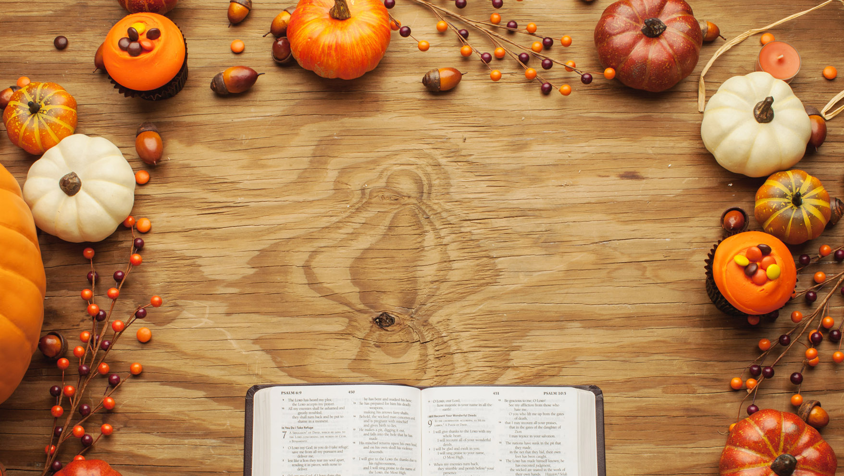
A Holiday for Life
Luke 17:11-19

Slide 2
For the believer, Thanksgiving
is to be a Holiday for Life.

Slide 3
Eph 2:13 But now in Christ Jesus ye who sometimes were far off are made nigh by the blood of Christ.

Slide 4
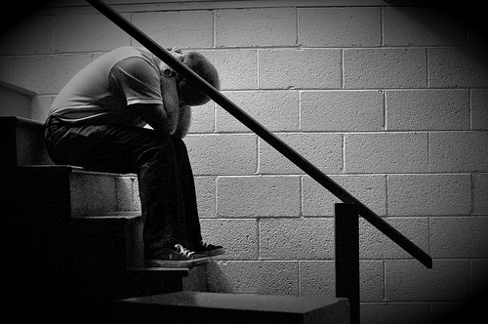
In desperate situations, people do 1 of 2 things:
1. They cry out for God’s mercy.
Gen 4:13 And Cain said unto the LORD, My punishment is greater than I can bear. 14 Behold, thou hast driven me out this day from the face of the earth; and from thy face shall I be hid; and I shall be a fugitive and a vagabond in the earth; and it shall come to pass, that every one that findeth me shall slay me. 15 And the LORD said unto him, Therefore whosoever slayeth Cain, vengeance shall be taken on him sevenfold. And the LORD set a mark upon Cain, lest any finding him should kill him.

Slide 5
In desperate situations, people do 1 of 2 things:
1. They cry out for God’s mercy.
OR
2. They curse God.
2 Chr 16:10 Then Asa was wroth with the seer, and put him in a prison house; for he was in a rage with him because of this thing. And Asa oppressed some of the people the same time. 11 And, behold, the acts of Asa, first and last, lo, they are written in the book of the kings of Judah and Israel. 12 And Asa in the thirty and ninth year of his reign was diseased in his feet, until his disease was exceeding great: yet in his disease he sought not to the LORD, but to the physicians.

Slide 6
Heb 4:16 Let us therefore come boldly unto the throne of grace, that we may obtain mercy, and find grace to help in time of need.

Slide 7
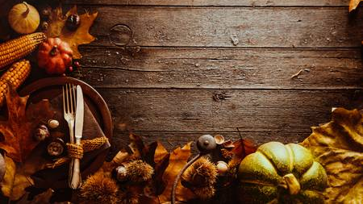
A Holiday for Life
I. Recognize what Jesus has Done for You.
II. Return to Jesus because of what He’s Done for You.

Slide 8

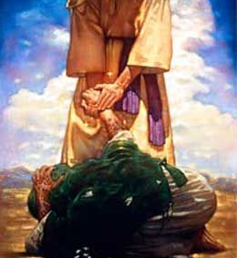
He recognized that Jesus did not have to even acknowledge him.
He recognized that Jesus didn’t
have to heal him.
Mar 1:40 And there came a leper to him, beseeching him, and kneeling down to him, and saying unto him, If thou wilt, thou canst make me clean.
Few things wreck your relationship w/ God like believing God is indebted to you.

Slide 9
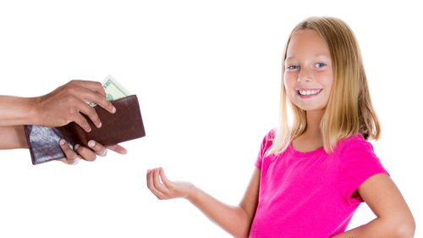
Spoiled children grow into ungrateful adults.

Slide 10
A Holiday for Life
I. Recognize what Jesus has Done for You.
II. Return to Jesus because of what He’s Done for You.
III. Resound praise to Jesus because of what He’s Done for You.

Slide 11
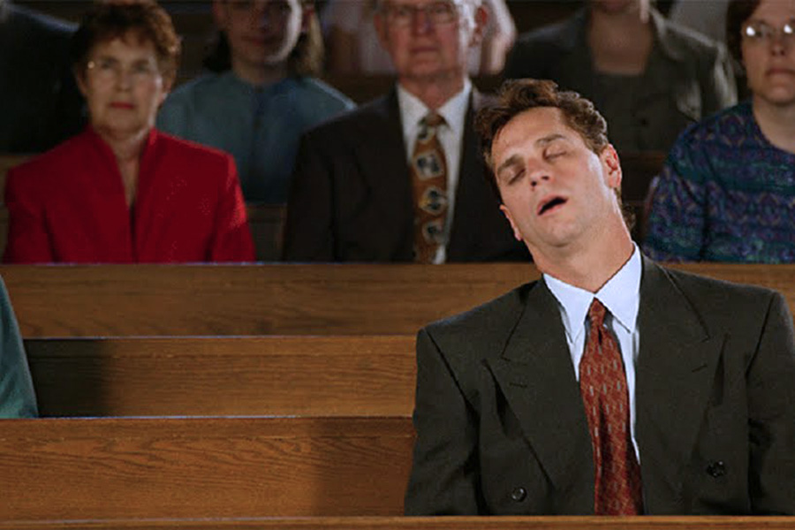
An irrefutable proof that we’ve forgotten what Jesus has done for us is weak or no praise.
Do you complain more
than you praise God?

Slide 12
A Holiday for Life
I. Recognize what Jesus has Done for You.
II. Return to Jesus because of what He’s Done for You.
III. Resound praise to Jesus because of what He’s Done for You.
IV. Reverence Jesus because of what He’s Done for You.

Slide 13
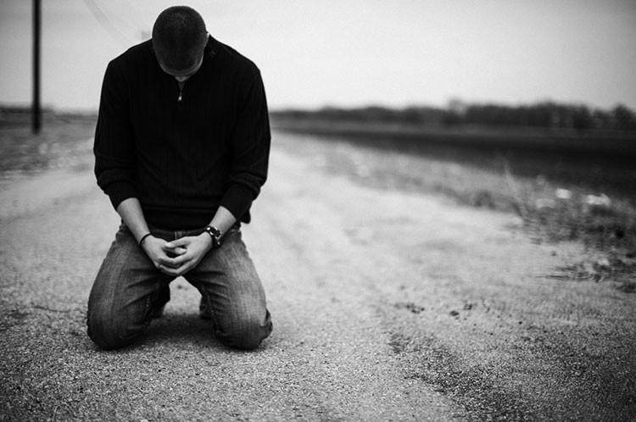
A thankful believer is a humble believer.

