Slide 1

The Practice of the Wise and the Foolish
Mat. 7:24-27

Slide 2


Slide 3
The Practice of the Wise in marriage is one of:
Audition and Reception
Audition – the act, sense, or power of hearing.

Slide 4
In Successful Marriages, Husbands:
Place a very high premium on the private hearing of the Word of God.
Place a very high premium on the corporate hearing of the Word of God.

Slide 5
Luke 11:28 But he said, Yea rather, blessed are they that hear the word of God, and keep it.
Blessed – supremely blest (made happy).

Slide 6
Mat 8:24 And, behold, there arose a great tempest in the sea, insomuch that the ship was covered with the waves: but he was asleep. 8:25 And his disciples came to him, and awoke him, saying, Lord, save us: we perish. 8:26 And he saith unto them, Why are ye fearful, O ye of little faith? Then he arose, and rebuked the winds and the sea; and there was a great calm. 8:27 But the men marvelled, saying, What manner of man is this, that even the winds and the sea obey him!

Slide 7
The Practice of the Wise in marriage is one of:
Audition and Reception
The Practice of the Foolish in marriage is one of:
Audition and Rejection

Slide 8
Pro 9:8 Reprove not a scorner, lest he hate thee: rebuke a wise man, and he will love thee. Pro 9:9 Give instruction to a wise man, and he will be yet wiser: teach a just man, and he will increase in learning.

Slide 9
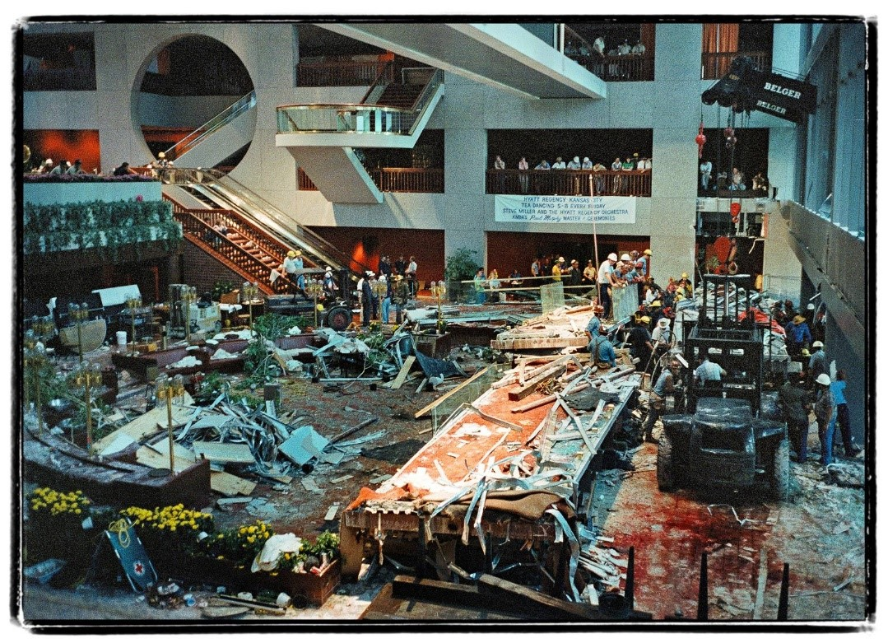

Slide 10
Pro 29:1 He, that being often reproved hardeneth his neck, shall suddenly be destroyed, and that without remedy.

