Slide 1

Love and Respect
Lessons: A Marriage Series

Slide 2
Love and Respect
The institution of marriage brings out the best and the worst in us.
At the start, Rebekah respected Isaac and Isaac loved Rebekah.

Slide 3

I. For a Wife, Submission in Marriage begins with God.
A woman who is not submitted to her husband is not submitted because she is in rebellion to God.
1 Sam. 15:23 For rebellion is as the sin of witchcraft, and stubbornness is as iniquity and idolatry. Because thou hast rejected the word of the LORD, he hath also rejected thee from being king.

Slide 4

Carnal parents are always carnal spouses.

Slide 5


Slide 6
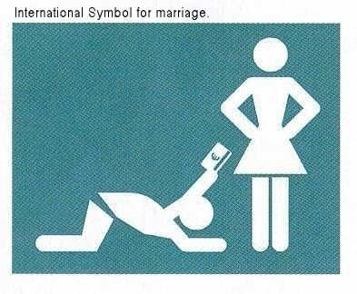
The goal for a wife in marriage is not to have her needs met by her husband.

Slide 7

Psa 37:4 Delight thyself also in the LORD; and he shall give thee the desires of thine heart.

Slide 8
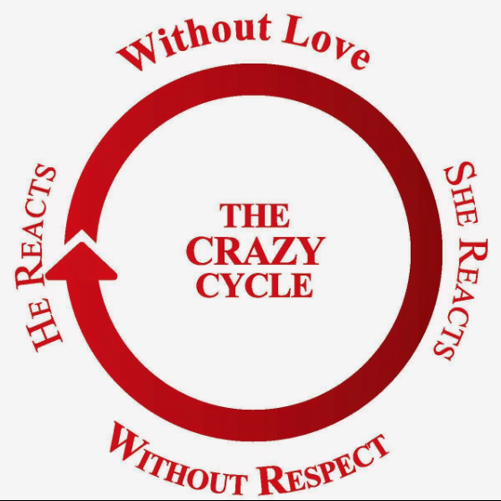
Dr. Emerson Eggrichs, author of “Love and Respect,”

Slide 9

THE most devastating messages that a man could ever send to his wife:
“I am not willing to die for you.”
“I do not love you.”
=

Slide 10
John 3:16 For God so loved the world, that he gave his only begotten Son, that whosoever believeth in him should not perish, but have everlasting life.
Eph 5:25 Husbands, love your wives, even as Christ also loved the church, and gave himself for it;
1 John 4:8 He that loveth not knoweth not God; for God is love.

Slide 11
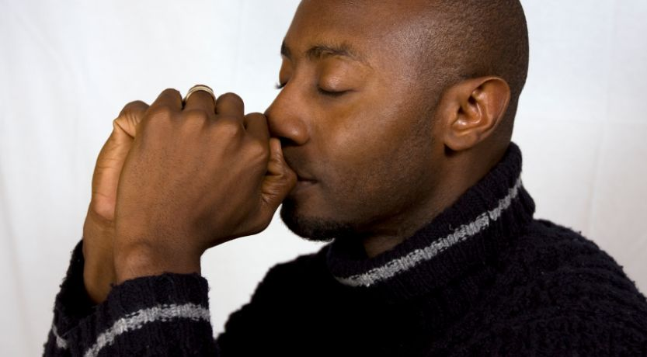
I. For a Wife, Submission in Marriage begins with God.
II. For a Husband, Love in Marriage begins with God.

Slide 12

A man who isn’t willing to lay his life down for his wife, is not willing because he has an idolatrous heart.

Slide 13

Rebekah = ensnarer.
1 Tim. 3:7 Moreover he must have a good report of them which are without; lest he fall into reproach and the snare of the devil.
2 Tim. 2:26 And that they may recover themselves out of the snare of the devil, who are taken captive by him at his will.

Slide 14

I. For a Wife, Submission in Marriage begins with God.
II. For a Husband, Love in Marriage begins with God.
III. A Rebellious Wife is Satan’s Agent against her husband.
Gen 2:22 And the rib, which the LORD God had taken from man, made he a woman, and brought her unto the man.

Slide 15


Are you a Helper or an Agent?

Slide 16

I. For a Wife, Submission in Marriage begins with God.
II. For a Husband, Love in Marriage begins with God.
III. A Rebellious Wife is Satan’s Agent against her Husband.
IV. An Irreverent Husband is Satan’s Agent Against His Wife.
Eph 5:33 Nevertheless let every one of you in particular so love his wife even as himself; and the wife see that she reverence her husband.

Slide 17
I. For a Wife, Submission in marriage begins with God.
II. For a Husband, Love in Marriage begins with God.
III. A Rebellious Wife is Satan’s Agent against her husband.
IV. An Irreverent Husband is Satan’s Agent Against His Wife.
A respectable man NEVER has to demand respect.

Slide 18

Let’s Talk (not argue)
As a wife, what do I need to confess to my husband and ask his forgiveness for?
As a husband, what do I need to confess to my wife and ask her forgiveness for?
What is God calling us to do to keep our marriage on the energizing cycle?

Slide 19
