Slide 1

Obedience in Marriage
Genesis 1 & 2

Slide 2
I. God Commanded them to be Fruitful.
The scope of this command was spiritual and physical.
Satan takes a high interest in spiritual reproduction.
God is as interested in us having spiritual children as we are interested in having physical children.

Slide 3
I. God Commanded them to be Fruitful.
John 15:2 Every branch in me that beareth not fruit he taketh away: and every branch that beareth fruit, he purgeth it, that it may bring forth more fruit.
John 15:8 Herein is my Father glorified, that ye bear much fruit; so shall ye be my disciples.
What glorifies God is fruit, more fruit, and much fruit.

Slide 4
I. God Commanded them to be Fruitful.
Ananias and Sapphira were about robbing from the Kingdom of God. Whereas Aquila and Priscilla were about investing into the kingdom of God.

Slide 5
I. God Commanded them to be Fruitful.
II. God Commanded them to be Victorious.
As believers in Jesus Christ, we ARE WINNERS,
not losers.
Rom 8:37 Nay, in all these things we are more than conquerors through him that loved us.
1 Cor. 15:57 But thanks be to God, which giveth us the victory through our Lord Jesus Christ.

Slide 6
I. God Commanded them to be Fruitful.
II. God Commanded them to be Victorious.
Eph 1:3 Blessed be the God and Father of our Lord Jesus Christ, who hath blessed us with all spiritual blessings in heavenly places in Christ:
Php 4:13 I can do all things through Christ which
strengtheneth me.
Col 2:10 And ye are complete in him, which is the head of all principality and power:

Slide 7
I. God Commanded them to be Fruitful.
II. God Commanded them to be Victorious.
Marriage is a team sport.
Eph 6:12 For we wrestle not against flesh and blood, but against principalities, against powers, against the rulers of the darkness of this world, against spiritual wickedness in high places.

Slide 8
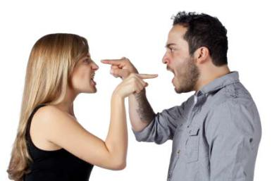
I. God Commanded them to be Fruitful.
II. God Commanded them to be Victorious.
Do you have an adversarial view of your spouse?

Slide 9
1Jn 5:11 And this is the record, that God hath given to us eternal life, and this life is in his Son. 12 He that hath the Son hath life; and he that hath not the Son of God hath not life.

Slide 10
I. God Commanded them to be Fruitful.
II. God Commanded them to be Victorious.
III. God Commanded them to Live.
John 6:51 I am the living bread which came down from heaven: if any man eat of this bread, he shall live for ever: and the bread that I will give is my flesh, which I will give for the life of the world.

Slide 11
III. God Commanded them to Live.
Psa 1:1 Blessed is the man that walketh not in the counsel of the ungodly, nor standeth in the way of sinners, nor sitteth in the seat of the scornful. 2 But his delight is in the law of the LORD; and in his law doth he meditate day and night. 3 And he shall be like a tree planted by the rivers of water, that bringeth forth his fruit in his season; his leaf also shall not wither; and whatsoever he doeth shall prosper.

Slide 12

From God’s vantage point, marriage is not an institution for strangers.

Slide 13
I. God Commanded them to be Fruitful.
II. God Commanded them to be Victorious.
III. God Commanded them to Live.
IV. God Commanded them to be Together.

Slide 14
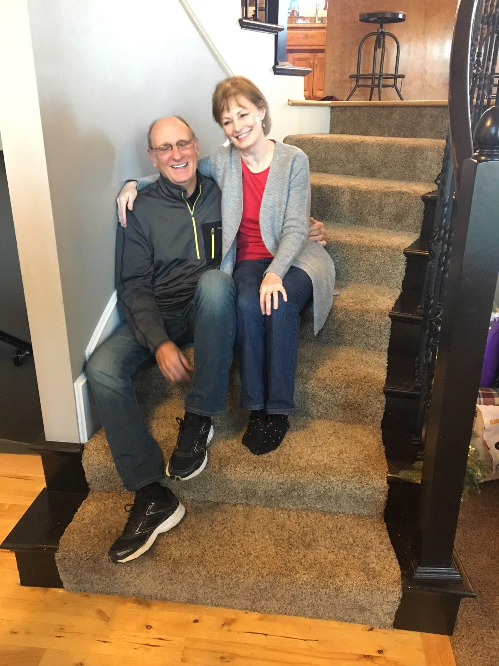
IV. God Commanded them to be Together.
46 Years!

Slide 15
Who are the unsaved people we need to pray for weekly?
Where are we losing in our marriage and what steps of obedience do we need to take to correct this?
What is our personal devotional plan and how can we encourage each other in the Word regularly?
Where are we in our togetherness and how can we grow in this area?

