Slide 1
Responding to the Lordship of Jesus Christ
Phil. 2:12-16

Slide 2

How do we respond?
Response One: Pursue Christlikeness
Col 1:27 To whom God would make known what is the riches of the glory of this mystery among the Gentiles; which is Christ in you, the hope of glory:
Gen 1:26 And God said, Let us make man in our image, after our likeness: and let them have dominion over the fish of the sea, and over the fowl of the air, and over the cattle, and over all the earth, and over every creeping thing that creepeth upon the earth.
Rom 8:29 For whom he did foreknow, he also did predestinate to be conformed to the image of his Son, that he might be the firstborn among many brethren.
The ultimate goal of discipleship is CHRISTLIKENESS!

Slide 3
How do we respond?
Response One: Pursue Christlikeness
Col 3:10 And have put on the new man, which is renewed in knowledge after the image of him that created him: 3:11 Where there is neither Greek nor Jew, circumcision nor uncircumcision, Barbarian, Scythian, bond nor free: but Christ is all, and in all.
Gal 3:28 There is neither Jew nor Greek, there is neither bond nor free, there is neither male nor female: for ye are all one in Christ

Slide 4
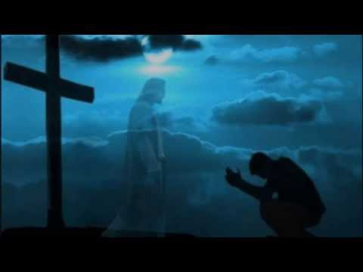
How do we respond?
Response One: Pursue Christlikeness
Response Two: Practice Complying
The problem however, for many, is that the work that God is doing in them is not being worked out by them.

Slide 5

How do we respond?
Response One: Pursue Christlikeness
Response Two: Practice Complying
Response Three: Provide Compliments
murmur - to grumble
disputings - debates
1 Cor. 10:10 Neither murmur ye, as some of them also murmured, and were destroyed of the destroyer.

Slide 6
How do we respond?
Response Three: Provide Compliments
Psa 52:2 Thy tongue deviseth mischiefs; like a sharp razor, working deceitfully.
Eph 4:29 Let no corrupt communication proceed out of your mouth, but that which is good to the use of edifying, that it may minister grace unto the hearers.
A BELIEVER WHO NEVER HAS A GOOD WORD TO SAY TO OR ABOUT ANYONE IS A BELIEVER THAT IS SPIRITUALLY SICK.

Slide 7
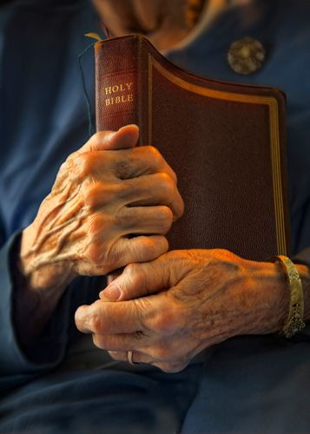
How do we respond?
Response One: Pursue Christlikeness
Response Two: Practice Complying
Response Three: Provide Compliments
Response Four: Possess the Word of Christ
Psa 119:93 I will never forget thy precepts: for with them thou hast quickened me.

