Slide 1
1 Thessalonians
Chapter 1: A Sold-out Church, Pt. 4

Slide 2
7 words associated w/ A Sold-out Church
Separation
Devotion
3. Anticipation
4. Authentication
5. Reception

Slide 3
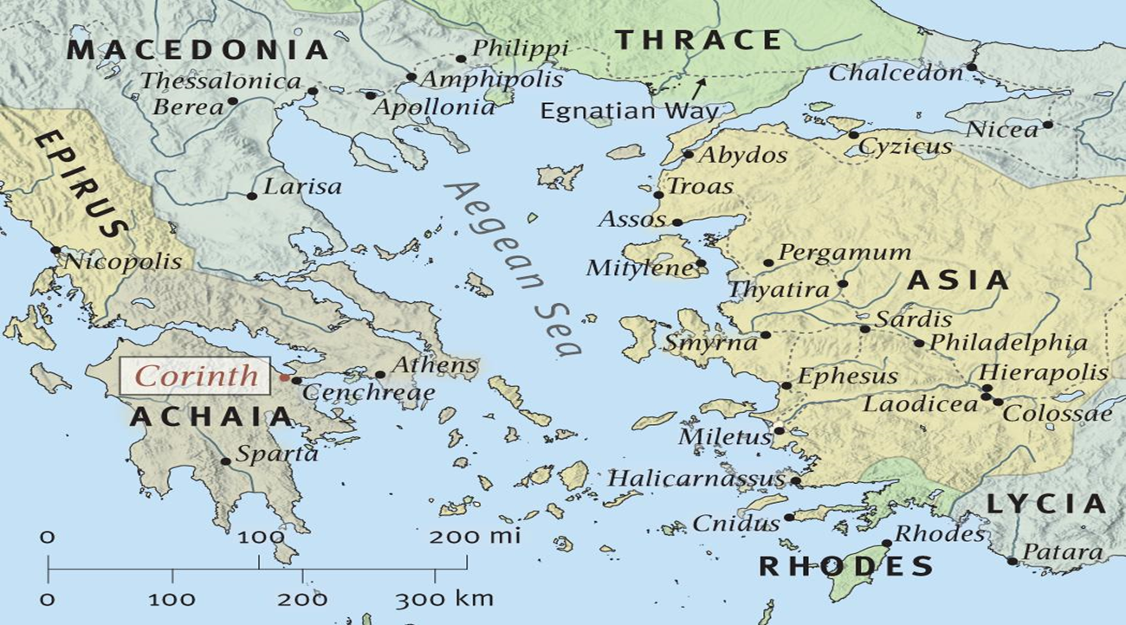
A Sold-out Church
Ensample – a living testimony.

Slide 4
7 words associated w/ A Sold-out Church
Separation
Devotion
3. Anticipation
4. Authentication
5. Reception
6. Maturation
“It takes a whole Bible to make a whole Christian.’

Slide 5
A Sold-out Church
Rev 1:3 Blessed is he that readeth, and they that hear the words of this prophecy, and keep those things which are written therein: for the time is at hand.
Eph 4:11 And he gave some, apostles; and some, prophets; and some, evangelists; and some, pastors and teachers; 4:12 For the perfecting of the saints, for the work of the ministry, for the edifying of the body of Christ: 4:13 Till we all come in the unity of the faith, and of the knowledge of the Son of God, unto a perfect man, unto the measure of the stature of the fulness of Christ:
perfecting – complete furnishing.

Slide 6
A Sold-out Church
2Ti 3:16 All scripture is given by inspiration of God, and is profitable for doctrine, for reproof, for correction, for instruction in righteousness: 3:17 That the man of God may be perfect, throughly furnished unto all good works.
throughly furnished – to finish out, to equip fully.
stature – maturity.
Heb 5:12 For when for the time ye ought to be teachers, ye have need that one teach you again which be the first principles of the oracles of God; and are become such as have need of milk, and not of strong meat. 5:13 For every one that useth milk is unskilful in the word of righteousness: for he is a babe. 5:14 But strong meat belongeth to them that are of full age, even those who by reason of use have their senses exercised to discern both good and evil.

Slide 7
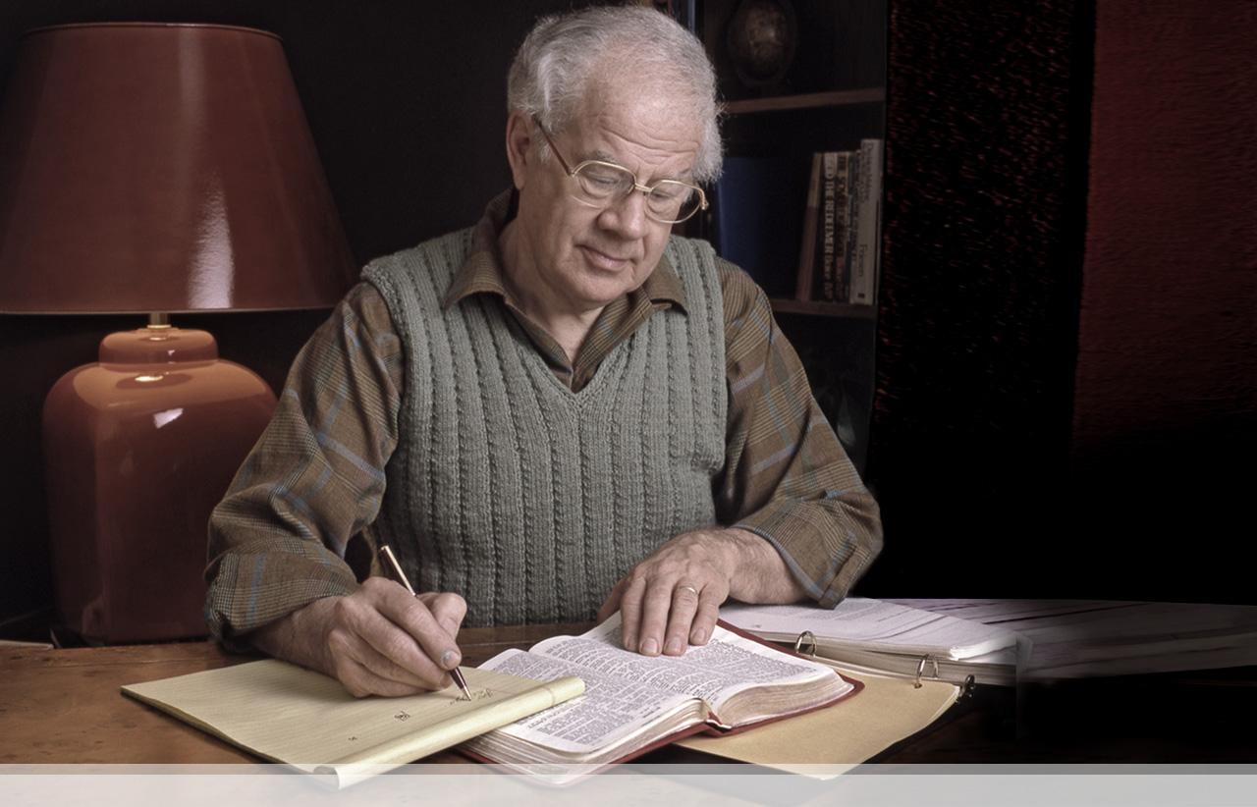
A Sold-out Church
“There is a vast difference between being saved and being a disciple. Not all men who are saved are disciples although all who are disciples as saved. In discussing the question of discipleship, we are not dealing with a man’s salvation. We are dealing with a man’s relationship to Jesus Christ as his Teacher, his Master, and his Lord.”
-J. Dwight Pentecost

Slide 8
A Sold-out Church
Act 1:8 But ye shall receive power, after that the Holy Ghost is come upon you: and ye shall be witnesses unto me both in Jerusalem, and in all Judaea, and in Samaria, and unto the uttermost part of the earth.

Slide 9
7 words associated w/ A Sold-out Church
Separation
Devotion
3. Anticipation
4. Authentication
5. Reception
6. Maturation
7. Proclamation

