Slide 1
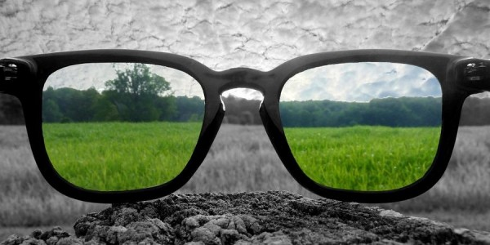
Perspective, Pt. 2
2 Thes. 1:5-12

Slide 2
Suffering, as it relates to God’s people
Perspective, Pt. 2
Gen 9:12 And God said, This is the token of the covenant which I make between me and you and every living creature that is with you, for perpetual generations: 13 I do set my bow in the cloud, and it shall be for a token of a covenant between me and the earth.
2 Thes. 1:5-12
1 Pet. 2:21 For even hereunto were ye called: because Christ also suffered for us, leaving us an example, that ye should follow his steps:

Slide 3
Suffering, as it relates to God’s people
Perspective, Pt. 2
God would be unfaithful and unrighteous if He shielded us from suffering. Because without it, we could not become like Christ.
2 Thes. 1:5-12
Acts 5:40 And to him they agreed: and when they had called the apostles, and beaten them, they commanded that they should not speak in the name of Jesus, and let them go. 41 And they departed from the presence of the council, rejoicing that they were counted worthy to suffer shame for his name. 42 And daily in the temple, and in every house, they ceased not to teach and preach Jesus Christ.

Slide 4
Suffering, as it relates to God’s people
Perspective, Pt. 2
Acts 14:19 And there came thither certain Jews from Antioch and Iconium, who persuaded the people, and, having stoned Paul, drew him out of the city, supposing he had been dead. 20 Howbeit, as the disciples stood round about him, he rose up, and came into the city: and the next day he departed with Barnabas to Derbe. 21 And when they had preached the gospel to that city, and had taught many, they returned again to Lystra, and to Iconium, and Antioch, 22 Confirming the souls of the disciples, and exhorting them to continue in the faith, and that we must through much tribulation enter into the kingdom of God.
2 Thes. 1:5-12

Slide 5

Suffering, as it relates to God’s people
Perspective, Pt. 2
1 Thes. 1:6 And ye became followers of us, and of the Lord, having received the word in much affliction, with joy of the Holy Ghost:
2 Thes. 1:5-12

Slide 6
Suffering, as it relates to those persecuting God’s people
Perspective, Pt. 2
Isa 66:15 For, behold, the LORD will come with fire, and with his chariots like a whirlwind, to render his anger with fury, and his rebuke with flames of fire.
2 Thes. 1:5-12
2 Pet. 3:7 But the heavens and the earth, which are now, by the same word are kept in store, reserved unto fire against the day of judgment and perdition of ungodly men.

