Slide 1

Portrait of a
Kingdom Believer,
Pt. 3 – Mk. 9:30-41

Slide 2

Portrait of a Kingdom Believer, Pt. 3
A Kingdom Believer:
Has a Transformed Life.
Has a Tamed Tongue.
Has an Understanding of the Times.
Ministers in Total Trust.
The Lord takes notice of our disputes.

Slide 3
Portrait of a Kingdom Believer, Pt. 3
Php 4:2 I beseech Euodias, and beseech Syntyche, that they be of the same mind in the Lord.
Php 2:14 Do all things without murmurings and disputings:
Disputing is unbiblical among brethren.
Mat 18:1 At the same time came the disciples unto Jesus, saying, Who is the greatest in the kingdom of heaven?

Slide 4
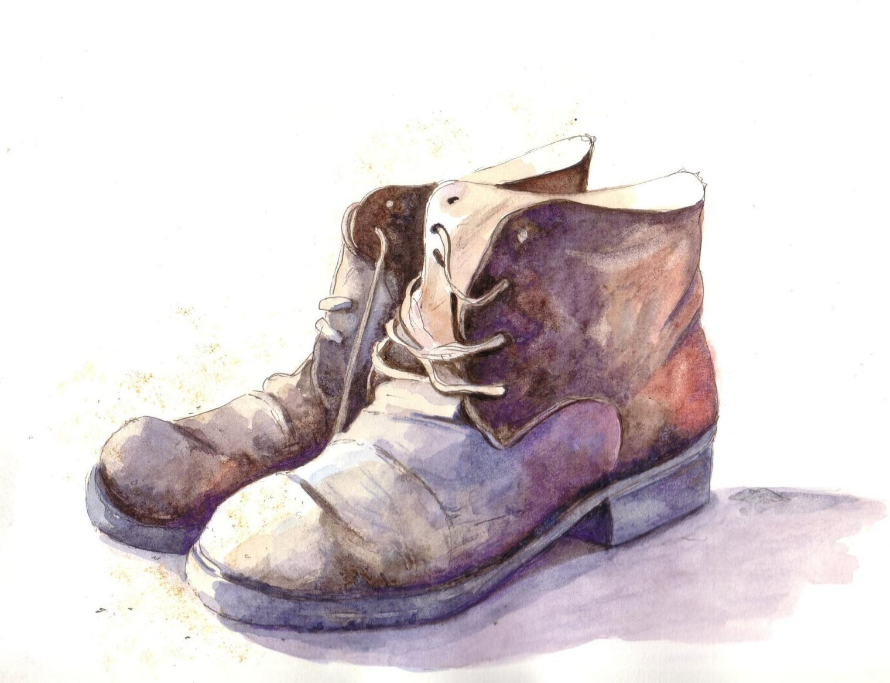
Portrait of a Kingdom Believer, Pt. 3
A Kingdom Believer:
Has a Transformed Life.
Has a Tamed Tongue.
Has an Understanding of the Times.
Ministers in Total Trust.
Walks in True Humility.

Slide 5
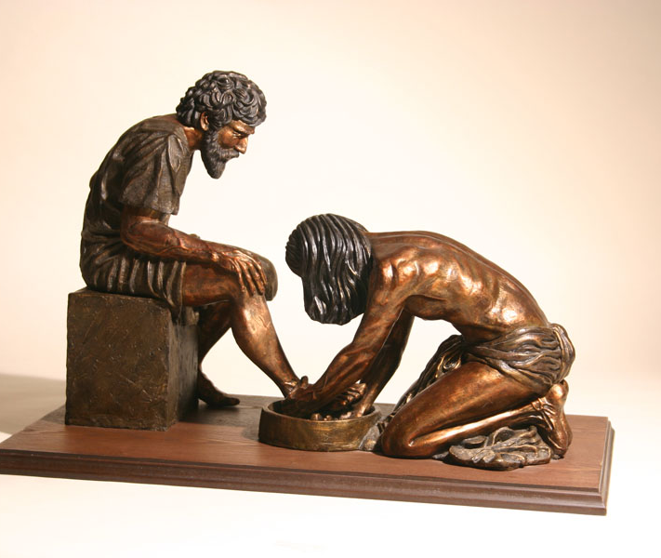
Portrait of a Kingdom Believer, Pt. 3
True greatness is found in preferring and serving others.
Rom 12:10 Be kindly affectioned one to another with brotherly love; in honour preferring one another;
Eph 5:21 Submitting yourselves one to another in the fear of God.

Slide 6

A staple in the wardrobe of a kingdom believer is an apron.

Slide 7

Portrait of a Kingdom Believer, Pt. 3
Mat 18:3 And said, Verily I say unto you, Except ye be converted, and become as little children, ye shall not enter into the kingdom of heaven. 4 Whosoever therefore shall humble himself as this little child, the same is greatest in the kingdom of heaven. 5 And whoso shall receive one such little child in my name receiveth me.
True greatness is found in lowering ourselves.

Slide 8
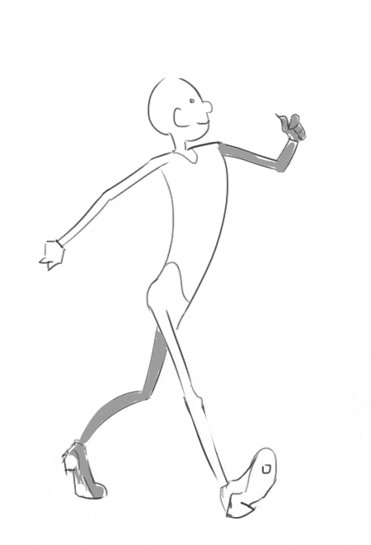
Portrait of a Kingdom Believer, Pt. 3
Php 2:3 Let nothing be done through strife or vainglory; but in lowliness of mind let each esteem other better than themselves.
How we walk is the result of how we think.

Slide 9

Portrait of a Kingdom Believer, Pt. 3
A Kingdom Believer:
Has a Transformed Life.
Has a Tamed Tongue.
Has an Understanding of the Times.
Ministers in Total Trust.
Walks in True Humility.
Has a Zeal for Unity in the Body of Christ.

Slide 10

Portrait of a Kingdom Believer, Pt. 3
We are not called to police the doctrine of the Christian world.

Slide 11

Portrait of a Kingdom Believer, Pt. 3
Pro 13:10 Only by pride cometh contention: but with the well advised is wisdom.

