Slide 1
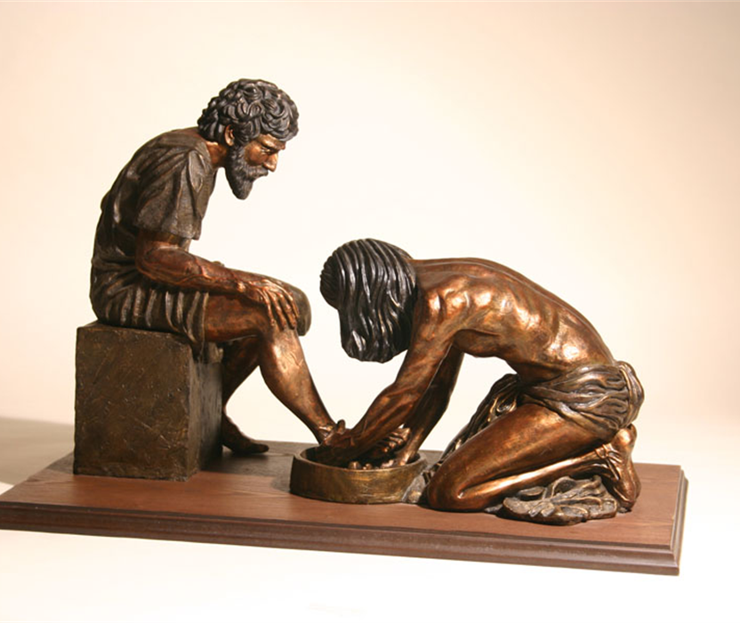
Portrait of a Kingdom Believer, Pt. 4
Mark 9:42-50

Slide 2
Portrait of a Kingdom Believer, Pt. 4
Jesus cares deeply about how believers treat one another.
A hard heart is the most serious heart condition that there is.
1 Cor. 7:5 Defraud ye not one the other, except it be with consent for a time, that ye may give yourselves to fasting and prayer; and come together again, that Satan tempt you not for your incontinency.

Slide 3
Portrait of a Kingdom Believer, Pt. 4
Eph 4:31 Let all bitterness, and wrath, and anger, and clamour, and evil speaking, be put away from you, with all malice: 32 And be ye kind one to another, tenderhearted, forgiving one another, even as God for Christ's sake hath forgiven you.
1Th 4:6 That no man go beyond and defraud his brother in any matter: because that the Lord is the avenger of all such, as we also have forewarned you and testified.
One of the greatest treasures in the Christian life is a tender heart.

Slide 4
Portrait of a Kingdom Believer, Pt. 4
We must learn how to disagree without despising.
“There’s only one person who sees everything the way you do, and that’s you.”
-Dr. Jeff Adams
Isa 66:24 And they shall go forth, and look upon the carcases of the men that have transgressed against me: for their worm shall not die, neither shall their fire be quenched; and they shall be an abhorring unto all flesh.

Slide 5
Portrait of a Kingdom Believer, Pt. 4
Isa 30:33 For Tophet is ordained of old; yea, for the king it is prepared; he hath made it deep and large: the pile thereof is fire and much wood; the breath of the LORD, like a stream of brimstone, doth kindle it.
If Jesus wanted us to take the command to cut off literally, every believer in the church age would be without hands, feet, and eyes.

Slide 6
Portrait of a Kingdom Believer, Pt. 4
VII. Radically Deals with Temptation.
Mar 10:45 For even the Son of man came not to be ministered unto, but to minister, and to give his life a ransom for many.
Psa 22:16 For dogs have compassed me: the assembly of the wicked have inclosed me: they pierced my hands and my feet.

