Slide 1
Portrait of a godly father
2 Samuel 7:10-16

Slide 2
Portrait of a godly father
I. A Godly Father has a Personal Relationship w/ His Children.
Mat 3:17 And lo a voice from heaven, saying, This is my beloved Son, in whom I am well pleased.
John 3:35 The Father loveth the Son, and hath given all things into his hand.
1 John 4:8 He that loveth not knoweth not God; for God is love.
T
I
M
E

Slide 3
Portrait of a godly father
I. A Godly Father has a Personal Relationship w/ His Children.
TALKING
John 10:4 And when he putteth forth his own sheep, he goeth before them, and the sheep follow him: for they know his voice. 10:5 And a stranger will they not follow, but will flee from him: for they know not the voice of strangers.
INTERESTED
Psa 121:4 Behold, he that keepeth Israel shall neither slumber nor sleep.

Slide 4
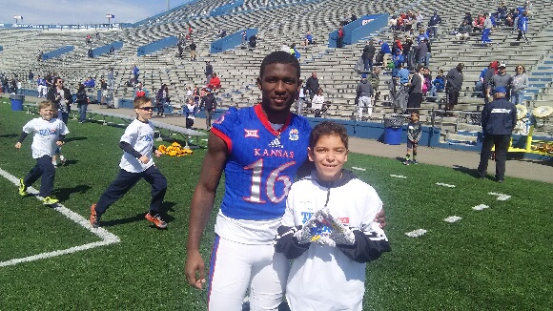

Portrait of a godly father
I. A Godly Father has a Personal Relationship w/ His Children.
TALKING
INTERESTED

Slide 5
Portrait of a godly father
I. A Godly Father has a Personal Relationship w/ His Children.
TALKING
INTERESTED
monetary
Php 4:19 But my God shall supply all your need according to his riches in glory by Christ Jesus.
Mat 6:30 Wherefore, if God so clothe the grass of the field, which to day is, and to morrow is cast into the oven, shall he not much more clothe you, O ye of little faith? 6:31 Therefore take no thought, saying, What shall we eat? or, What shall we drink? or, Wherewithal shall we be clothed? 6:32 For after all these things do the Gentiles seek:) for your heavenly Father knoweth that ye have need of all these things.

Slide 6
Portrait of a godly father
I. A Godly Father has a Personal Relationship w/ His Children.
TALKING
INTERESTED
monetary
EDIFY
Pro 4:20 My son, attend to my words; incline thine ear unto my sayings. 4:21 Let them not depart from thine eyes; keep them in the midst of thine heart. 4:22 For they are life unto those that find them, and health to all their flesh.

