Slide 1
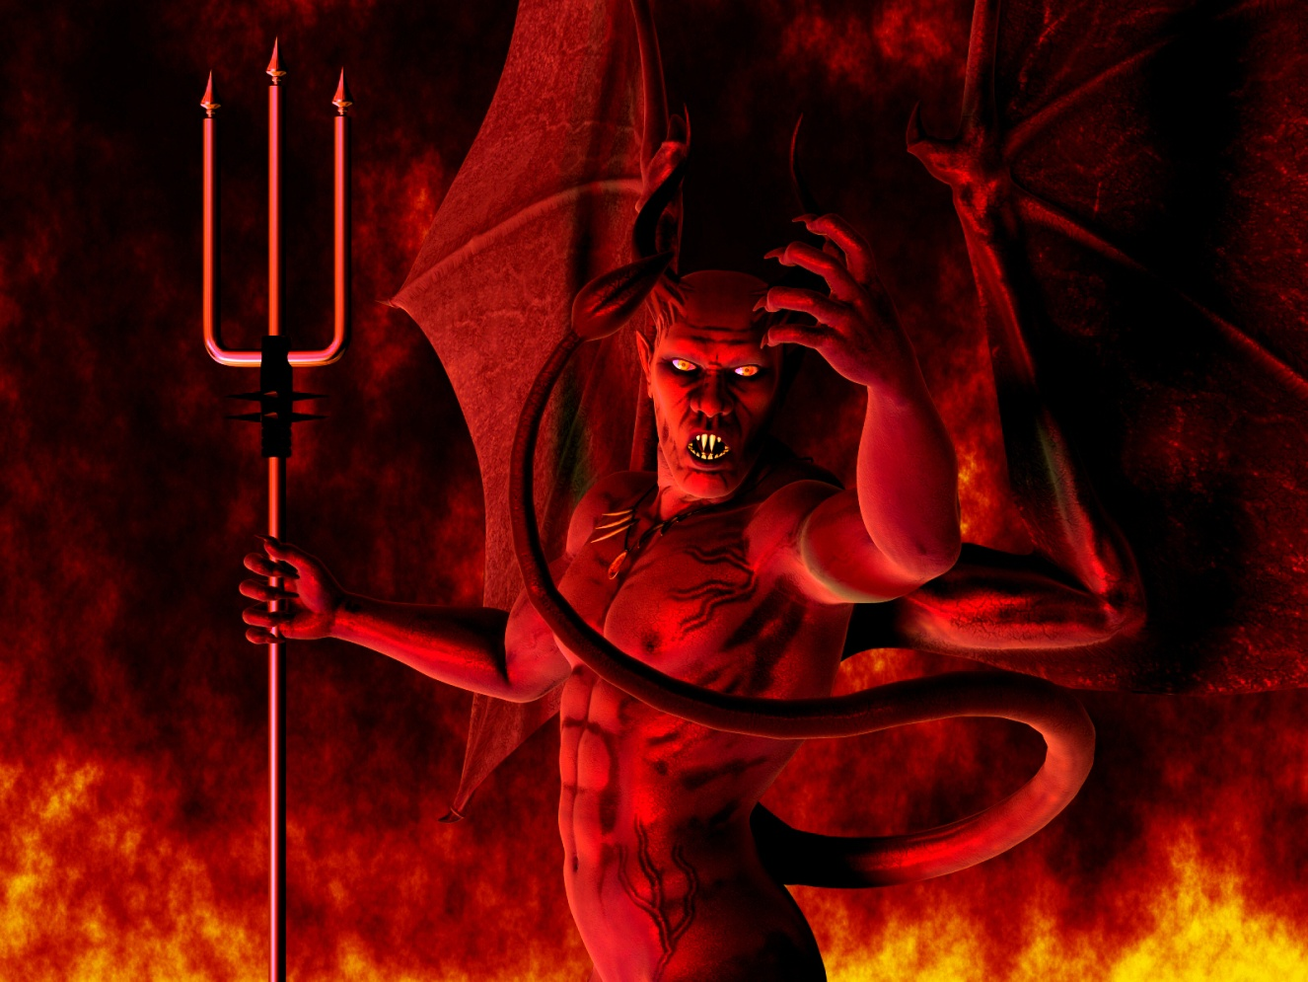
Proverbs for Life
Lesson #2
Satan’s Destructive Trio;
Greed, Pride and Sexual Immorality

Slide 2
GREED:
The first way that many Christians completely ruin their lives is through Greed:
Pro 1:10-19

Slide 3
See that Evil of Greed will :
10 Entice us out of God’s will
11-12, innocent are often harmed…often not a win - win
14 You put in the money, we’ll put in our talents – you get taken!
15 God says get away
16 Why - Their way is evil
17 -18 They are looking for greedy victims
Accept God’s provision – greed ruins a spirit filled life

Slide 4
Debt is one of the biggest indicators of Greed – and debt ruins many Christians Lives!
Proverbs Finances Principle #1: The wise save while the foolish spend:
  Pr 21:20 There is treasure to be desired and oil in the dwelling of the wise; but a foolish man spendeth it up.
Proverbs Finances Principle #2: Debt equals slavery:
  Pr 22:7 The rich ruleth over the poor, and the borrower is servant to the lender.

Slide 5
A. Consider the facts about debt in our society today:
    58% Males
    66% Females
    87% Single Moms
    List debt as the #1 stress factor in their lives!

Slide 6
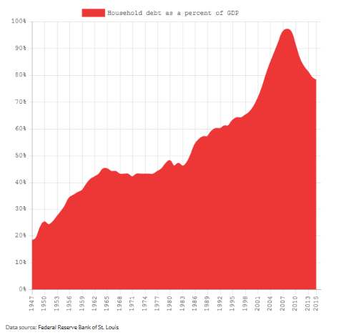
Here is how debt has grown in America:

Slide 7
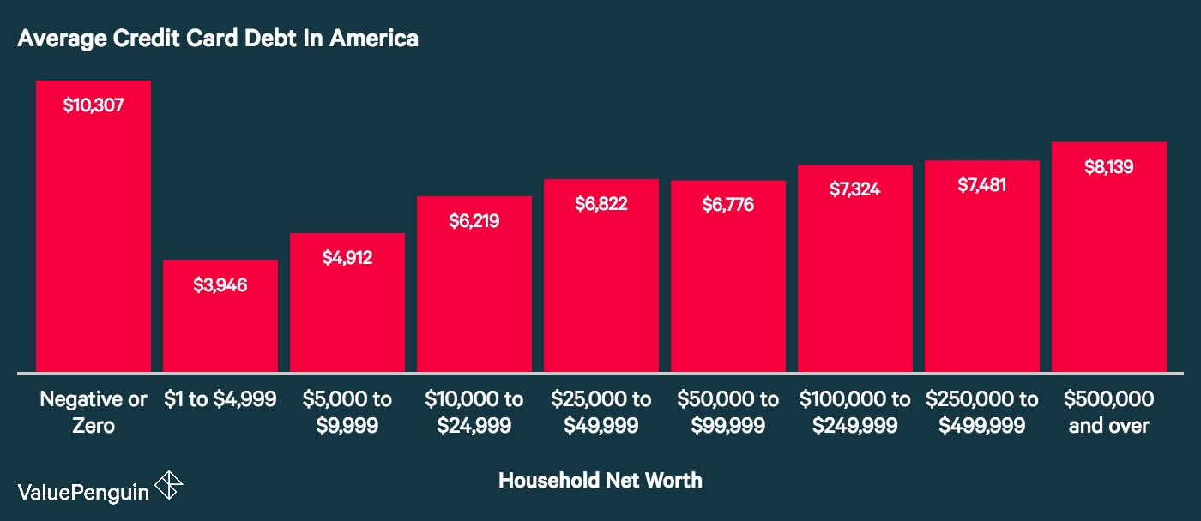
Now Americans carry an average credit-card balance of $16,061 per household, of those that have credit cards.

Slide 8
Credit-card debt more than doubled between 2005 and 2016.
Only 30% pay off their cards bills on a regular basis.
Almost half the households in America report having difficulty paying their minimum monthly payments.

Slide 9

If your credit card balance is $8,000.00, and you make the minimum monthly payment at 18% interest, it will take you 25 years, 7 months to pay off the debt. You will also pay $15,432 in interest charges (almost twice the balance), bringing your total to $23,432.

Slide 10

If you didn’t have your credit card payment of $218 a month, and instead you invested that money in a 12% savings plan (historical stock market return), you could retire in 25 years with $1.3 Million Saved!

Slide 11
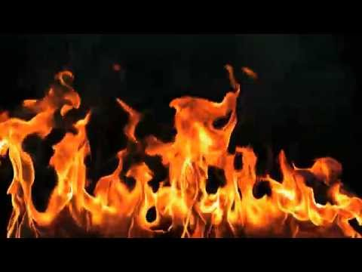
TRAGEDY: Christian households fail financially due to high debt at nearly the same rate lost world, even though Bible teaches foolproof debt management principles!

Slide 12
Learn God’s view of taking on debt
  A. Biblical Debt
  Debt is frequently discussed in the Bible, never strictly forbidden, is also not once encouraged.
  The Bibles direction to avoid borrowing is a Biblical Principal not commandment

Slide 13
Breaking Biblical principals does not result in punishment, it results in suffering consequences for our Bad Choices.
Debt causes turmoil in Christian families = Satan at work to slow God’s plan.
The sin most often connected with Debt is Greed!

Slide 14
B. God’s overall statement about debt:
    Pro 22:7 The rich ruleth over the poor, and the borrower is servant to the lender.

Slide 15
Biblical borrowing is where you borrow and can pay back the money as scheduled and, are certain that if necessary, you could cash out and payback the entire debt at any time.
The important issue is not the debt, it’s servanthood

Slide 16
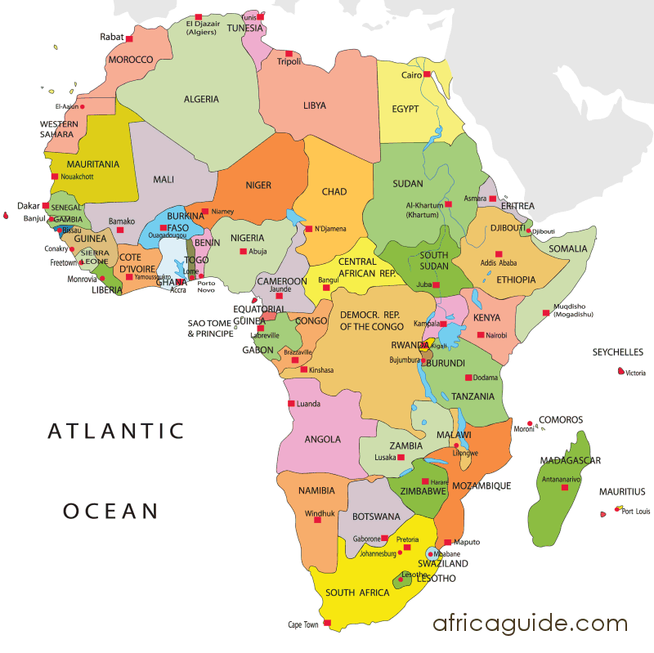
Most Important Question: Can you at any time answer God’s call to drop everything in your present life to serve God somewhere else without being bound by debt?

Slide 17
D. Why we over borrow - Greed / Covetousness
Webster’s Definition covetous:
    Marked by inordinate desire for wealth or possessions
    or for Another's possessions
    or Having a craving for possession <covetous of power>

Slide 18
Our NT –has 2 strong’s numbers that directly correlate with Webster’s 2 points above:
    philarguros
    fil-ar'-goo-ros
    From G5384 and G696; overly fond of silver (money)
    pleonekteō
    pleh-on-ek-teh'-o
    From G4123; to be covetous, that is, (by implication) to over reach: - get an advantage, defraud, make a gain. (Taking advantage of other people esp poor)

Slide 19


Slide 20
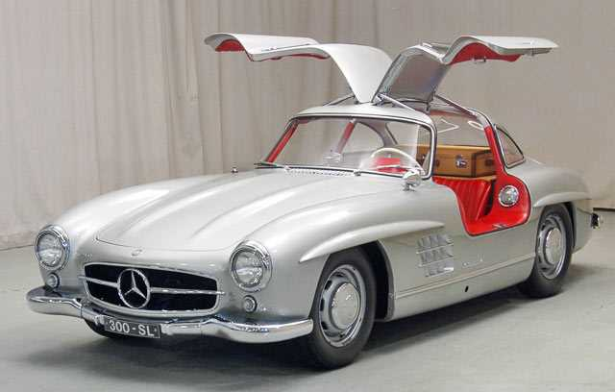
300SL Gullwing

Slide 21
E. Covetousness is Sin
1 Cor 5: 9 ¶ I wrote unto you in an epistle not to company with fornicators:
10 Yet not altogether with the fornicators of this world, or with the covetous, or extortioners, or with idolaters; for then must ye needs go out of the world.
11 But now I have written unto you not to keep company, if any man that is called a brother be a fornicator, or covetous, or an idolater, or a railer, or a drunkard, or an extortioner; with such an one no not to eat.

Slide 22
The sin of covetousness is so bad that God says that we should not even be hanging out with covetous people.
Eph 5:3 But fornication, and all uncleanness, or covetousness, let it not be once named among you.
Col 3:5 Mortify therefore your members which are upon the earth; fornication, uncleanness, inordinate affection, evil concupiscence, and covetousness, which is idolatry:

Slide 23
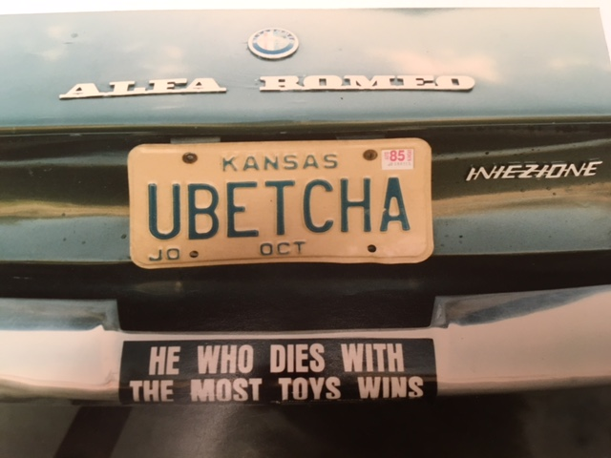
My Car and Philosophy when I was 25

Slide 24
  F. How to Use Money in a way that DOES make you more happy:
  1. What spending does make us happy?
    a. Realize that money and stuff do not make you happy
    b. Money can make life easier, but not happier

Slide 25
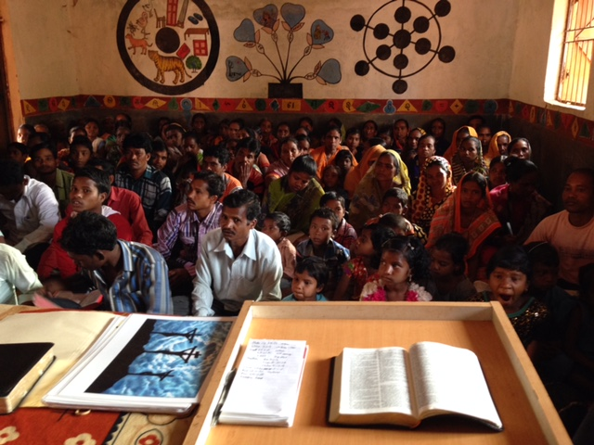


What makes you happy
is Good Experiences
not stuff!!

Slide 26

2. Best way - Pay others to do mundane tasks that you really do not want to do:
  a. Like hire a maid to come twice a month
  b. Pay someone to mow the lawn

Slide 27
V. Through Greed, Many Christians also curse their financial lives by Not Tithing:
    Pro 3:9-10 Honour the LORD with thy substance, and with the firstfruits of all thine increase:
    10 So shall thy barns be filled with plenty, and thy presses shall burst out with new wine

Slide 28
Mal 3:7 ¶ Even from the days of your fathers ye are gone away from mine ordinances, and have not kept them. Return unto me, and I will return unto you, saith the LORD of hosts. But ye said, Wherein shall we return?8 Will a man rob God? Yet ye have robbed me. But ye say, Wherein have we robbed thee? In tithes and offerings.9 Ye are cursed with a curse: for ye have robbed me, even this whole nation.10 Bring ye all the tithes into the storehouse, that there may be meat in mine house, and prove me now herewith, saith the LORD of hosts, if I will not open you the windows of heaven, and pour you out a blessing, that there shall not be room enough to receive it.

Slide 29
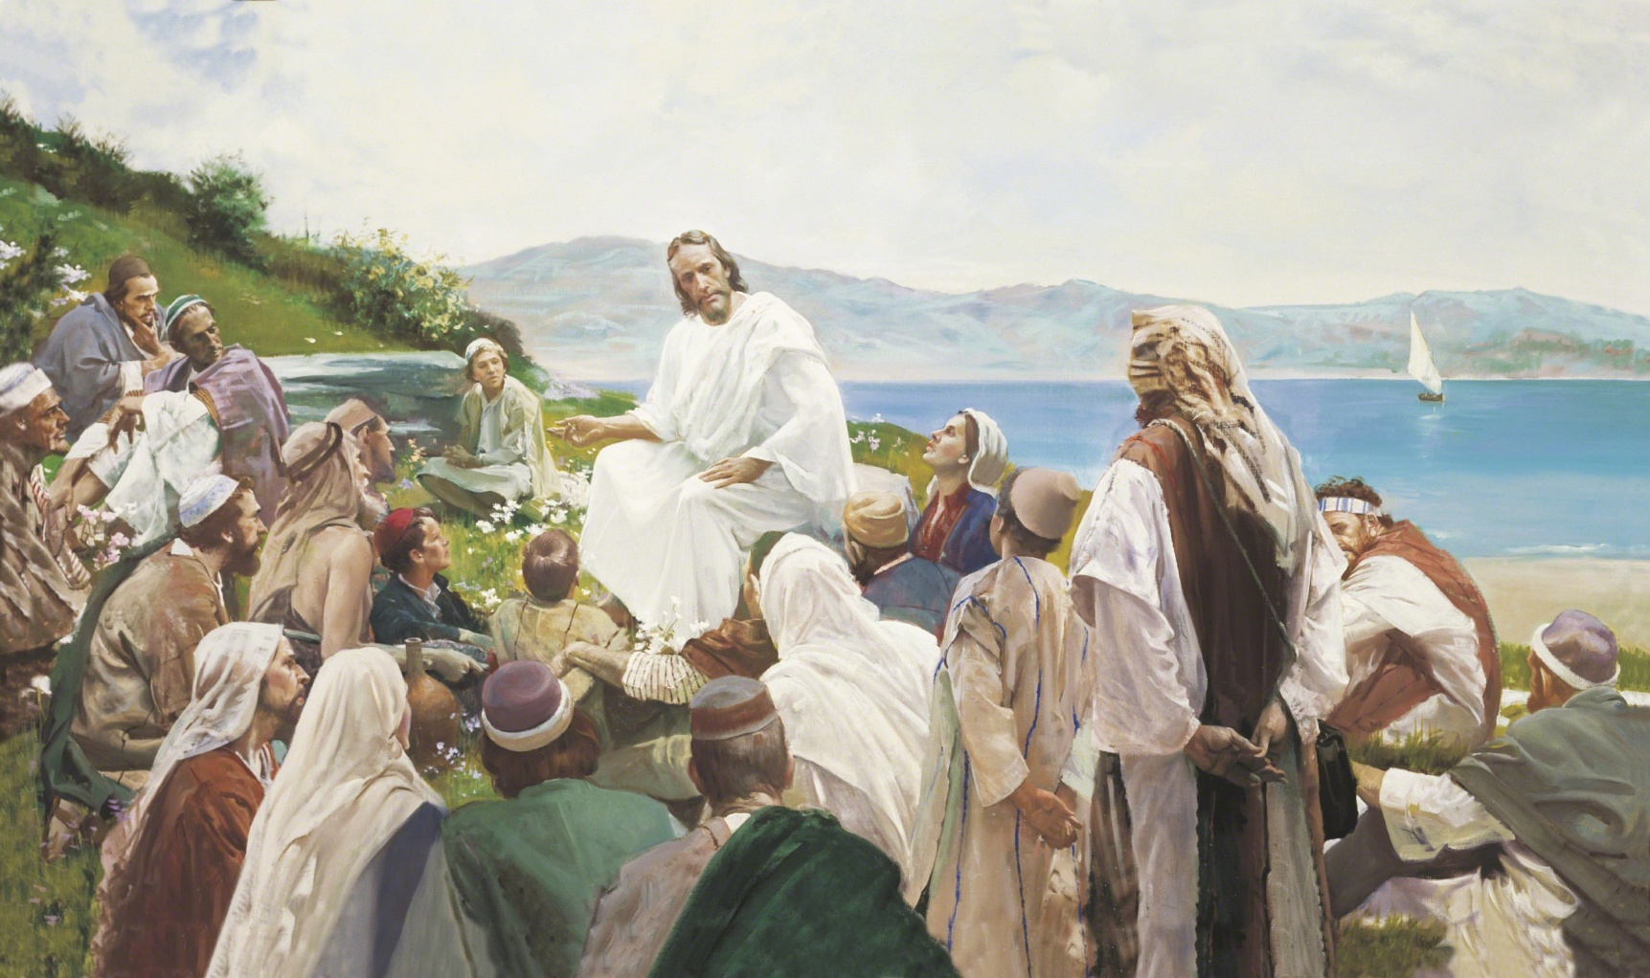
d. Also Note: All NT commandments TIGHTENED requirements on believers, never required less (not look on a woman…sinned already)

Slide 30
F. Not only Wisdom, and financial blessing on earth can be lost, but Eternal rewards can be lost through Greed also:
  Gal 5:19 Now the works of the flesh are manifest, which are these; Adultery, fornication, uncleanness, lasciviousness, 20 Idolatry, witchcraft, hatred, ………………..: of the which I tell you before, as I have also told you in time past, that they which do such things shall not inherit the kingdom of God.

Slide 31
8 Steps to Financial Peace:
1. Give God His share first –Tithe - ALWAYS
2. $1000 Emergency Fund
3. Pay off all debt but the house – smallest to largest debt – emotion – not math!
4. 3-6 months living expenses – rainy day fund – most laid off at some time in life
5. Invest 15% of household income into Roth IRA’s and pre-tax retirement like 401K’s at work – start as early as possible.
6. College Funding - $11,000 per year state school.
7. Pay off Home Early – yields unbelievable financial freedom
8. Build Wealth!

Slide 32
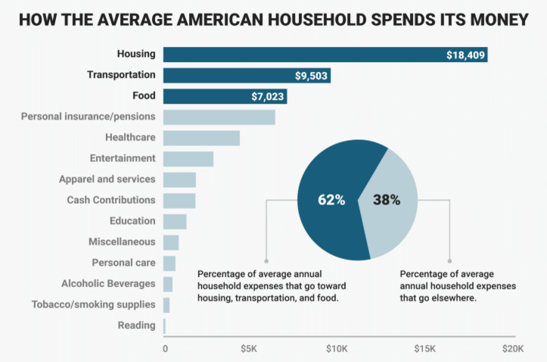

Slide 33
  Homework – Points of Application
  Greed:
  Are you living in greed?
    Is your life focused on having; More, More, More? (More stuff, More Money, More Power, More Fame…)
    Do you have debt that is the result of greed to have things that God did not provide?
  What is your plan to correct your wrong thinking and correct any financial mess and eliminate any debt that may exist?

