Slide 1
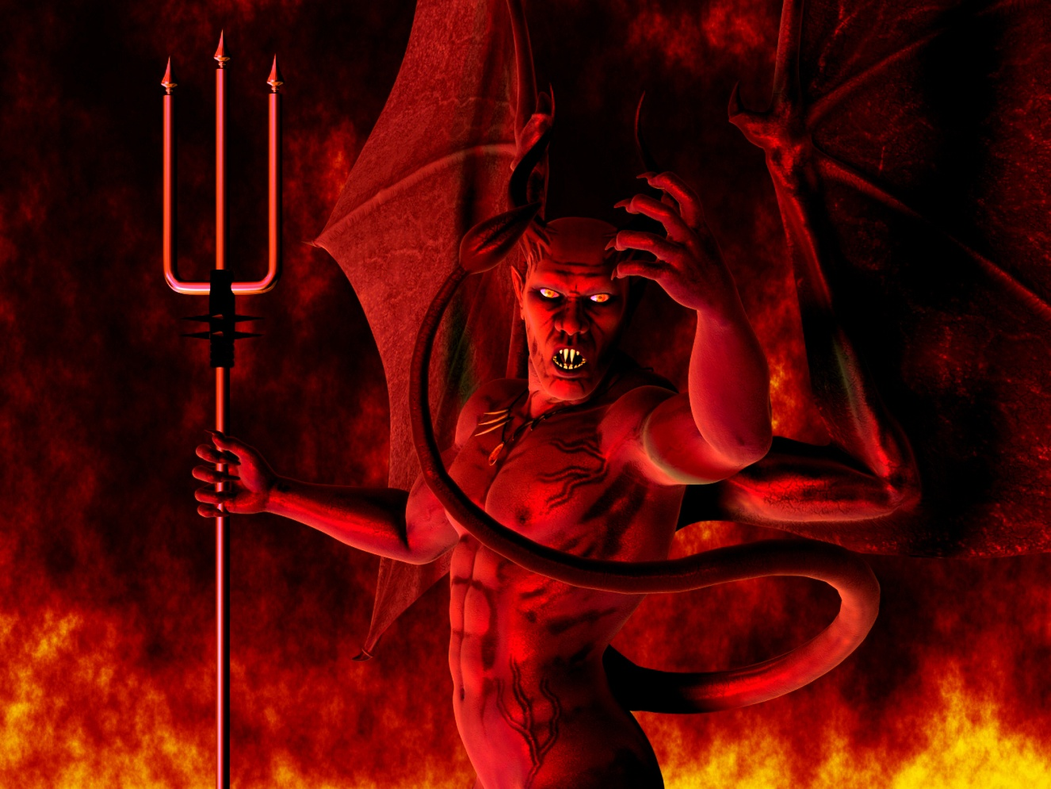
Proverbs for Life
Lesson #3
Satan’s Destructive Trio;
Greed, Pride and Sexual Immorality

Slide 2
I. Pride - Isaiah 14:12
A. Pride is the second of the three of Satan’s deadly sin traps.
B. See that Pride was the original sin of Satan:
  1. Pride caused a great fall: Isa 14:12

Slide 3
3. Consider for a moment what the WOG says about your thoughts: Psa 19:14
Psa 19:14 Let the words of my mouth, and the meditation of my heart, be acceptable in thy sight, O LORD, my strength, and my redeemer.

Slide 4
  Notice how Satan talked to himself in his heart – I, I, I
  One of the biggest ways to beat pride is to very carefully guard what you are telling yourself about yourself!
  Do not read your own press releases – they are not reality and will get you into big trouble!!

Slide 5
Or ….Satan will try to neutralize you by having you convince yourself that you are so worthless, and ineffective that you will not even engage in the fight.
Woe Is Me attitude = Pride too!!
Either way – he wins. Puffing yourself up or tearing yourself down are both based on self focused pride. Stop listening to you self talk about how great or terrible you are.

Slide 6
C. God HATES pride – because it is when man is stealing Gods Glory for himself:
    Never forget, every ability that you have, every good thing that you have received, every situation that you find yourself in are from God – you did not give yourself any of those.

Slide 7

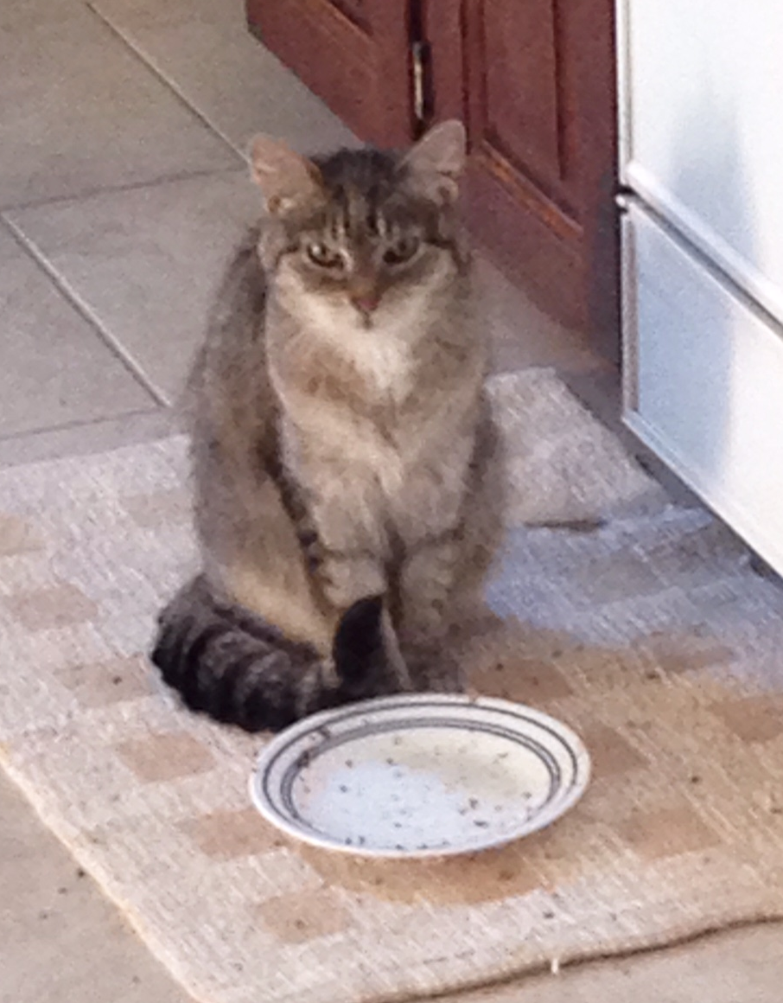
So the real question – do you have a Dog or a Cat mindset?

Slide 8
The Dog Says:
You Love me
You Feed me
You Play with me
You Give me a nice place to live…..
So YOU must be God!

Slide 9
The Cat Says:
You Love me
You Feed me
You Play with me
You Give me a nice place to live…..
So I must be God

Slide 10
Pro 6:16 These six things doth the LORD hate: yea, seven are an abomination unto him:
Pro 6:17 A proud look, a lying tongue, and hands that shed innocent blood,
Pro 6:18 An heart that deviseth wicked imaginations, feet that be swift in running to mischief,
Pro 6:19 A false witness that speaketh lies, and he that soweth discord among brethren.

Slide 11
Pro_8:13 The fear of the LORD is to hate evil: pride, and arrogancy, and the evil way, and the forward mouth, do I hate.

Slide 12
D. So what does God say about all this? The prideful will be destroyed!
  Pro_16:18 Pride goeth before destruction, and an haughty spirit before a fall.
  Pro_29:23 A man's pride shall bring him low: but honour shall uphold the humble in spirit.

Slide 13
E. God labels those who are prideful as fools:
    Pro_14:3 In the mouth of the foolish is a rod of pride: but the lips of the wise shall preserve them.

Slide 14

F. Pride is also the source of fights:
    Pro_13:10 Only by pride cometh contention: but with the well advised is wisdom.

Slide 15
II. Sexual Immorality
1. In a recent Barna study, 4 out of 10 Americans believe that adultery is morally acceptable.
2. Over 33% of married men will cheat on their wives; and nearly 25% of all married women will cheat on their husbands.
3. More than 50% of all marriages will be impacted by one of the spouses committing adultery.

Slide 16
  4. Christianity Today Poll shows that 45 percent of Christians indicate having done something sexually inappropriate, and 23 percent admit to having extramarital intercourse.
  5. Years back the stereotype was that the husband was unfaithful – often with a single girl. Today, researchers are finding that women are almost as likely as men to have an affair and affairs occur most often between “equals” at work.

Slide 17


Slide 18
E. What God says about sexual immorality
1. Avoiding fornication is simple. If you have the need – get married!
  1Co 7:2 - Nevertheless, [to avoid] fornication, let every man have his own wife, and let every woman have her own husband. 3 Let the husband render unto the wife due benevolence: and likewise also the wife unto the husband. 4 The wife hath not power of her own body, but the husband: and likewise also the husband hath not power of his own body, but the wife. 5 Defraud ye not one the other, except it be with consent for a time, that ye may give yourselves to fasting and prayer; and come together again, that Satan tempt you not for your incontinency.

Slide 19
2. We must maintain a vibrant and fulfilling marriage.
    Notice that Proverbs 5 said that we are to be both satisfied and ravaged.
    This is one area where being just OK at it is not good enough!

Slide 20

Women are “suspect to affairs to satisfy their longing for love, appreciation and tenderness.”

Slide 21

Eph 5:25 Husbands, love your wives, even as Christ also loved the church, and gave himself for it;
Eph_5:28 So ought men to love their wives as their own bodies. He that loveth his wife loveth himself.
Eph_5:33 Nevertheless let every one of you in particular so love his wife even as himself;

Slide 22
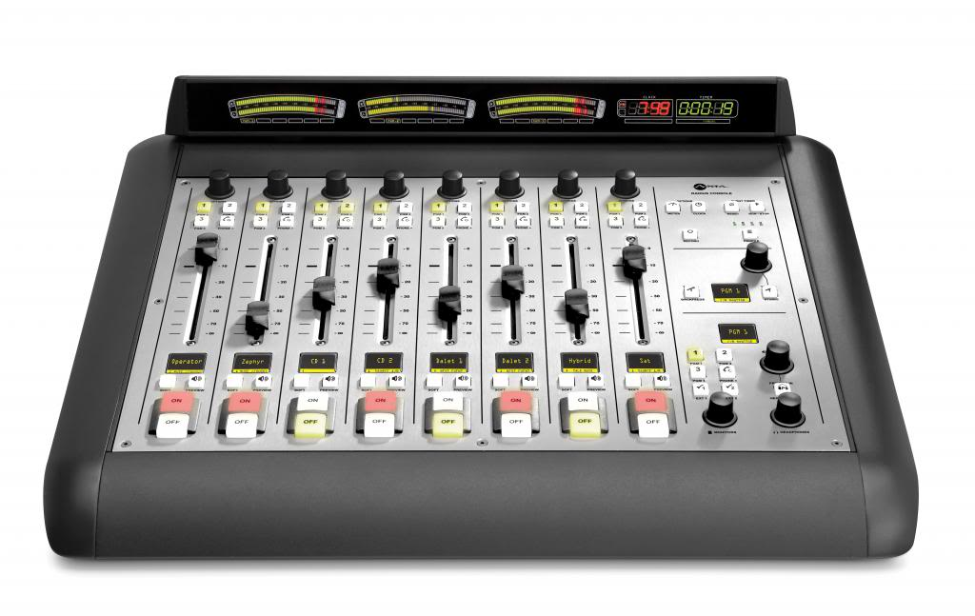
Marital failure #1 for Men –
Wrong Definition of Love for their wife
1. Show that you are truly committed and care for her – or nothing else matters
2. 5 Love Languages
      A. Words of Affirmation
      B. Quality Time
      C. Receiving Gifts
      D. Acts of Service
      E. Physical Touch

Slide 23
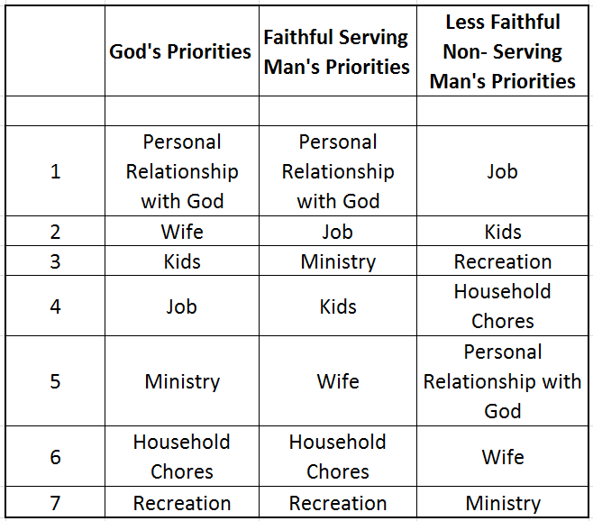
Marital failure #2 for Men –
Wrong Priorities

Slide 24

Men, to safeguard your wife from adultery, you must set the priorities right and spend time and effort truly loving her in the way she best receives love.

Slide 25

Men tend to turn to extramarital affairs to build up their self-image or sexual self-esteem.

Slide 26
Marital failure #1 for Women – Wrong Definition of Love for their Husband
Good Physical Intimacy = Showing that you truly care for him
    5 Love Languages
    1. Words of affirmation
    2. Quality time
    3. Receiving gifts
    4. Acts of service
    5. Physical touch

Slide 27
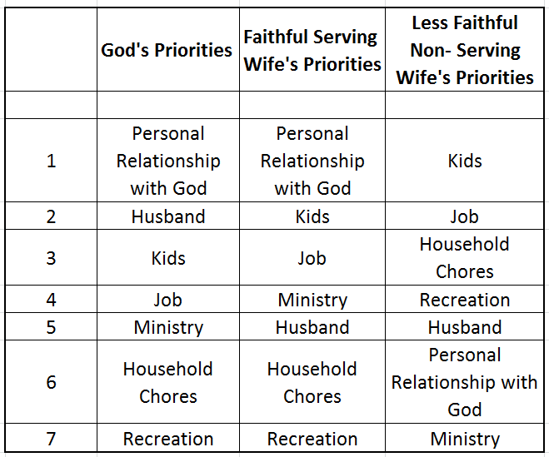
Marital failure #2 for Women – Wrong Priorities

Slide 28

Eph_5:33 Nevertheless let every one of you in particular so love his wife even as himself; and the wife see that she reverence her husband.

Slide 29

The Wife’s Ultimate Mission:
A wife’s job is treat and encourage her husband in such a way that he feels like the; biggest, strongest, most confident, most invincible, soldier for the Lord Jesus Christ that he can possibly be!

Slide 30

The Crazy Cycle

Slide 31

3. Determine that you will honor God and not even start on the path where you are tempted.

Slide 32
4. Guard your thoughts carefully:
  21 For from within, out of the heart of men, proceed evil thoughts, adulteries, fornications, murders, 22 Thefts, covetousness, wickedness, deceit, lasciviousness, an evil eye, blasphemy, pride, foolishness: 23 All these evil things come from within, and defile the man.

Slide 33
F. Warning signs adultery is present, or coming soon:
1. One partner stops kissing the other with passion.
2. One partner starts to talk about another person of the opposite sex more often than is normal for them
3. One partner suddenly has work requirements at unusual times.
4. Partner avoids eye contact with you.

Slide 34
5. Partner makes excuses for not spending time alone with you.
6. Partner no longer talks about emotional feelings – just day to day facts.
7. Partner acts unusually guilty when you do something nice for him/her.
8. Partner quits complimenting you on your physical attractiveness.

Slide 35
9. Partner stops saying, "I love you" and even acts rudely to you.
10. Partner starts buying you gifts to ease his or her guilt.
11. Partner suddenly becomes more preoccupied with appearance.
12. Partner’s Car is suddenly cleaner than usual – kids toys and personal items hidden.

Slide 36
III. Pornography
Matt 5:28 But I say unto you, That whosoever looketh on a woman to lust after her hath committed adultery with her already in his heart.
Married? Pornography use is Adultery.
Not married? Pornography use is Fornication.

Slide 37
C. How to Escape Porn:
1. Be a man (or woman) and admit that you are deep in sin and must get out!
2. Confess your sin to God (1 jo 1:9). And Ask God to cleanse, renew, and transform your mind (Rom 12:2).
3. Ask God to fill your mind with the things from Php 4:8
    Finally, brethren, whatsoever things are true, whatsoever things are honest, whatsoever things are just, whatsoever things are pure, ……….

Slide 38

3. Get bullet proof accountability from a Christian friend, including full monitoring on all electronic devices.

Slide 39
Homework - Pride:
  1. Are you always telling yourself how great you are?
  2. Or are you telling yourself that you deserve more?
  3. Or just as bad (and prideful) do you have a woe is me – I don’t deserve this attitude?
  4. Do you find yourself saying prideful things?
  5. Do you find yourself doing or purchasing things with an attitude to impress others?
  6. Do you find yourself admiring prideful people?
What is your plan to correct this wrong thinking

Slide 40
Sexual Impurity: (if Single)
  1. Commit to God that you will remain sexually pure in thoughts and actions.
  2. Identify your area(s) of weakness where Satan is attacking or is likely to attack.
  3. Determine ways that you can protect yourself from sexual impurity.
  4. If tempted, determine ways that you can safeguard yourself from porn.
  5. If using porn, even occasionally, repent and then establish an accountability partner.

Slide 41
Sexual Impurity: (if Married)
1. Commit to God that you will remain sexually pure in thoughts and actions in your marriage.
2. Discuss your area(s) of weakness with your spouse where Satan is likely to attack your relationship.
3. Read Song of Solomon together and note how each partner treats and relates to the other.
4. Assure protected times to spend time with your spouse; to build the relationship, and times for your intimate relationship.
5. If tempted, formulate ways that you can safeguard yourself(s) from porn.
6. If using porn, even occasionally, repent and then establish an accountability partner.

