Slide 1

Proverbs for Life
Lesson #4
Proverbs for Men, Women and about kids

Slide 2
Pro 16:3 Commit thy works unto the LORD, and thy thoughts shall be established.
Pro 16: 9 A man’s heart deviseth his way: but the LORD directeth his steps.
Pro 24:16 For a just man falleth seven times, and riseth up again:

Slide 3

I. Proverbs for Men
  A. First and foremost - A man of God must have the right life focus

Slide 4
  Ecc 12:13 Let us hear the conclusion of the whole matter: Fear God, and keep his commandments: for this is the whole duty of man.
  Mat_6:33 But seek ye first the kingdom of God, and his righteousness; and all these things shall be added unto you.

Slide 5
C. God commands that men be diligent in their work:
Pro_12:24 The hand of the diligent shall bear rule: but the slothful shall be under tribute.
Pro_12:27 The slothful man roasteth not that which he took in hunting: but the substance of a diligent man is precious.
Pro_13:4 The soul of the sluggard desireth, and hath nothing: but the soul of the diligent shall be made fat.
Pro_10:4 He becometh poor that dealeth with a slack hand: but the hand of the diligent maketh rich.

Slide 6
4. To succeed, a man must have a plan:
Pro_21:5 The thoughts of the diligent tend only to plenteousness;
If you are just letting life happen to you, you are letting others determine your outcome !

Slide 7
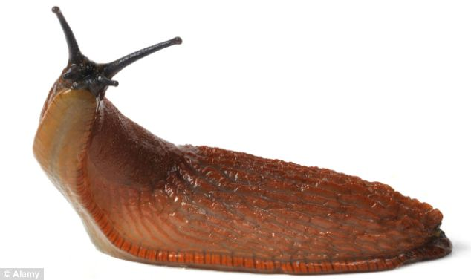
D. What the Bible says about a man who does not work diligently =The Sluggard
Pro 6:9 How long wilt thou sleep, O sluggard? when wilt thou arise out of thy sleep?

Slide 8
3. Sleep and inaction are the downfall of the sluggard
Pro 19:15 Slothfulness casteth into a deep sleep; and an idle soul shall suffer hunger.
4. Sleep is not the cause of Slothfulness – It’s the other way around!!
Pro 20:13 Love not sleep, lest thou come to poverty; open thine eyes, and thou shalt be satisfied with bread.

Slide 9
5. The Bible also does not endorse procrastination:
Pro 10:5 He that gathereth in summer is a wise son: but he that sleepeth in harvest is a son that causeth shame. -do not procrastinate!! Same applies to gathering souls.

Slide 10

Live life with true passion!
  Diligent includes effort with results.
  Not just busyness!

Slide 11

7. Be Diligent in Ministry:
Pro 11:30 The fruit of the righteous is a tree of life; and he that winneth souls is wise.
Pro 14:25 A true witness delivereth souls:

Slide 12
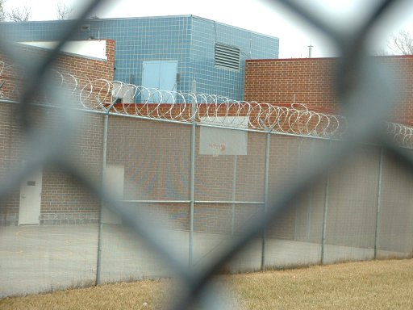


Detention Center

Slide 13
E. How the man of God deals with others:
1. Does not Strive:
Pro_3:30 Strive not with a man without cause, if he have done thee no harm.

Slide 14
2. Is Merciful:
Pro 11:17 The merciful man doeth good to his own soul: but he that is cruel troubleth his own flesh.

Slide 15
Is Honest:
Pro 12:22 Lying lips are abomination to the LORD: but they that deal truly are his delight.

Slide 16

II. Proverbs for Women
The Woman of God is:
1. Faithful (10-11) A Virtuous Woman is faithful Her husband (and God).

Slide 17
4. Fit (17) A Virtuous Woman keeps her body in shape to serve with strength.
5. Charitable (20) A Virtuous Woman considers the needs of others.
6. Confident (21) A Virtuous Woman is not afraid.

Slide 18
11. Kind (26) A Virtuous Woman speaks kindly.
12. Respected (28) A Virtuous Woman earns the respect of her family

Slide 19
III. Additional Proverbs about Women:
A. The Godly Woman is:
1. Gracious:
Pro 11:16 A gracious woman retaineth honour: and strong men retain riches.

Slide 20
B. The Ungodly Woman is:
1. Loud:
Pro 7:10 And, behold, there met him a woman with the attire of an harlot, and subtil of heart. Pro 7:11 (She is loud and stubborn; her feet abide not in her house:)

Slide 21

2. Clamorous:
Pro 9:13 A foolish woman is clamorous: she is simple, and knoweth nothing.

Slide 22
Contentious and Angry:
Pro 21:19 It is better to dwell in the wilderness, than with a contentious and an angry woman.
Pro 25:24 It is better to dwell in the corner of the housetop, than with a brawling woman and in a wide house.
Pro 27:15 A continual dropping in a very rainy day and a contentious woman are alike.

Slide 23
4. Odious: (Hateful)
Pro 30:21 For three things the earth is disquieted, and for four which it cannot bear…..23 For an odious woman when she is married;

Slide 24

IV. Proverbs about Raising Children:
Pro_22:6 Train up a child in the way he should go: and when he is old, he will not depart from it.

Slide 25
B. Consistent Clear Discipline is the key:
Pro_13:24 He that spareth his rod hateth his son: but he that loveth him chasteneth him betimes.
Pro_22:15 Foolishness is bound in the heart of a child; but the rod of correction shall drive it far from him.

Slide 26
Pro_23:13 Withhold not correction from the child: for if thou beatest him with the rod, he shall not die.
Pro_29:15 The rod and reproof give wisdom: but a child left to himself bringeth his mother to shame.

Slide 27
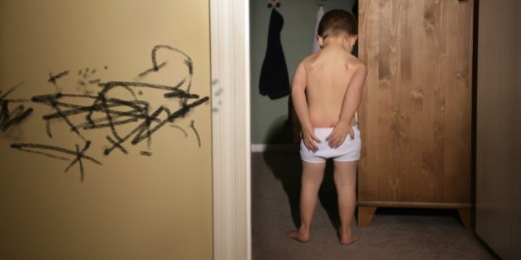
1. Very simple, Use the rod early and often and kids will be obedient later!

Slide 28
C. Ultimate End result is to break their pride so later they will get saved.
Pro_23:14 Thou shalt beat him with the rod, and shalt deliver his soul from hell.
Psa 34:11 Come, ye children, hearken unto me: I will teach you the fear of the LORD.

Slide 29
D. Children Bible Teaching
Pro 20:11 Even a child is known by his doings, whether his work be pure, and whether it be right.

Slide 30
  Make it fun -
  God is amazing - make Him appear that way.
  Paraphrase Bible stories with picture books when young.
  Don't underestimate what they can learn- discipleship in 5 grade - really got it!

Slide 31

  Balance - Not Bible Time Out!!!
Or later they will reject God and the Bible

Slide 32
Eph 6:1 Children, obey your parents in the Lord: for this is right.
Eph 6:2 Honour thy father and mother; (which is the first commandment with promise;)
Eph 6:3 That it may be well with thee, and thou mayest live long on the earth.
Eph 6:4 And, ye fathers, provoke not your children to wrath: but bring them up in the nurture and admonition of the Lord.

Slide 33
Continuously teach through life
Include in discussions – let them see you live the Bible

Slide 34


