Slide 1

Remember, Repent, and Return
Rev. 2:1-5

Slide 2
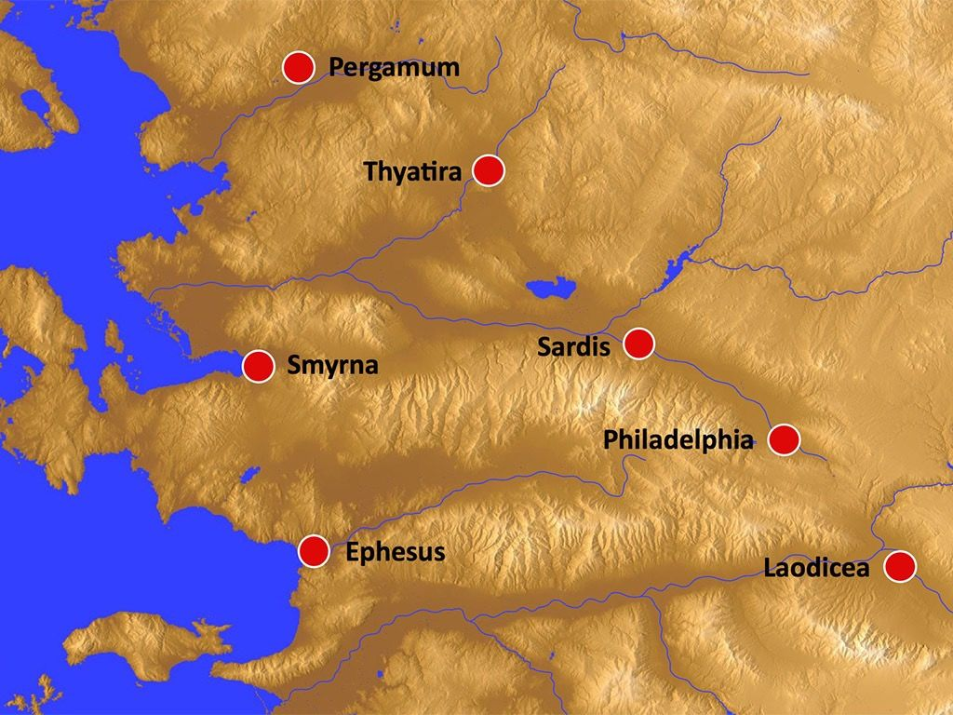

Slide 3
Remember, Repent, and Return
Leaving their first love
1. They left Jesus.
2. Jesus did not leave them.
3. Jesus desired to be in relationship with them.
4. Their departure hurt Him.

Slide 4
Remember, Repent, and Return
I. Remember the Relationship You Once Had with Jesus.
II. Repent for Leaving Him.
Losing something is accidental.
Leaving something is intentional.
III. Return to the Basics of Your Relationship with Jesus.

