Slide 1

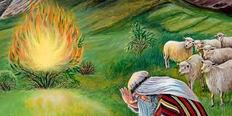
Exodus 3:1-14
Separated

Slide 2
Separated
the posture
v. 1 kept the flock
v. 1 came to the mountain of God
v. 2 “he looked"
v. 3 “he” turned aside, and saw this great sight
The Call
v. 4 when the Lord saw that he turned aside to see, God called.
1st Response
v. 4 "Here am I"
v. 5 He removed his shoes because it was holy
v. 6 He hid his face
The Commission
v. 10 Come now, I will send thee
2nd Response
v. 11 "Who am I?”
The Comfort
v. 12 "certainly I will be with thee”
3rd response
v. 13 What shall I Say?
The content
v. 14 “I AM hath sent me unto you"

Slide 3
Exodus 3:1-14
Separated

Slide 4
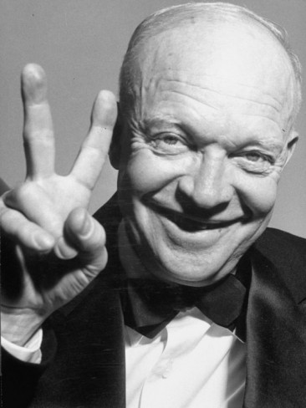
Dwight D. Eisenhower
34th President of the United States
Eisenhower Principle

Slide 5
Urgent
Not Urgent
Urgent
Important
Not Urgent
Important
Important
Urgent
Not Important
Not Urgent
Not Important
Not Important

Slide 6
Urgent
Not Urgent
Urgent
Important
Not Urgent
Important
Important
Work obligations, Deadlines,
Crises, Kids daily needs,
House hold daily needs,
Ministry, Discipleship
Urgent
Not Important
Not Urgent
Not Important
Not Important

Slide 7
Urgent
Not Urgent
Urgent
Important
Not Urgent
Important
Important
Time with God
(Praise, Prayer, meditating on his word)
Building meaningful relationships
Self – Care
Working towards Goals,
True Recreation
Work obligations, Deadlines,
Crises, Kids daily needs,
House hold daily needs,
Ministry, Discipleship
Urgent
Not Important
Not Urgent
Not Important
Not Important

Slide 8
Urgent
Not Urgent
Urgent
Important
Not Urgent
Important
Important
Time with God
(Praise, Prayer, meditating on his word)
Building meaningful relationships
Self – Care
Working towards Goals,
True Recreation
Work obligations, Deadlines,
Crises, Kids daily needs,
House hold daily needs,
Ministry, Discipleship
Urgent
Not Important
Not Urgent
Not Important
Not Important
Interruptions, Emails,
Phone calls, busy work,
Some house chores

Slide 9
Urgent
Not Urgent
Urgent
Important
Not Urgent
Important
Important
Time with God
(Praise, Prayer, meditating on his word)
Building meaningful relationships
Self – Care
Working towards Goals,
True Recreation
Work obligations, Deadlines,
Crises, Kids daily needs,
House hold daily needs,
Ministry, Discipleship
Urgent
Not Important
Not Urgent
Not Important
Interruptions, Emails,
Phone calls, busy work,
Some house chores
Web browsing, social media
Binge watching,
analysis paralysis
Anything you use to procrastinate
“checking – out”
Not Important

Slide 10
Urgent
Not Urgent
Urgent
Important
Not Urgent
Important
Important
Time with God
(Praise, Prayer, meditating on his word)
Building meaningful relationships
Self – Care
Working towards Goals,
True Recreation
Work obligations, Deadlines,
Crises, Kids daily needs,
House hold daily needs,
Ministry, Discipleship
75%
5%
Urgent
Not Important
Not Urgent
Not Important
Interruptions, Emails,
Phone calls, busy work,
Some house chores
Web browsing, social media
Binge watching,
analysis paralysis
Anything you use to procrastinate
“checking – out”
Not Important
10%
10%

