Slide 1
Psa 139:1-2,1 O LORD, thou hast searched me, and known [me]. 2 Thou knowest my downsitting and mine uprising, thou understandest my thought afar off.

Slide 2
[Mar 2:6-8 KJV] 6 But there were certain of the scribes sitting there, and reasoning in their hearts, 7 Why doth this [man] thus speak blasphemies? who can forgive sins but God only? 8 And immediately when Jesus perceived in his spirit that they so reasoned within themselves, he said unto them, Why reason ye these things in your hearts?

Slide 3
[Jas 3:17 KJV] 17 But the wisdom that is from above is first pure, then peaceable, gentle, [and] easy to be intreated, full of mercy and good fruits, without partiality, and without hypocrisy.

Slide 4
Rev. 3:17 Because thou sayest, I am rich, and increased with goods, and have need of nothing; and knowest not that thou art wretched, and miserable, and poor, and blind, and naked:

Slide 5
Psa 139:23-24 23 Search me, O God, and know my heart: try me, and know my thoughts: 24 And see if [there be any] wicked way in me, and lead me in the way everlasting.

Slide 6
[Mat 23:2-12 KJV] 2 Saying, The scribes and the Pharisees sit in Moses' seat: 3 All therefore whatsoever they bid you observe, [that] observe and do; but do not ye after their works: for they say, and do not. 4 For they bind heavy burdens and grievous to be borne, and lay [them] on men's shoulders; but they [themselves] will not move them with one of their fingers. 5 But all their works they do for to be seen of men: they make broad their phylacteries, and enlarge the borders of their garments, 6 And love the uppermost rooms at feasts, and the chief seats in the synagogues, 7 And greetings in the markets, and to be called of men, Rabbi, Rabbi. 8 But be not ye called Rabbi: for one is your Master, [even] Christ; and all ye are brethren. 9 And call no [man] your father upon the earth: for one is your Father, which is in heaven. 10 Neither be ye called masters: for one is your Master, [even] Christ. 11 But he that is greatest among you shall be your servant. 12 And whosoever shall exalt himself shall be abased; and he that shall humble himself shall be exalted.

Slide 7
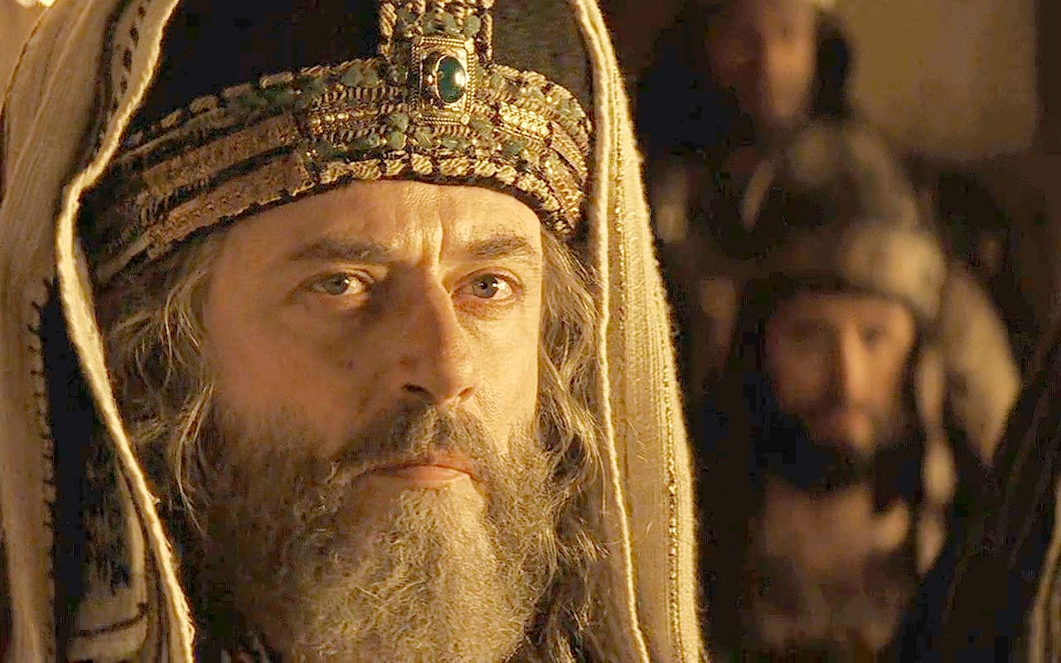
THE WOES OF HYPOCRISY
How to live A Sincere Life

Slide 8
THE WOES OF HYPOCRISY
An insincere life deters salvation to others.

Slide 9
THE WOES OF HYPOCRISY
[Mat 23:13 KJV] 13 But woe unto you, scribes and Pharisees, hypocrites! for ye shut up the kingdom of heaven against men: for ye neither go in [yourselves], neither suffer ye them that are entering to go in.

Slide 10
THE WOES OF HYPOCRISY
An insincere life deters salvation to others.
An insincere life covets and manipulates others

Slide 11
THE WOES OF HYPOCRISY
[Mat 23:13 KJV] 13 But woe unto you, scribes and Pharisees, hypocrites! for ye shut up the kingdom of heaven against men: for ye neither go in [yourselves], neither suffer ye them that are entering to go in.

Slide 12
THE WOES OF HYPOCRISY
[Mat 23:14 KJV] 14 Woe unto you, scribes and Pharisees, hypocrites! for ye devour widows' houses, and for a pretence make long prayer: therefore ye shall receive the greater damnation.

Slide 13
THE WOES OF HYPOCRISY
[Mat 15:7,8 KJV] 7 [Ye] hypocrites, well did Esaias prophesy of you, saying, 8 This people draweth nigh unto me with their mouth, and honoureth me with [their] lips; but their heart is far from me.

Slide 14
THE WOES OF HYPOCRISY
An insincere life deters salvation to others.
An insincere life covets and manipulates others
An insincere life converts others to perfectionism

Slide 15
THE WOES OF HYPOCRISY
[Mat 23:15 KJV] 15 Woe unto you, scribes and Pharisees, hypocrites! for ye compass sea and land to make one proselyte, and when he is made, ye make him twofold more the child of hell than yourselves.

Slide 16
THE WOES OF HYPOCRISY
An insincere life deters salvation to others.
An insincere life covets and manipulates others
An insincere life converts others to perfectionism
An insincere life is blinded and misguides others

Slide 17
THE WOES OF HYPOCRISY
[Mat 23:16-22 KJV] 16 Woe unto you, [ye] blind guides, which say, Whosoever shall swear by the temple, it is nothing; but whosoever shall swear by the gold of the temple, he is a debtor! 17 [Ye] fools and blind: for whether is greater, the gold, or the temple that sanctifieth the gold? 18 And, Whosoever shall swear by the altar, it is nothing; but whosoever sweareth by the gift that is upon it, he is guilty. 19 [Ye] fools and blind: for whether [is] greater, the gift, or the altar that sanctifieth the gift? 20 Whoso therefore shall swear by the altar, sweareth by it, and by all things thereon. 21 And whoso shall swear by the temple, sweareth by it, and by him that dwelleth therein. 22 And he that shall swear by heaven, sweareth by the throne of God, and by him that sitteth thereon.

Slide 18
THE WOES OF HYPOCRISY
An insincere life deters salvation to others.
An insincere life covets and manipulates others
An insincere life converts others to perfectionism
An insincere life is blinded and misguides others
An insincere life lives without authority.

Slide 19
THE WOES OF HYPOCRISY
[Mat 23:23 KJV] 23 Woe unto you, scribes and Pharisees, hypocrites! for ye pay tithe of mint and anise and cummin, and have omitted the weightier [matters] of the law, judgment, mercy, and faith: these ought ye to have done, and not to leave the other undone.

Slide 20
THE WOES OF HYPOCRISY
Luk 18:12 KJV - 12 I fast twice in the week, I give tithes of all that I possess.

Slide 21
THE WOES OF HYPOCRISY
24 [Ye] blind guides, which strain at a gnat, and swallow a camel.

Slide 22
THE WOES OF HYPOCRISY
An insincere life deters salvation to others.
An insincere life covets and manipulates others
An insincere life converts others to perfectionism
An insincere life is blinded and misguides others
An insincere life lives without authority.
An insincere life has a facade.

Slide 23
THE WOES OF HYPOCRISY
[Mat 23:25-26 KJV] 25 Woe unto you, scribes and Pharisees, hypocrites! for ye make clean the outside of the cup and of the platter, but within they are full of extortion and excess.

Slide 24
THE WOES OF HYPOCRISY
Psa 5:9 KJV - 9 For there is no faithfulness in their mouth; their inward part is very wickedness; their throat is an open sepulchre; they flatter with their tongue.

Slide 25
THE WOES OF HYPOCRISY
26 [Thou] blind Pharisee, cleanse first that [which is] within the cup and platter, that the outside of them may be clean also.

Slide 26
THE WOES OF HYPOCRISY
[Rom 12:2 KJV] 2 And be not conformed to this world: but be ye transformed by the renewing of your mind, that ye may prove what [is] that good, and acceptable, and perfect, will of God.

Slide 27
THE WOES OF HYPOCRISY
[Rom 12:9 KJV] [Let] love be without dissimulation. Abhor that which is evil; cleave to that which is good.

Slide 28
THE WOES OF HYPOCRISY
[Mat 23:27-28 KJV] 27 Woe unto you, scribes and Pharisees, hypocrites! for ye are like unto whited sepulchers, which indeed appear beautiful outward, but are within full of dead [men's] bones, and of all uncleanness

Slide 29
THE WOES OF HYPOCRISY
Num 19:16 KJV - 16 And whosoever toucheth one that is slain with a sword in the open fields, or a dead body, or a bone of a man, or a grave, shall be unclean seven days.

Slide 30
THE WOES OF HYPOCRISY
28 Even so ye also outwardly appear righteous unto men, but within ye are full of hypocrisy and iniquity.

Slide 31
THE WOES OF HYPOCRISY
[1Co 3:12-13 KJV] 12 Now if any man build upon this foundation gold, silver, precious stones, wood, hay, stubble; 13 Every man's work shall be made manifest: for the day shall declare it, because it shall be revealed by fire; and the fire shall try every man's work of what sort it is.

Slide 32
THE WOES OF HYPOCRISY
[Mat 23:29-31 KJV] 29 Woe unto you, scribes and Pharisees, hypocrites! because ye build the tombs of the prophets, and garnish the sepulchres of the righteous,

Slide 33
THE WOES OF HYPOCRISY
30 And say, If we had been in the days of our fathers, we would not have been partakers with them in the blood of the prophets.

Slide 34
THE WOES OF HYPOCRISY
[Gal 6:1 KJV] 1 Brethren, if a man be overtaken in a fault, ye which are spiritual, restore such an one in the spirit of meekness; considering thyself, lest thou also be tempted.

Slide 35
An insincere life deters salvation to others
    Are you inadvertently living as advisories to the kingdom?
An insincere life covets and manipulates others
    Are you lusting and striving towards something that God hasn’t given you?
An insincere life converts others to perfectionism
    Are you holding others to expectations you can’t live up to?
An insincere life is blinded and misguides others
    Are you living a life of legalism and pressuring others to do the same?
An insincere life lives without authority.
    Are you picking and choosing how you will obey God?
An insincere life has a facade.
    Are you being honest with others about your life?

