Slide 1
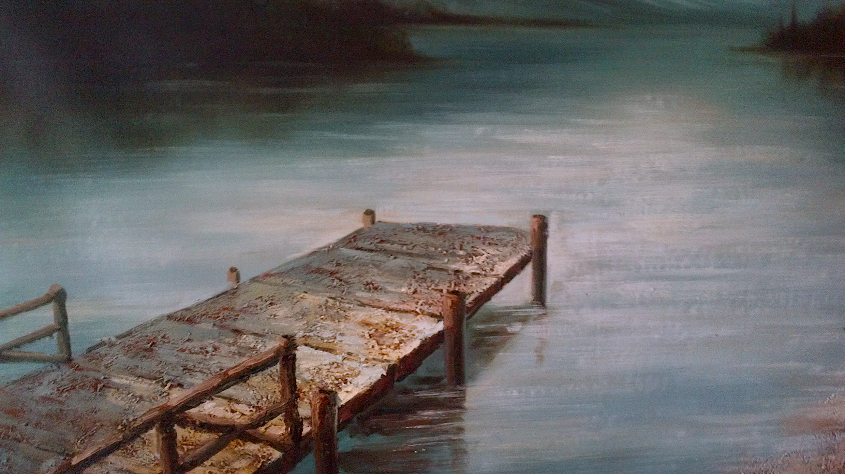
The Quiet Time
7 Key Components

Slide 2
What is The Quiet Time?
Quality time spent with God free from distraction, competition and expedition.
Distraction - Time spent w/ God and something else.
Competition – Time spent w/ God and someone else.
Expedition – Time rushed to get somewhere else.
Hurry is poison to the Quiet Time.
The Quiet Time

Slide 3
The Quiet Time
7 Key Components
Conviction.
a strong belief or opinion.
“If a man has not discovered something that he will die for, he isn't fit to live.”-Dr. Martin Luther King, Jr.

Slide 4
The Quiet Time
7 Key Components
Conviction.
Direction.
Reclusion.
a state of retirement from the world.

Slide 5
The Quiet Time
7 Key Components
3. Reclusion.
a state of retirement from the world.
Mat 14:23 And when he had sent the multitudes away, he went up into a mountain apart to pray: and when the evening was come, he was there alone.
Luk 5:16 And he withdrew himself into the wilderness, and prayed.

Slide 6
The Quiet Time
7 Key Components
Conviction.
Direction.
Reclusion.
Cooperation.
Meditation.
Close or continued thought; the turning or revolving of a subject in the mind…

Slide 7
The Quiet Time
7 Key Components
Conviction.
Direction.
Reclusion.
Cooperation.
Meditation.
Communication.
Expression.

