Slide 1
Urgency
Ephesians 5-6

Slide 2
Gods command to live apart
Walk in love – vs 1-2
  Prayer of Paul - Eph 3:14-21
Walk in Light – vs 3-9
  Joh 8:12 Then spake Jesus again unto them, saying, I am the light of the world: he that followeth me shall not walk in darkness, but shall have the light of life.
Walk Separate – vs 10-13
  It is missed
  It is minimized
  It is hypocritical

Slide 3
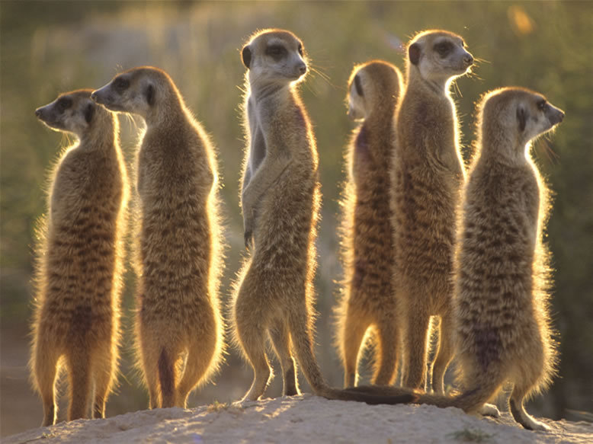
Gods command to live apart
Wake up from living dead – Vs 14-15
  If we are asleep in sin’s arms, we cannot rescue others from death’s grip
  Circumspectly – Diligently, perfectly
    adverb Cautiously; with watchfulness every way; with attention to guard against surprise or danger.

Slide 4
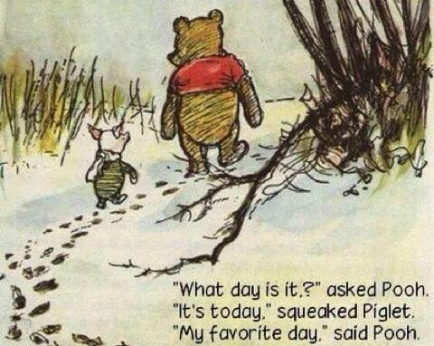
Redeeming the Time
Evil Days
  Mat 6:34 Take therefore no thought for the morrow: for the morrow shall take thought for the things of itself. Sufficient unto the day is the evil thereof.
  We can only make the next choice count, we can’t change one already made, or worry about the many not yet made.

Slide 5
Redeeming the Time
Understanding our Lord’s will
  Pursuit of God and His Glory
  Working for Unity
    1Pe 5:5 Likewise, ye younger, submit yourselves unto the elder. Yea, all of you be subject one to another, and be clothed with humility: for God resisteth the proud, and giveth grace to the humble.
  Glorifying Marriages
  Children
  Working unto God
  Engaging in the Battle for souls

Slide 6
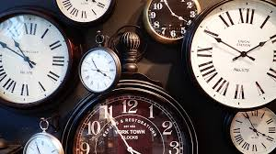
Waking Up
Look at the Time
  Joh 4:35 Say not ye, There are yet four months, and then cometh harvest? behold, I say unto you, Lift up your eyes, and look on the fields; for they are white already to harvest.
  Psa 103:14 For he knoweth our frame; he remembereth that we are dust. 15 As for man, his days are as grass: as a flower of the field, so he flourisheth. 16 For the wind passeth over it, and it is gone; and the place thereof shall know it no more.

Slide 7
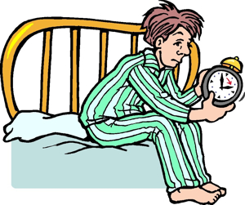
Waking Up
Get up!
What we choose
What we mean
One more hour of sleep
One more check of social media
One more superficial conversation
One more check of news or sports
One more episode of Netflix
One more drink to feel better
God isn’t worth rising early
My family isn’t worth my attention
Talking about God is uncomfortable
I’m not interested in my surroundings
I would rather be entertained than invest my life
I feel bad about my choices, I need escape
Rinse and repeat tomorrow…..

Slide 8
Waking Up
Get up!
  Rom 13:11 And that, knowing the time, that now it is high time to awake out of sleep: for now is our salvation nearer than when we believed. 12 The night is far spent, the day is at hand: let us therefore cast off the works of darkness, and let us put on the armour of light. 13 Let us walk honestly, as in the day; not in rioting and drunkenness, not in chambering and wantonness, not in strife and envying.14 But put ye on the Lord Jesus Christ, and make not provision for the flesh, to fulfil the lusts thereof.

Slide 9
Waking Up
Get invested
Time
  Start redeeming the time for things that matter
Treasure
  Start investing in the mission
Talent
  Start working for something that has eternal weight

Slide 10
Bring it back to Jesus
Despair
  We can’t change what has been done or left undone, we must make the next choice we have count for Christ.
  Php 3:13 Brethren, I count not myself to have apprehended: but this one thing I do, forgetting those things which are behind, and reaching forth unto those things which are before, 14 I press toward the mark for the prize of the high calling of God in Christ Jesus.
Discouragement
  Don’t focus on the whole, focus on following God with your next step
  Jer 10:23 O LORD, I know that the way of man is not in himself: it is not in man that walketh to direct his steps. 24 O LORD, correct me, but with judgment; not in thine anger, lest thou bring me to nothing.

Slide 11
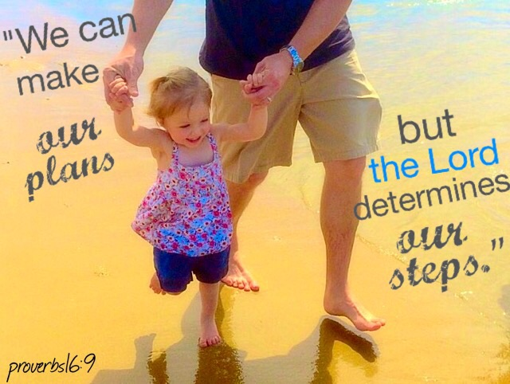
Bring it back to Jesus
  Psa 37:23 The steps of a good man are ordered by the LORD: and he delighteth in his way.24 Though he fall, he shall not be utterly cast down: for the LORD upholdeth him with his hand.
Seek God First
  Eph 5:1-2

