Slide 1
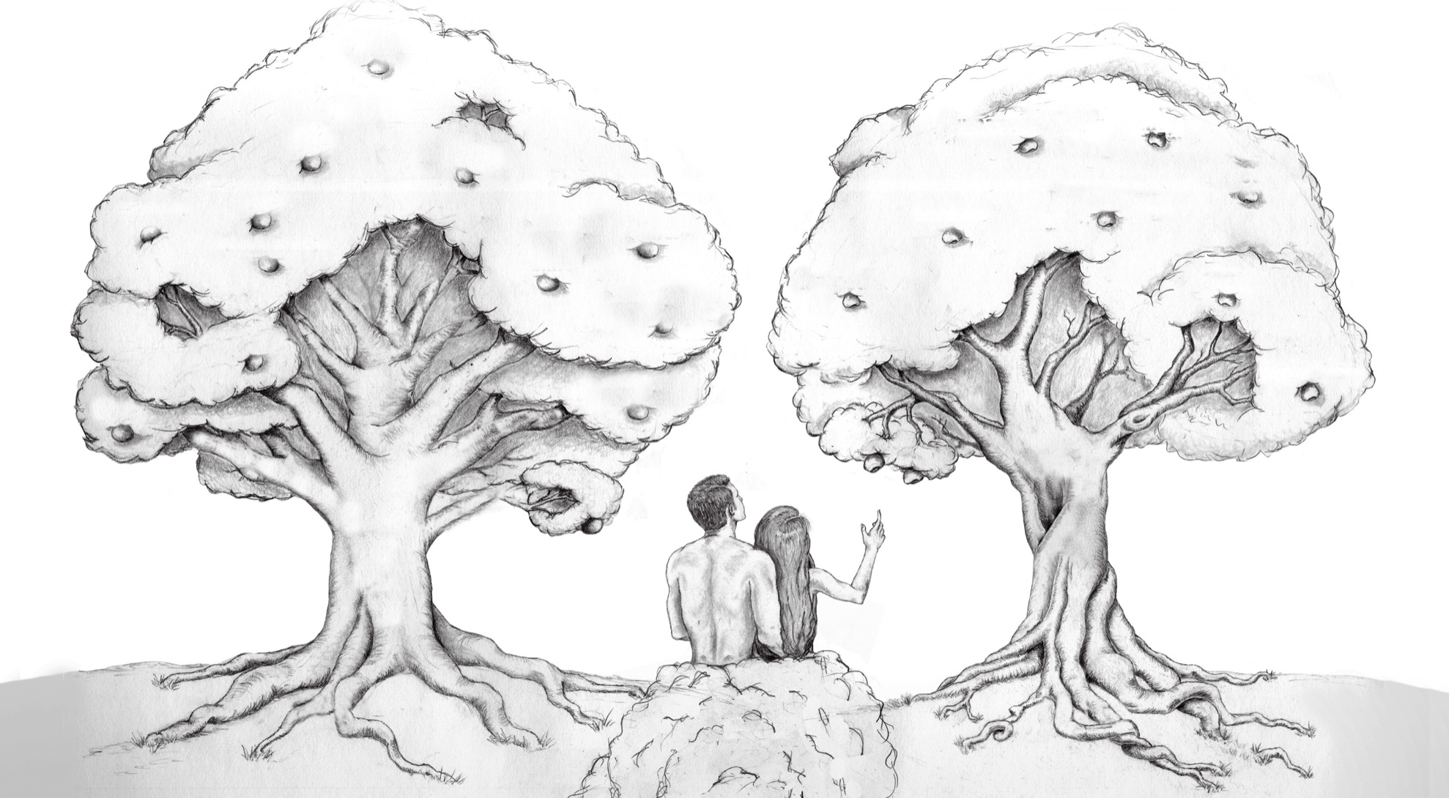
Godly Fathers are Gods Children

Slide 2
Portrait of a Godly Father
A Godly Father has a Personal Relationship w/ His Children.
T ALKING
I NTERESTED
MONETARY
E DIFY

Slide 3
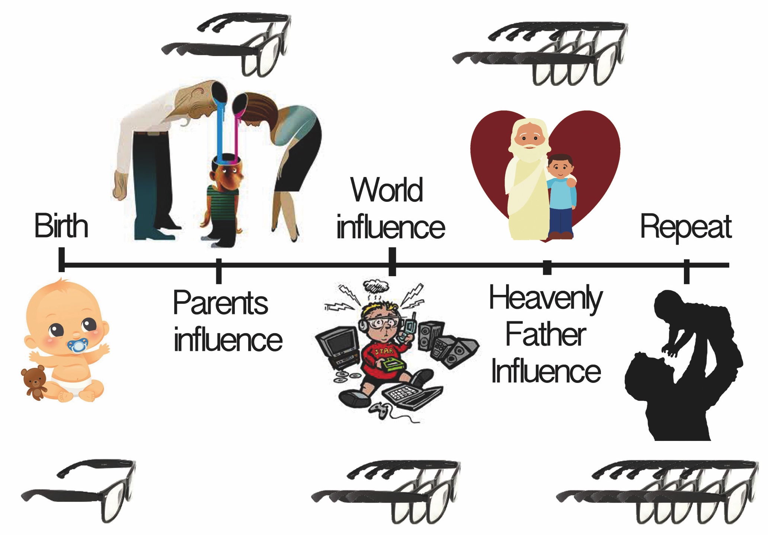
Generations

Slide 4
Generations

Slide 5
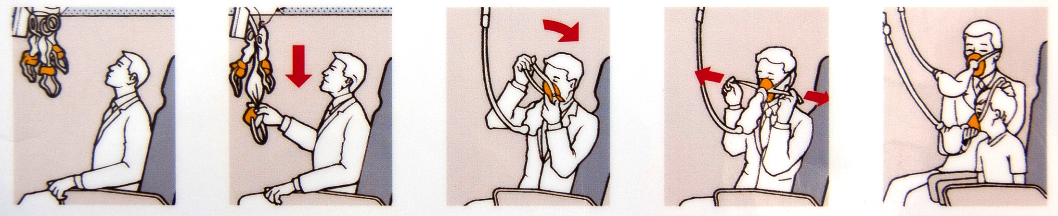
God is enough: Our needs are met in him, and what the world offers are dissatisfying trappings
In order to be a Godly Fathers, we must first be Gods children.

Slide 6
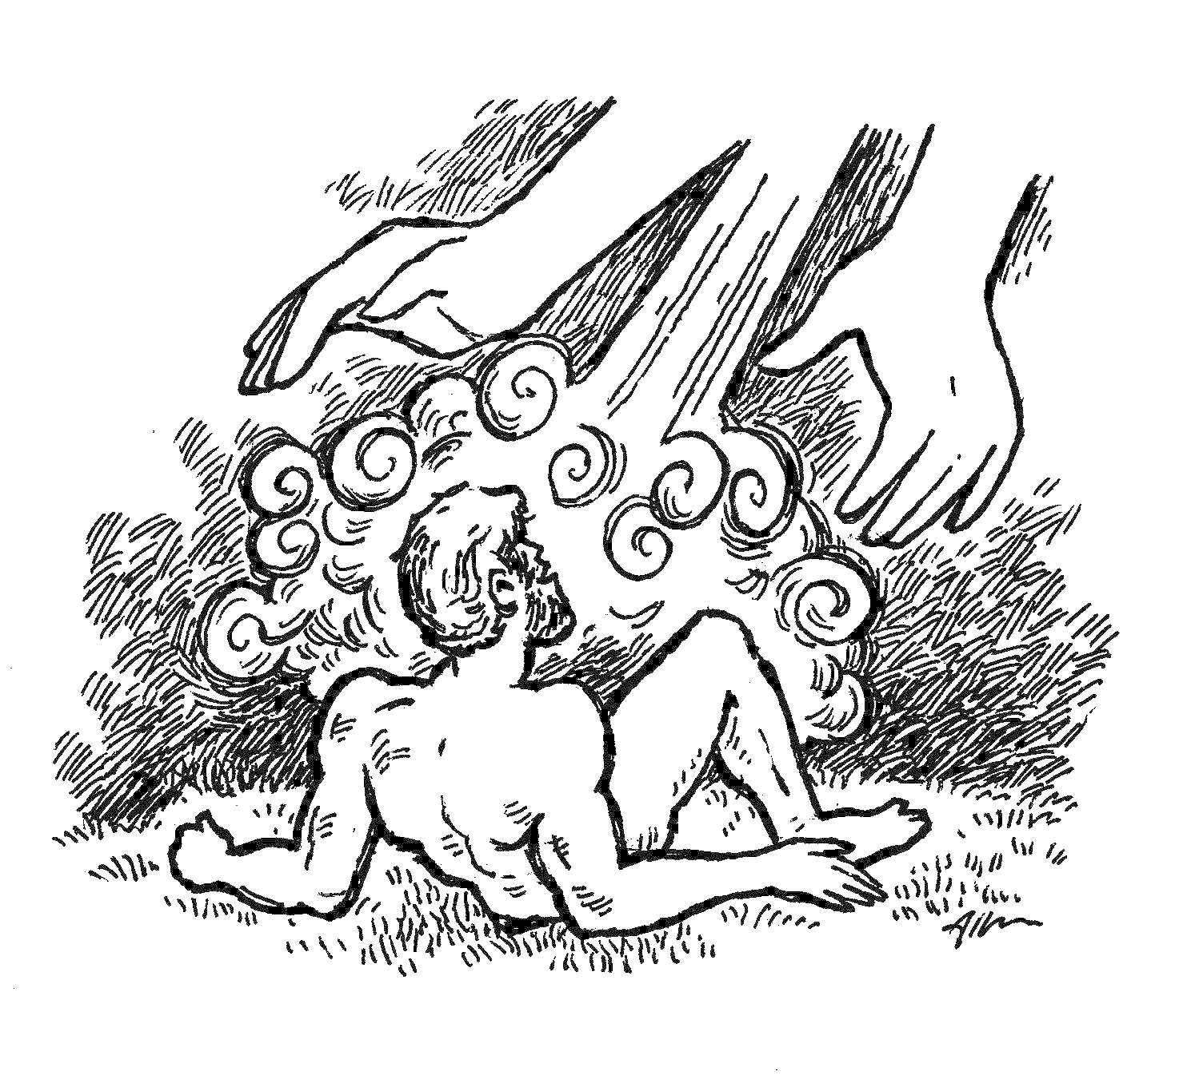
IN the beginning God created man, and when he did, God created man with needs
Genesis 2
Created man
Genesis 2:7 (KJV) 7 And the LORD God formed man [of] the dust of the ground, and breathed into his nostrils the breath of life; and man became a living soul.

Slide 7
IN the beginning God created man, and when he did, God created man with needs
Genesis 2
Provided safe haven
Genesis 2:8 (KJV) 8 And the LORD God planted a garden eastward in Eden; and there he put the man whom he had formed.

Slide 8
IN the beginning God created man, and when he did, God created man with needs
Genesis 2
Provided pleasantries, food, and structure
Genesis 2:9 (KJV) 9 And out of the ground made the LORD God to grow every tree that is pleasant to the sight, and good for food; the tree of life also in the midst of the garden, and the tree of knowledge of good and evil.

Slide 9
IN the beginning God created man, and when he did, God created man with needs
Genesis 2
Provided purpose
Genesis ‪2:15 (KJV) 15 And the LORD God took the man, and put him into the garden of Eden to dress it and to keep it.

Slide 10
IN the beginning God created man, and when he did, God created man with needs
Genesis 2
Provided boundaries
Genesis ‪2:16 (KJV) 16 And the LORD God commanded the man, saying, Of every tree of the garden thou mayest freely eat:17 But of the tree of the knowledge of good and evil, thou shalt not eat of it: for in the day that thou eatest thereof thou shalt surely die.

Slide 11
IN the beginning God created man, and when he did, God created man with needs
Genesis 2
Provided a companion and help meet
Genesis ‪2:18 (KJV) 18 And the LORD God said, [It is] not good that the man should be alone; I will make him an help meet for him.

Slide 12
IN the beginning God created man, and when he did, God created man with needs
Genesis 2
God created man with legitimate needs. Then he met all of those needs.
God spent T-I-M-E with Adam
So what happened?

Slide 13
IN the beginning God created man, and when he did, God created man with needs
Genesis 2
God created man with legitimate needs. Then he met all of those needs.
God spent T-I-M-E with Adam
So what happened?

Slide 14

Satan provided dissatisfying trappings
Genesis 3
Satan Challenged Gods Word
[Gen 3:1 KJV] 1 Now the serpent was more subtil than any beast of the field which the LORD God had made. And he said unto the woman, Yea, hath God said, Ye shall not eat of every tree of the garden?

Slide 15
Satan provided dissatisfying trappings
Genesis 3
Man Provides for himself
[Gen 3:6-7 KJV] 6 And when the woman saw that the tree [was] good for food, and that it [was] pleasant to the eyes, and a tree to be desired to make [one] wise, she took of the fruit thereof, and did eat, and gave also unto her husband with her; and he did eat. 7 And the eyes of them both were opened, and they knew that they [were] naked; and they sewed fig leaves together, and made themselves aprons.

Slide 16
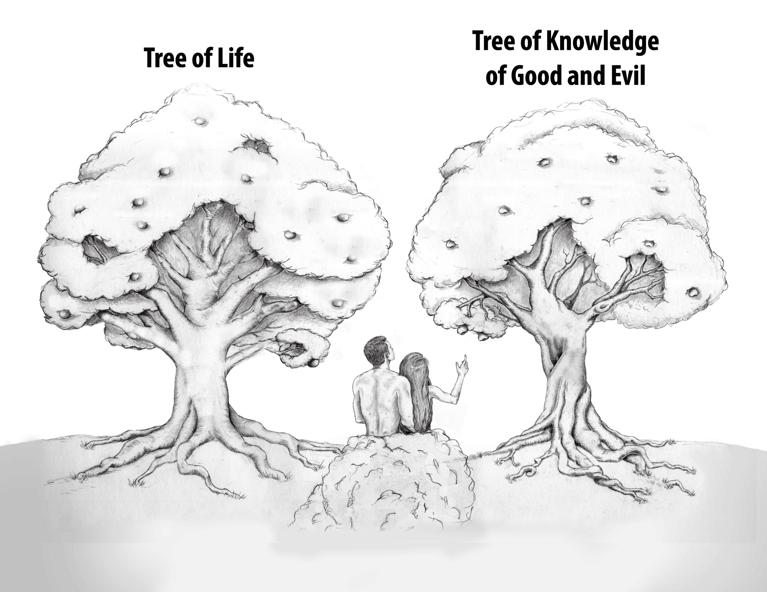

Slide 17
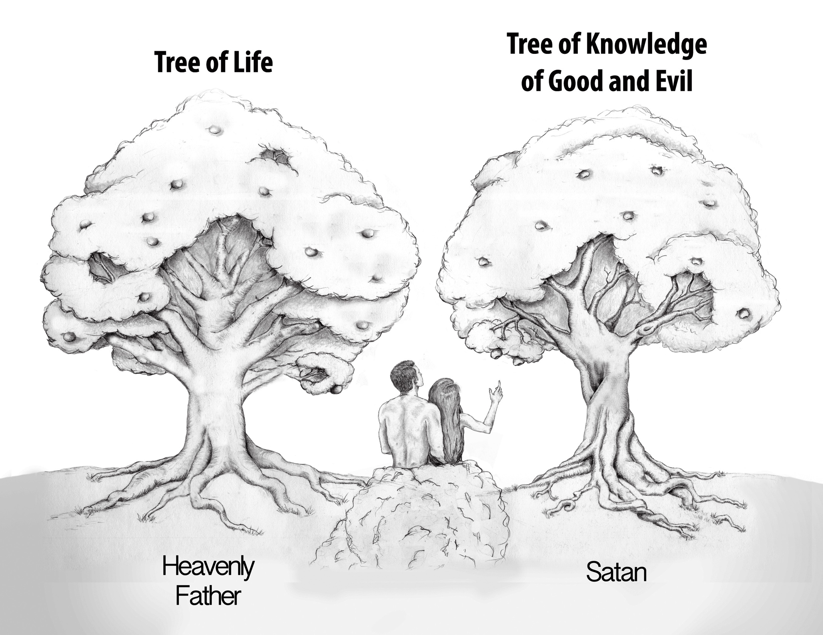


Slide 18
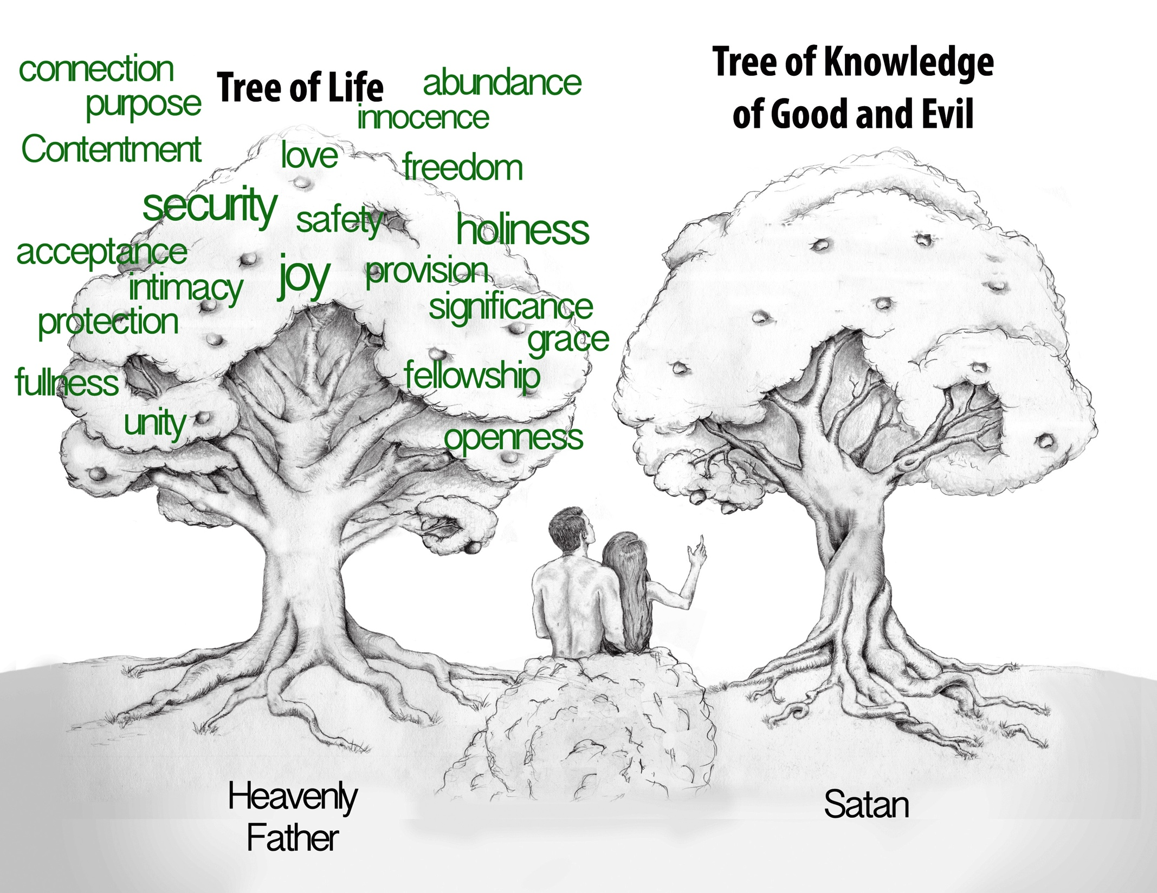

Slide 19
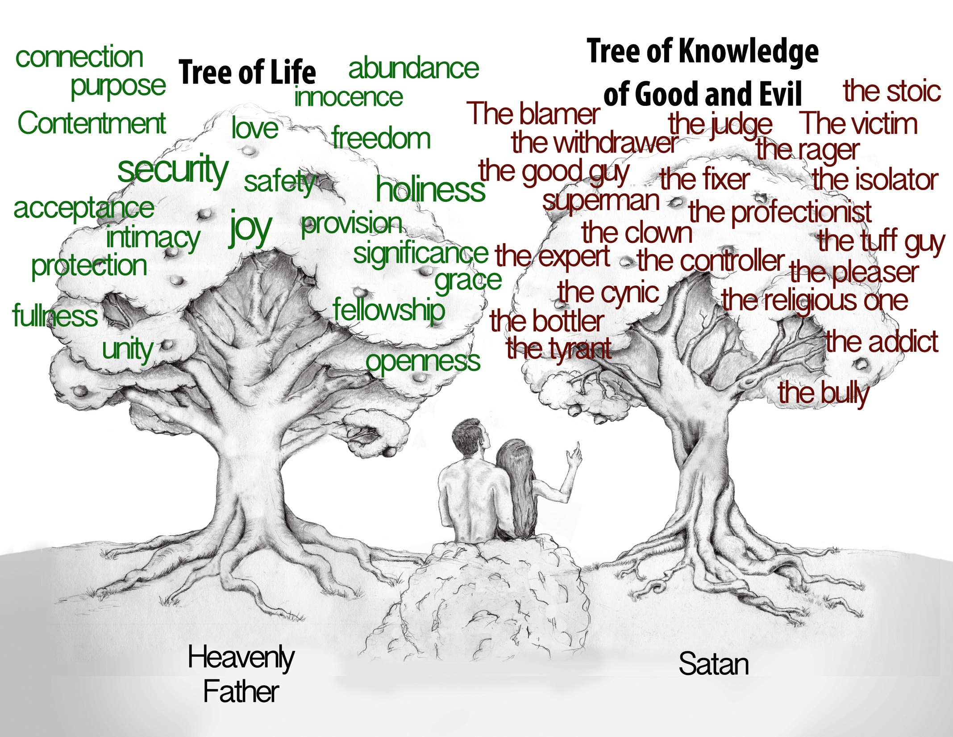

Slide 20

How can we be sure that WE are in a right relationship with our Heavenly Father?
John 8
We do what our father Taught us.
[Jhn 8:28 KJV] 28 Then said Jesus unto them, When ye have lifted up the Son of man, then shall ye know that I am [he], and [that] I do nothing of myself; but as my Father hath taught me, I speak these things.

Slide 21
How can we be sure that WE are in a right relationship with our Heavenly Father?
John 8
We do what Pleases our Father
[Jhn 8:29 KJV] 29 And he that sent me is with me: the Father hath not left me alone; for I do always those things that please him.

Slide 22
How can we be sure that WE are in a right relationship with our Heavenly Father?
John 8
We Listen and believe and when we do we are free.
[Jhn 8:30-32 KJV] 30 As he spake these words, many believed on him. 31 Then said Jesus to those Jews which believed on him, If ye continue in my word, [then] are ye my disciples indeed; 32 And ye shall know the truth, and the truth shall make you free.

Slide 23
How can we be sure that WE are in a right relationship with our Heavenly Father?
John 8
We Listen and believe and when we do we are free.
[Rom 8:15 KJV] 15 For ye have not received the spirit of bondage again to fear; but ye have received the Spirit of adoption, whereby we cry, Abba, Father.
[Gal 4:5 KJV] 5 To redeem them that were under the law, that we might receive the adoption of sons.

Slide 24
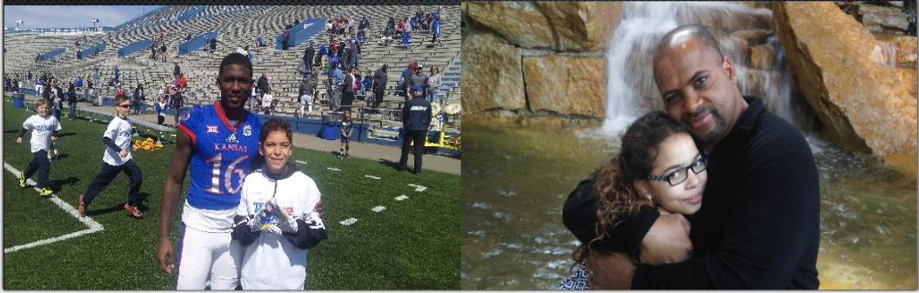
How did he do it?

Slide 25
How can we be sure that WE are in a right relationship with our Heavenly Father?
John 8
Not by relying on our heritage or Religion
[Jhn 8:33-44 KJV] 33 They answered him, We be Abraham's seed, and were never in bondage to any man: how sayest thou, Ye shall be made free? 34 Jesus answered them, Verily, verily, I say unto you, Whosoever committeth sin is the servant of sin. 35 And the servant abideth not in the house for ever: [but] the Son abideth ever. 36 If the Son therefore shall make you free, ye shall be free indeed.

Slide 26
How can we be sure that WE are in a right relationship with our Heavenly Father?
John 8
Not by relying on our Solutions
37 I know that ye are Abraham's seed; but ye seek to kill me, because my word hath no place in you. 38 I speak that which I have seen with my Father: and ye do that which ye have seen with your father. 39 They answered and said unto him, Abraham is our father. Jesus saith unto them, If ye were Abraham's children, ye would do the works of Abraham. 40 But now ye seek to kill me, a man that hath told you the truth, which I have heard of God: this did not Abraham.

Slide 27
How can we be sure that WE are in a right relationship with our Heavenly Father?
John 8
But by HEARING HIS WORDS
41 Ye do the deeds of your father. Then said they to him, We be not born of fornication; we have one Father, [even] God. 42 Jesus said unto them, If God were your Father, ye would love me: for I proceeded forth and came from God; neither came I of myself, but he sent me. 43 Why do ye not understand my speech? [even] because ye cannot hear my word. 44 Ye are of [your] father the devil, and the lusts of your father ye will do. He was a murderer from the beginning, and abode not in the truth, because there is no truth in him. When he speaketh a lie, he speaketh of his own: for he is a liar, and the father of it.

Slide 28
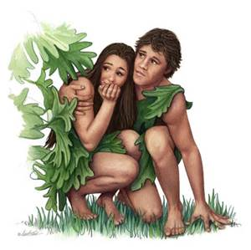
How can we be sure that WE are in a right relationship with our Heavenly Father?
Genesis 3
But by HEARING HIS WORDS
[Gen 3:8 KJV] 8 And they heard the voice of the LORD God walking in the garden in the cool of the day: and Adam and his wife hid themselves from the presence of the LORD God amongst the trees of the gard

Slide 29
Consequences of not being in a right relationship with our Heavenly Father?
Genesis 3
We get the worlds results
[Gen 3:9-12 KJV] 9 And the LORD God called unto Adam, and said unto him, Where [art] thou? 10 And he said, I heard thy voice in the garden, and I was afraid, because I [was] naked; and I hid myself. 11 And he said, Who told thee that thou [wast] naked? Hast thou eaten of the tree, whereof I commanded thee that thou shouldest not eat? 12 And the man said, The woman whom thou gavest [to be] with me, she gave me of the tree, and I did eat

Slide 30
How can we be sure that WE are in a right relationship with our Heavenly Father?
We must spend T-I-M-E with our Heavenly Father
We must see our propensity to Walk in the ways of the Father of this world.
We must see that its not about our religion, our solutions, but Hearing him, receiving His adoption and Following him.

