Slide 1
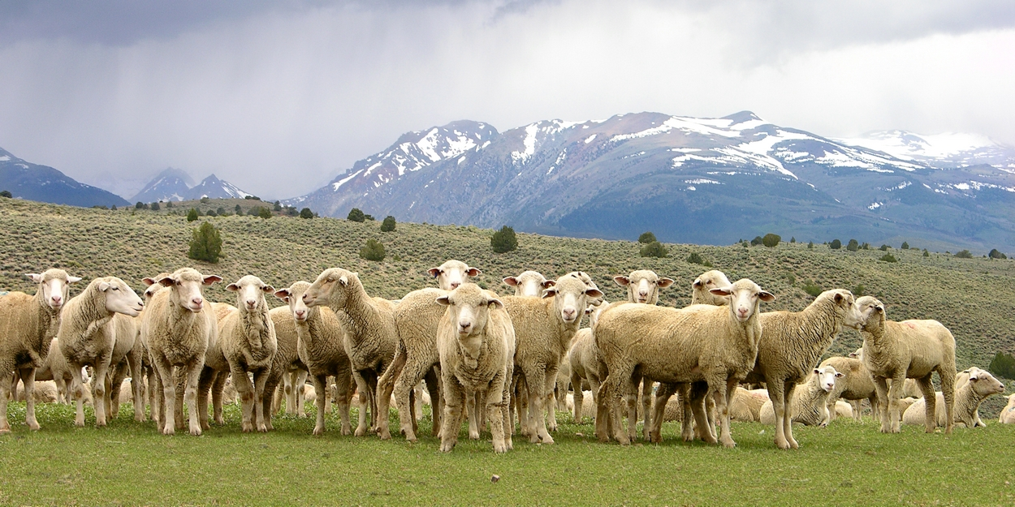
“Feed my sheep”
Rightly dividing 1Thessalonians by applying the principles of Bible study.

Slide 2
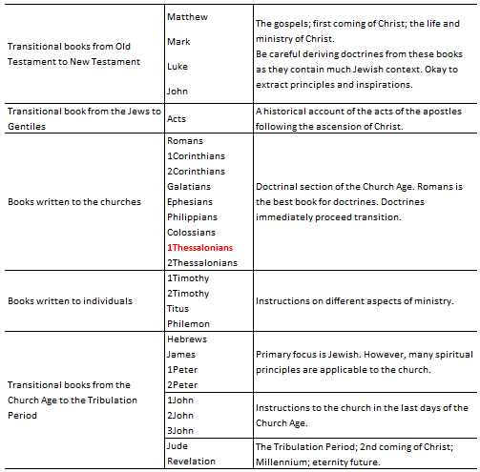
Bible Study Principle
All scripture is to be rightly divided
2Tim 2:15 Study to shew thyself approved unto God, a workman that needeth not to be ashamed, rightly dividing the word of truth.
The Principle of Time – Rightly dividing days and times.
The Bible is divided into several dispensations of God’s dealing with mankind. Ask “When was this written; in what dispensation?” O.T. and N.T. are two obvious dispensations.
Edenic/Innocence – before the fall of man
Conscience – following the fall of man before the Flood
Noahnic/Human government – The Flood to Abraham
Law – Moses to Jesus
Grace – 1st coming of Christ until rapture
Tribulation – Rapture to 2nd coming of Christ
Millennium – 2nd coming to the Great White Throne Judgment

Slide 3
Bible Study Principle
All scripture is to be rightly divided
2Tim 2:15 Study to shew thyself approved unto God, a workman that needeth not to be ashamed, rightly dividing the word of truth.
1Thessalonians 1:1 Paul, and Silvanus, and Timotheus, unto the church of the Thessalonians which is in God the Father and in the Lord Jesus Christ: Grace be unto you, and peace, from God our Father, and the Lord Jesus Christ.
The Principle of People Groups – Rightly dividing peoples.
The Bible is written to 3 groups of people: Jews, Gentiles, Church. 1Cor 10:32.
All of the Bible is written FOR you; not all of the Bible is directly TO you.
Ask yourself, “To whom is God speaking?”

Slide 4
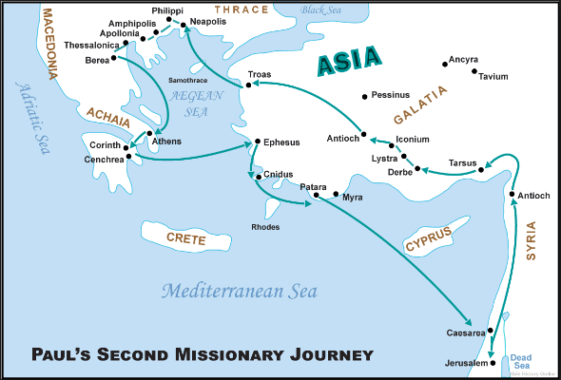
Historical: The Apostle Paul’s
2nd Missionary Journey Acts 15:36-18:22
Bible Study Principle
All scripture is to be rightly divided
2Tim 2:15 Study to shew thyself approved unto God, a workman that needeth not to be ashamed, rightly dividing the word of truth.
The Principle of Three Applications of Scripture – Rightly dividing the application of scripture.
All Scripture has one meaning in its natural context that can be applied in three ways: Historical, Doctrinal, Devotional
Historical application is simply story telling – anyone can do it.
Doctrinal application requires the enlightenment of the Holy Spirit, a correct heart attitude, prayers, and study.

Slide 5
1Thessalonians 1
Outline
Bible Study Principle
All scripture is to be rightly divided
2Tim 2:15 Study to shew thyself approved unto God, a workman that needeth not to be ashamed, rightly dividing the word of truth.
Divide each chapter into 2 to 4 sections.
The validation of the election of God – verses 1-4
  As demonstrated by the work of faith, labor of love, and patience of hope.
The validation of the Gospel – verse 5
  As demonstrated by the word of God, the power of God, the residence of the Holy Spirit, and the full assurance of the hope.
The validation of discipleship – verses 6-10
  As demonstrated by the steadfastness of faith, the fruitfulness of faith, the repentance from idols, and the patience of faith.
The Principle of Three Applications of Scripture – Rightly dividing the application of scripture.
All Scripture has one meaning in its natural context that can be applied in three ways: Historical, Doctrinal, Devotional
Historical application:
What was the historical, social, political, and cultural background of the book, chapter, verse?
Doctrinal application:
What is the Scripture directly teaching?
Personal application:
How can I apply this teaching or principle to my life?

Slide 6
1Thessalonians 2
Outline
Bible Study Principle
All scripture is to be rightly divided
2Tim 2:15 Study to shew thyself approved unto God, a workman that needeth not to be ashamed, rightly dividing the word of truth.
Divide each chapter into 2 to 4 sections.
In what manner the gospel was preached – verses 1-12
In what manner the gospel was received – verses 13-14
In what manner the Jews and Satan hinder the gospel – verses 15-20
The Principle of Three Applications of Scripture – Rightly dividing the application of scripture.
All Scripture has one meaning in its natural context that can be applied in three ways: Historical, Doctrinal, Devotional
Historical application:
What was the historical, social, political, and cultural background of the book, chapter, verse?
Doctrinal application:
What is the Scripture directly teaching?
Personal application:
How can I apply this teaching or principle to my life?

Slide 7
1Thessalonians 3
Outline
Bible Study Principle
All scripture is to be rightly divided
2Tim 2:15 Study to shew thyself approved unto God, a workman that needeth not to be ashamed, rightly dividing the word of truth.
Divide each chapter into 2 to 4 sections.
Faith that withstands afflictions – verses 1-6
Faith that comforts others of afflictions – verses 7-13
The Principle of Three Applications of Scripture – Rightly dividing the application of scripture.
All Scripture has one meaning in its natural context that can be applied in three ways: Historical, Doctrinal, Devotional
Historical application:
What was the historical, social, political, and cultural background of the book, chapter, verse?
Doctrinal application:
What is the Scripture directly teaching?
Personal application:
How can I apply this teaching or principle to my life?

Slide 8
1Thessalonians 4
Outline
Bible Study Principle
All scripture is to be rightly divided
2Tim 2:15 Study to shew thyself approved unto God, a workman that needeth not to be ashamed, rightly dividing the word of truth.
Divide each chapter into 2 to 4 sections.
Exhortation to sanctification – verses 1-8
Exhortation to increase in brotherly love – verses 9-12
Exhortation to comfort those who lost loved ones in Christ –
verses 13-18
The Principle of Three Applications of Scripture – Rightly dividing the application of scripture.
All Scripture has one meaning in its natural context that can be applied in three ways: Historical, Doctrinal, Devotional
Historical application:
What was the historical, social, political, and cultural background of the book, chapter, verse?
Doctrinal application:
What is the Scripture directly teaching?
Personal application:
How can I apply this teaching or principle to my life?

Slide 9
1Thessalonians 5
Outline
Bible Study Principle
All scripture is to be rightly divided
2Tim 2:15 Study to shew thyself approved unto God, a workman that needeth not to be ashamed, rightly dividing the word of truth.
Divide each chapter into 2 to 4 sections.
Exhortation to live a vigilant and sober life in anticipation of Christ’s return – verses 1-11
Exhortation to know and to love the church elders – verses 12-13
Misc exhortations – verses 14-28
The Principle of Three Applications of Scripture – Rightly dividing the application of scripture.
All Scripture has one meaning in its natural context that can be applied in three ways: Historical, Doctrinal, Devotional
Historical application:
What was the historical, social, political, and cultural background of the book, chapter, verse?
Doctrinal application:
What is the Scripture directly teaching?
Personal application:
How can I apply this teaching or principle to my life?

Slide 10
Which sections are more strongly emphasized by the writer?
1
The validation of the election of God – verses 1-4
The validation of the Gospel – verse 5
The validation of discipleship – verses 6-10
In what manner the gospel was preached – verses 1-12
In what manner the gospel was received – verses 13-14
In what manner the Jews and Satan hinder the gospel – verses 15-20
Faith that withstands afflictions – verses 1-6
Faith that comforts others of afflictions – verses 7-13
Exhortation to sanctification – verses 1-8
Exhortation to increase in brotherly love – verses 9-12
Exhortation to comfort those who lost loved ones in Christ – verses 13-18
Exhortation to live a vigilant and sober life in anticipation of Christ’s return – verses 1-11
Exhortation to know and to love the church elders – verses 12-13
Misc exhortations – verses 14-28
2
3
4
5

Slide 11
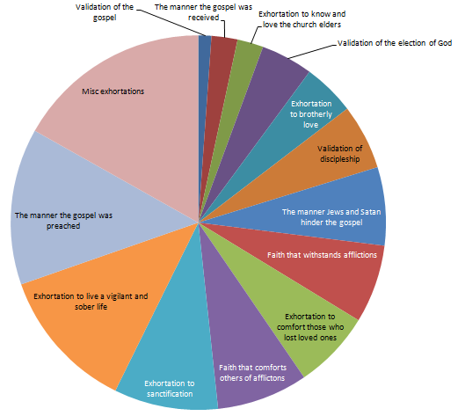
Bible Study Principle
The Principle of Measured Words
Proverbs 30:5 Every word of God is pure: he is a shield unto them that put their trust in him.
(6) Add thou not unto his words, lest he reprove thee, and thou be found a liar.
1
God measures His words and says what He wants us to know.
5
2
4
3
* Based on verse count

Slide 12
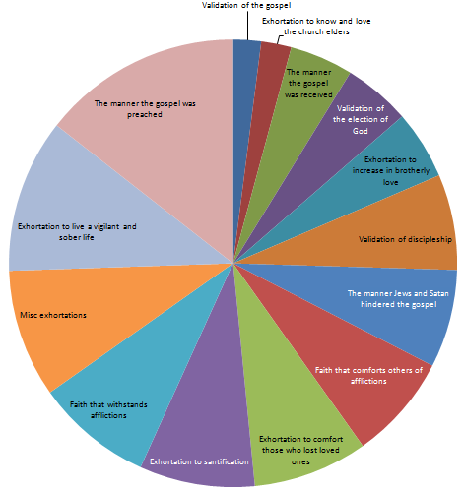
1
2
1
5
3
2
4
3
5
4
* Based on verse count
* Based on word count

Slide 13
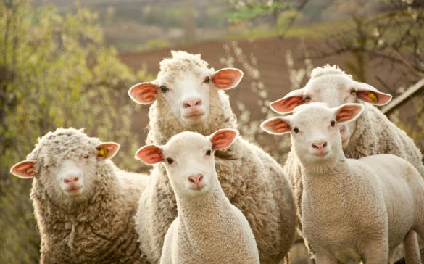
Top 3 Lessons from the principle of Measured Words
The manner the gospel was preached.
  Not academic credential, oratory, or presentation skills, but the “manner of men.”
  1Thes 1:5 For our gospel came not unto you in word only, but also in power, and in the Holy Ghost, and in much assurance; as ye know what manner of men we were among you for your sake.
  Good shepherd vs. Hireling
    A hireling sacrifices the sheep. A good shepherd sacrifices his life for the sheep.
    John 10:11 I am the good shepherd: the good shepherd giveth his life for the sheep.
    1Thes 2: 8 So being affectionately desirous of you, we were willing to have imparted unto you, not the gospel of God only, but also our own souls, because ye were dear unto us.

Slide 14
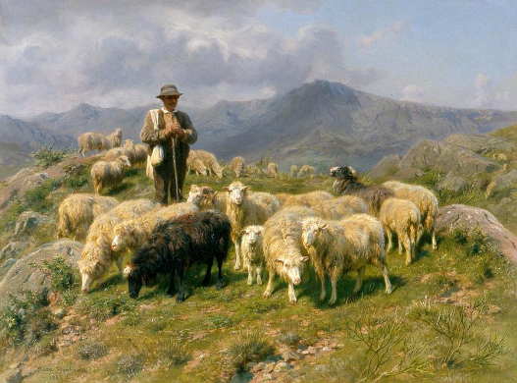
Top 3 Lessons from the principle of Measured Words
The manner the gospel was preached (cont…)
  Not academic credential, oratory, or presentation skills, but the “manner of men.”
  1Thes 1:5 For our gospel came not unto you in word only, but also in power, and in the Holy Ghost, and in much assurance; as ye know what manner of men we were among you for your sake.
  Good shepherd vs. Hireling
    The maturity of the faith of the believers kept the Apostle Paul up at night.
    1Thes 3:9 For what thanks can we render to God again for you, for all the joy wherewith we joy for your sakes before our God; (10) Night and day praying exceedingly that we might see your face, and might perfect that which is lacking in your faith?
    1Thes 3:1 Wherefore when we could no longer forbear, we thought it good to be left at Athens alone; (2) And sent Timotheus, our brother, and minister of God, and our fellowlabourer in the gospel of Christ, to establish you, and to comfort you concerning your faith.
    A good shepherd is fashioned and forged in the field.

Slide 15
Top 3 Lessons from the principle of Measured Words
Bible Study Principle
The Principle of Full Mention
  Definition of a good shepherd
  1Thes 2:1 For yourselves, brethren, know our entrance in unto you, that it was not in vain:
  2 But even after that we had suffered before, and were shamefully entreated, as ye know, at Philippi, we were bold in our God to speak unto you the gospel of God with much contention.
  3 For our exhortation was not of deceit, nor of uncleanness, nor in guile:
  4 But as we were allowed of God to be put in trust with the gospel, even so we speak; not as pleasing men, but God, which trieth our hearts.
  5 For neither at any time used we flattering words, as ye know, nor a cloke of covetousness; God is witness:
  6 Nor of men sought we glory, neither of you, nor yet of others, when we might have been burdensome, as the apostles of Christ.
  7 But we were gentle among you, even as a nurse cherisheth her children:
  8 So being affectionately desirous of you, we were willing to have imparted unto you, not the gospel of God only, but also our own souls, because ye were dear unto us.
  9 For ye remember, brethren, our labour and travail: for labouring night and day, because we would not be chargeable unto any of you, we preached unto you the gospel of God.
  10 Ye are witnesses, and God also, how holily and justly and unblameably we behaved ourselves among you that believe:
  11 As ye know how we exhorted and comforted and charged every one of you, as a father doth his children,
  12 That ye would walk worthy of God, who hath called you unto his kingdom and glory.
God declares His mind fully in regard to issues of vital importance.
Get the biblical definition for the particular subject of great importance. The passage may be a verse, verses, a chapter, or chapters. Use this key passage as a basis for understanding the various pieces that you find throughout the Bible.
Examples:
The good shepherd – 1Thes 2:1-12, John 10:1-18, 1Tim 3:1-7
The Gospel – 1Cor 15:1-4
Spiritual gifts – 1Cor 12-14
God’s love for mankind – John 3:16
God’s plan for Israel (past, present, & future) – Romans 9-11

Slide 16
What Worked
The Scorecard of the Church of Thessalonica
A
F
What Didn’t
A working faith – “work of faith” 1Thes 1:3, 3:6
A charitable faith – “labor of love” 1Thes 1:3, 4:9-10
A steadfast faith – “patience of hope”
A living testimony – 1Thes 1:5-10
Wisdom to discern the good ministers from the wolves in sheep’s clothing – 1Thes 2:1-12
Wisdom to receive the word of God as truth – 1Thes 2:13
Wisdom to be disciples – 1Thes 1:6, 2:14
Brotherly love – 1Thes 4:9-10
Issue with fornication – 1Thes 4:3-8
Ignorant of eschatology – 1Thes 4:11-18, 5:1-5
A good shepherd knows the state of the flock and admonishes the sheep accordingly.
The maturity of the faith of the believers kept the Apostle Paul up at night – 1Thes 3:9-10, 1-2. A mature faith gets an “A” in everything.
B

Slide 17
Top 3 Lessons from the principle of Measured Words
Live a watchful and sober life in anticipation of Christ’s return.
  1Thes 5:4 But ye, brethren, are not in darkness, that that day should overtake you as a thief.
  5 Ye are all the children of light, and the children of the day: we are not of the night, nor of darkness.
  6 Therefore let us not sleep, as do others; but let us watch and be sober.
  7 For they that sleep sleep in the night; and they that be drunken are drunken in the night.
  8 But let us, who are of the day, be sober, putting on the breastplate of faith and love; and for an helmet, the hope of salvation.
  Be assured that “the day of the Lord” will come.
    Also referred to as “The day” or “That day.”
    Context: The second coming of the Lord Jesus Christ.
    Two major biblical events precede this: Rapture of the church and Tribulation.
    What is it like? Mal 4:1, Joel, Zec 12-14
    Apply the principles of first and full mention.
  Be awake.
  Be watchful.
  Be sober.

Slide 18
Top 3 Lessons from the principle of Measured Words
Live a watchful and sober life in anticipation of Christ’s return.
  1Thes 5:6 Therefore let us not sleep, as do others; but let us watch and be sober.
  Be Awake
  And be about the Father’s business.
    Romans 13:11 And that, knowing the time, that now it is high time to awake out of sleep: for now is our salvation nearer than when we believed. (12) The night is far spent, the day is at hand: let us therefore cast off the works of darkness, and let us put on the armour of light. (13) Let us walk honestly, as in the day; not in rioting and drunkenness, not in chambering and wantonness, not in strife and envying. (14) But put ye on the Lord Jesus Christ, and make not provision for the flesh, to fulfil the lusts thereof.
    1Corinthians 15:34 Awake to righteousness, and sin not; for some have not the knowledge of God: I speak this to your shame.
  Be watchful
  Watch over ourselves, our hearts, thoughts, affections, words and actions, and give not into bad principles and sinful practices.
    Mark 13:37 And what I say unto you I say unto all, Watch.
    Mark 14:38 Watch ye and pray, lest ye enter into temptation. The spirit truly is ready, but the flesh is weak.

Slide 19
Top 3 Lessons from the principle of Measured Words
Live a watchful and sober life in anticipation of Christ’s return.
  1Thes 5:6 Therefore let us not sleep, as do others; but let us watch and be sober.
  Be sober
  Be not intoxicated with the world, which chokes the Word and makes us unfruitful.
  Realize that we are in a foxhole inside the enemy’s territory.
  1Thes 5:8 But let us, who are of the day, be sober, putting on the breastplate of faith and love; and for an helmet, the hope of salvation.
  Ephesians 6:11-18
  1Peter 5:8 Be sober, be vigilant; because your adversary the devil, as a roaring lion, walketh about, seeking whom he may devour.

Slide 20

Top 3 Lessons from the principle of Measured Words
Exhortation to Sanctification
Issue with fornication – 1Thes 4:3-8
1Cor 6:9 Know ye not that the unrighteous shall not inherit the kingdom of God? Be not deceived: neither fornicators, nor idolaters, nor adulterers, nor effeminate, nor abusers of themselves with mankind, (10) Nor thieves, nor covetous, nor drunkards, nor revilers, nor extortioners, shall inherit the kingdom of God. (11) And such were some of you: but ye are washed, but ye are sanctified, but ye are justified in the name of the Lord Jesus, and by the Spirit of our God. Read 1Cor 6:9-18.
Read 1Cor 6:9-18, Gal 5:19-21, Eph 5:1-20, Col 3:1-7

Slide 21
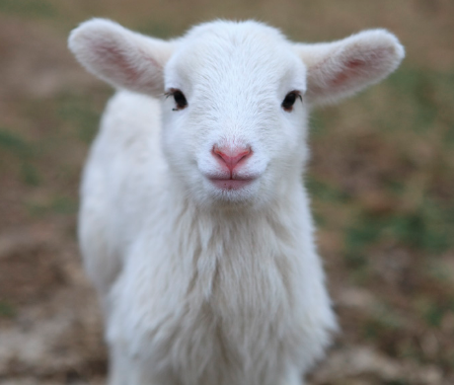
1Thessalonians
“Feed my sheep”
Bible Study Principles applied
The principle of Time
The principle of People Groups
The principle of Three Applications of Scripture
The principle of Context
The principle of Measured Words
The principle of Full Mention

