Slide 1
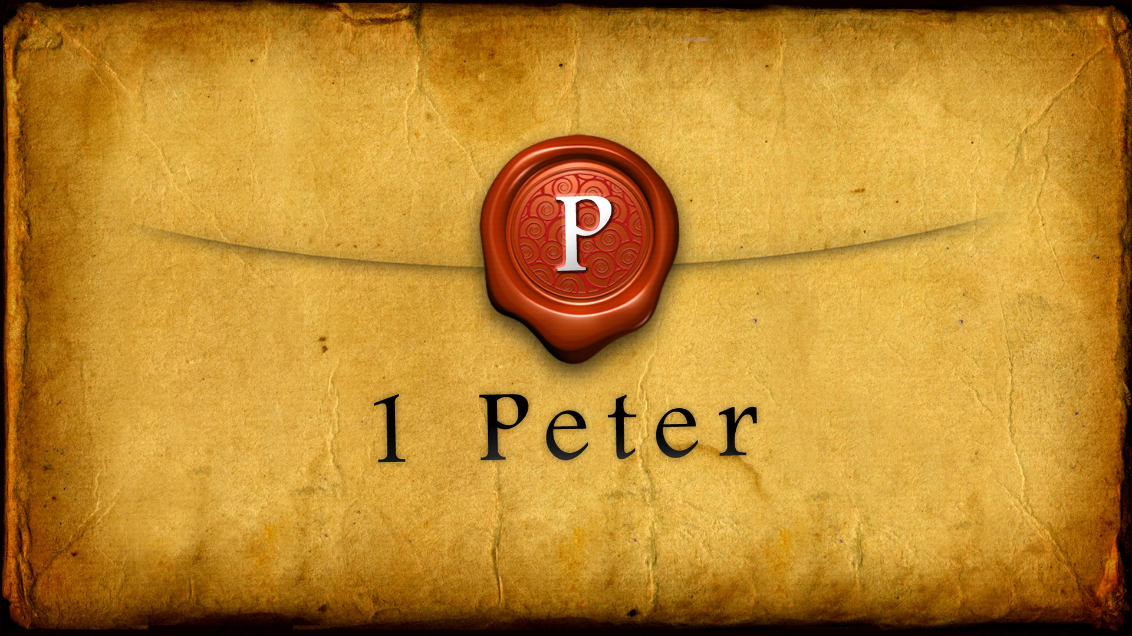

Slide 2

The Notecard
Author:
Peter
Theme:
God’s grace is sufficient
Chapters:
5
Outline:
Salvation (Chap 1)
Sanctification (Chap 2 & 3)
Suffering (Chap 4)
Serving (Chap 5)
Anchor verse:
5:12 - By Silvanus, a faithful brother unto you, as I suppose, I have written briefly, exhorting, and testifying that this is the true grace of God wherein ye stand.
Notes:
1 Peter outlines in so many different ways. I couldn’t wrap my head around it, so I finally started looking for some help. That’s when I discovered 4 almost completely different outlines of 1 Peter. So I

Slide 3
The Outline
Salvation 1:3-25
  The hope of salvation vs. 3-5
  The joy of salvation vs. 6-9
  The inquiry into salvation vs. 10-12
  The new life of salvation vs. 13-16
  The redemption of salvation vs. 17-21
  The new birth of salvation vs. 22-25

Slide 4
The Outline
Sanctification 2-3
  The sustenance of sanctification vs. 1-3
  The structure of sanctification vs. 4-8
  The society of sanctification vs. 9-10
  The service of sanctification vs. 11-17
  The suffering of sanctification vs. 18-20
  The Shepherd of sanctification vs. 21-25
  The spousal duties of sanctification 3:1-7
  The speech of sanctification 3:8-12
  The seat of sanctification 3:13-17
  The Savior of sanctification 3:18-22

Slide 5
The Outline
Suffering 4
  The present response to suffering vs. 1-11
  The future hope of suffering vs. 12-19
Serving 5:1-11
  The charge to the elders vs. 1-4
  The instructions to the suffering church vs. 5-10
  The Doxology vs. 11

Slide 6
The Anchor Verse
1Pe 5:12 – By Silvanus, a faithful brother unto you, as I suppose, I have written briefly, exhorting, and testifying that this is the true grace of God wherein ye stand.

Slide 7
Our Example of Suffering
2:21 – 25
v2:21 – For even hereunto were ye called: because Christ also suffered for us, leaving us an example, that ye should follow his steps:
Acts 11:26b – And the disciples were called Christians first in Antioch.
The suffix “ian” means to have the same meaning or properties as

Slide 8
Our Example of Suffering - 2:21 – 25
2:22-23 – Who did no sin, neither was guile found in his mouth: ²³Who, when he was reviled, reviled not again; when he suffered, he threatened not; but committed himself to him that judgeth righteously:
Jas 3:2 – For in many things we offend all. If any man offend not in word, the same is a perfect man, and able also to bridle the whole body.
Heb 9:27 And as it is appointed unto men once to die, but after this the
2Co 5:10 For we must all appear before the judgment seat of Christ; that every one may receive the things done in his body, according to that he hath done, whether it be good or bad.
judgment:

Slide 9
Our Example of Suffering - 2:21 – 25
2:24 Who his own self bare our sins in his own body on the tree, that we, being dead to sins, should live unto righteousness: by whose stripes ye were healed.
1Pe 4:8 And above all things have fervent charity among yourselves: for charity shall cover the multitude of sins.

Slide 10
Likewise
1Pe 3:1 Likewise, ye wives, be in subjection to your own husbands; that, if any obey not the word, they also may without the word be won by the conversation of the wives;
1Pe 3:2 While they behold your chaste conversation coupled with fear.
1Pe 3:7 Likewise, ye husbands, dwell with them according to knowledge, giving honour unto the wife, as unto the weaker vessel, and as being heirs together of the grace of life; that your prayers be not hindered.

Slide 11
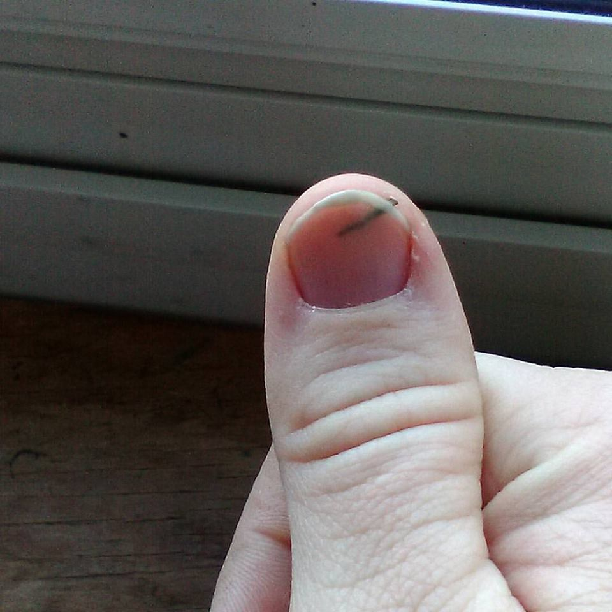
Choices
Basically here you have 2 choices:
Leave it in
Pull the splinter out

