Slide 1


Slide 2
Up From the Grave He Arose
Low in the grave He lay, Jesus my Savior!
Waiting the coming day, Jesus my Lord!

Slide 3
Up From the Grave He Arose
Up from the grave He arose,
With a mighty triumph o'er His foes;
He arose a victor from the dark domain,
And He lives forever with His saints to reign,
He arose! He arose! Hallelujah! Christ arose!

Slide 4
Up From the Grave He Arose
Vainly they watch His bed, Jesus my Savior!
Vainly the seal the dead, Jesus my Lord!

Slide 5
Up From the Grave He Arose
Up from the grave He arose,
With a mighty triumph o'er His foes;
He arose a victor from the dark domain,
And He lives forever with His saints to reign,
He arose! He arose! Hallelujah! Christ arose!

Slide 6
Up From the Grave He Arose
Death cannot keep his prey, Jesus my Savior!
He tore the bars away, Jesus my Lord!

Slide 7
Up From the Grave He Arose
Up from the grave He arose,
With a mighty triumph o'er His foes;
He arose a victor from the dark domain,
And He lives forever with His saints to reign,
He arose! He arose! Hallelujah! Christ arose!

Slide 8
Hallelujah Thine the Glory

Slide 9
We praise Thee, O God! for the Son of Thy love, for Jesus who died, and is now gone above.

Slide 10
Hallelujah! Thine the glory. Hallelujah! Amen. Hallelujah! Thine the glory. Revive us again.

Slide 11
We praise Thee, O God! for Thy Spirit of light, who hath shown us our Savior, and scattered our night.

Slide 12
Hallelujah! Thine the glory. Hallelujah! Amen. Hallelujah! Thine the glory. Revive us again.

Slide 13
All glory and praise to the Lamb that was slain, who hath borne all our sins, and hath cleansed every stain.

Slide 14
Hallelujah! Thine the glory. Hallelujah! Amen. Hallelujah! Thine the glory. Revive us again.

Slide 15
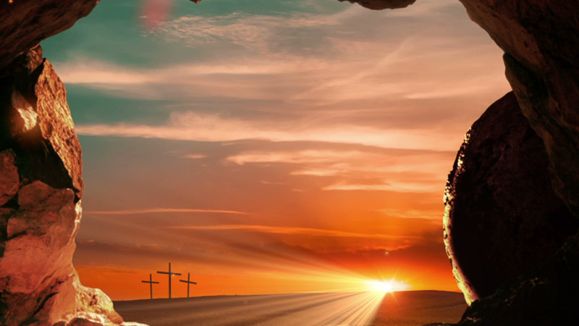
Easter
LWC 2018

Slide 16
Review:
God is Merciful. Jonah was not.

Slide 17
Acts 12:1-3

Slide 18
1. Now about that time...: Context: Gospel going to the Gentiles. See Acts 11.

Slide 19
1. Now about that time...: Context: Gospel going to the Gentiles. See Acts 11. An assembly (not a synagogue) is established at Antioch, as the gospel has gone out from Jerusalem.

Slide 20
1. Because it pleased the Jews that he killed James with the sword, Herod took Peter also. What!

Slide 21
3. Days of unleavened bread: This is a feast associated with the Passover. See Lev 23.

Slide 22
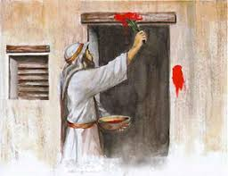
Exodus 12

Slide 23
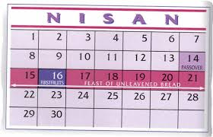

Slide 24
Ps 118:21-26
I will praise thee: for thou hast heard me, and art become my salvation.
The stone which the builders refused is become the head stone of the corner.
This is the LORD'S doing; it is marvellous in our eyes.
This is the day which the LORD hath made; we will rejoice and be glad in it.
Save now, I beseech thee, O LORD: O LORD, I beseech thee, send now prosperity.
Blessed be he that cometh in the name of the LORD: we have blessed you out of the house of the LORD.

Slide 25
Verse 4
What about Easter?

Slide 26
The word translated Easter is elsewhere translated Passover (every time).

Slide 27
A. In Acts 12:4 it is translated Easter. It is ridiculous to attribute this as a translation error!

Slide 28
The word Easter is translated from has nothing to do with Ishtar!

Slide 29
Easter has replaced Passover for the church.

Slide 30
(2) That which was foreshadowed by the Passover, occurred with the death, burial, and resurrection of Christ. There is no need for continued hints once the big reveal is over.

Slide 31
The law (including the Passover) was fulfilled. We walk in newness of life (1 Co 5:1-8)

Slide 32
The Lamb has been slain once and for all. We have a finished work, not a religious work. Beginning of a new day—at sunrise, not end of the day, at sunset….We gather together in victory, not in bondage!

