Slide 1
Book of James Overview

Slide 2
The Notecard
Author:
James
Theme: The evidence of faith is good works
Chapters:
5
Outline:
Testing Faith (Chap 1 & 2)
Faith tested by the tongue (Chap 3)
Rebuke of worldliness (Chap 4)
Warning to the rich (5:1 - 6)
Exhortation (5:7 - 20)
Anchor verse: James 2:26
Notes:
James is the first epistle not written by Paul

Slide 3
Outline
Testing Faith (Chap 1 & 2)
  Character (1:1 – 18)
  Hearing and Doing (1:19 – 27)
  Respect of persons (2:1 – 13)
  Evidence of faith (2:14 – 26)
Faith tested by the tongue (Chap 3)
Rebuke of worldliness (Chap 4)
Warning to the rich (5:1 - 6)
Exhortation (5:7 - 20)
Notes:
I. Testing of Faith
A. Anchor: Jas 1:12 Blessed is the man that endureth temptation: for when he is tried, he shall receive the crown of life, which the Lord hath promised to them that love him.
B. Anchor: Jas 1:22 But be ye doers of the word, and not hearers only, deceiving your own selves.
C. Anchor: Jas 2:8 If ye fulfil the royal law according to the scripture, Thou shalt love thy neighbour as thyself, ye do well:
Jas 2:9 But if ye have respect to persons, ye commit sin, and are convinced of the law as transgressors.
D. Anchor: Jas 2:26 – anchor verse for the book. We’ll go into a little more depth in a bit.
II. We’ll get into this in more depth too.
III. Two points: James 4:2 – Ye have not because ye ask not; and James 4:3 – Ye ask and receive not because ye ask amiss
IV. James clearly has some issues with rich people. This doesn’t really apply to us very easily. Early Christians and Christians in the tribulation were/will be very poor. For us, don’t defraud people. The Lord is a righteous judge. Don’t make him have to deal with you.
V. Jas 5:16 Confess your faults one to another, and pray one for another, that ye may be healed. The effectual fervent prayer of a righteous man availeth much.

Slide 4
Anchor Verse
James 2:26 – For as the body without the spirit is dead, so faith without works is dead also.
Jas 2:15-16 – If a brother or sister be naked, and destitute of daily food, ¹⁶And one of you say unto them, Depart in peace, be ye warmed and filled; notwithstanding ye give them not those things which are needful to the body; what doth it profit?
Notes:
There are a couple examples that lead into this verse:
James 2:15-16 - If a brother or sister be naked, and destitute of daily food, ¹⁶And one of you say unto them, Depart in peace, be ye warmed and filled; notwithstanding ye give them not those things which are needful to the body; what doth it profit?
What would the good Samaritan story look like without works? Luke 10:25-37. Don’t read it, summarize what happened.
“Be ye whole and your raiment and mammon restored!” Did it help?
Lev 19:34, Deut 10:18-19, Exo 23:9, Mal 3:5, Prov 3:27, 19:17
Will’s story about receiving money and “Jesus loves you” from a woman.
Will had an unconventional upbringing.
A woman offered money to feed Will and his dad. She said “Jesus loves you” when she gave the money to Will. So what made that moment stick in Will’s memory? Was it the prayers she almost certainly offered up? It was that work produced by the faith that God would use a $20 bill and a simple “Jesus loves you” to save a soul or two.
The story of Abraham sacrificing Isaac. Abraham had faith that God would raise Isaac from the dead>
Heb 11:19 Accounting that God was able to raise him up, even from the dead; from whence also he received him in a figure.
What would that look like if Abraham had faith that God would raise Isaac from the dead, but didn’t do the work of faith. “Yeah, yeah, God, I know you’ll raise Isaac from the dead after I sacrifice him. I believe it with my whole heart. So, I’m going to go back in my tent and forget about you telling me to sacrifice him.”

Slide 5
Chapter 3 – Taming the Tongue
James 3:2 – For in many things we offend all. If any man offend not in word, the same is a perfect man, and able also to bridle the whole body.
James 3:3-4 – Behold, we put bits in the horses' mouths, that they may obey us; and we turn about their whole body. ⁴Behold also the ships, which though they be so great, and are driven of fierce winds, yet are they turned about with a very small helm, whithersoever the governor listeth.
Notes:
This is the goal. If we can control our mouth, we can control our entire body. Don’t ask Marla about this because she might lie out of love or to protect my reputation, and I don’t want her to be enticed into lying; but, I don’t speak kindly to my wife as I ought. I can give 100 excuses, but the truth is that I’m not a mature believer and I’m not full of faith, at least not enough to control that devil that lives in my mouth.
To use a Kyleism, when I preach this, I’m not preaching to you, I’m preaching to me.

Slide 6
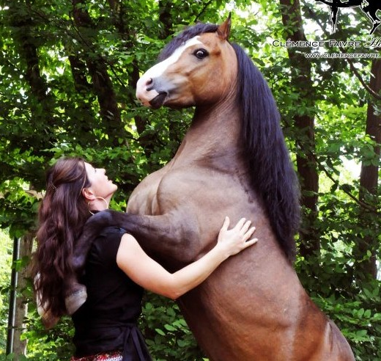
Chapter 3 – Taming the Tongue
That huge horse can be controlled with a small piece of metal and a leather strap.
Notes:
Your average walking horse weighs around 1,000 lbs. The Welsh pony pictured only weighs about 625 lbs. So, yeah, a horse can crush a person.

Slide 7
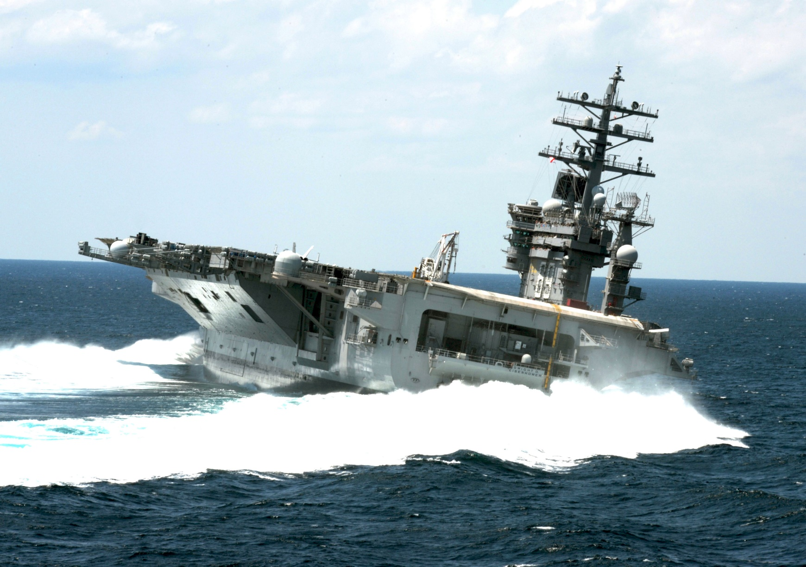
Chapter 3 – Taming the Tongue
Notes:
This is CVN 69. USS Dwight D Eisenhower. It is a carrier which means it is big enough to have airplane take off and land on it.
Overall length is 1,092 ft (longer than 3 football fields). There are 2 rudders, each 29’ x 22’. The rudder (assuming it’s 29’ wide) is about 2.5% of the length of the ship. I watched a video. A carrier this size can turn 90 degrees in 1 minute.
What’s the point. Something really little can affect a lot of change: for better or worse.

Slide 8
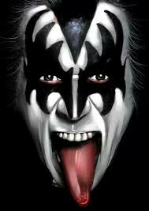
Chapter 3 – Taming the Tongue
James 3:5-6
Even so the tongue is a little member, and boasteth great things. Behold, how great a matter a little fire kindleth! ⁶And the tongue is a fire, a world of iniquity: so is the tongue among our members, that it defileth the whole body, and setteth on fire the course of nature; and it is set on fire of hell.
Matthew 15:11
Not that which goeth into the mouth defileth a man; but that which cometh out of the mouth, this defileth a man.
Notes:
This is kind of a big deal.
Verse 7 talks about man having tamed all the animals of the world. Horses … tamed! Elephants … tamed! Lions and tigers and bears … tamed! We don’t have to “Oh my” them anymore. That tiny little hunk of muscle in our mouths and it cannot be tamed.
Jesus said it best in Matthew. Think about the show “Fear Factor”. Did you make character judgements about people on the show based on what they ate? We might have thought they were crazy, or even admired them for doing something we couldn’t. But you probably dind’t think this person is a “good person” or that one is a “bad person” based on what they ate on the show.
How do we tame the untamable?
Eph 4:29
1 Pet 3:10
Titus 3:2
Col 3:7-8; 4:6

Slide 9
Chapter 3 – Taming the Tongue
James 9,11-12
Therewith bless we God, even the Father; and therewith curse we men, which are made after the similitude of God. ¹¹Doth a fountain send forth at the same place sweet water and bitter? ¹²Can the fig tree, my brethren, bear olive berries? either a vine, figs? so can no fountain both yield salt water and fresh.
James 3:10
Out of the same mouth proceedeth blessing and cursing. My brethren, these things ought not so to be.
Notes:
These things aught not be so – The world will see us as hypocrites. No one will want to be like us. And it just doesn’t make sense. You love Jesus, but you hate his creation … the same creation that he loved enough to die for?
How do we tame the untamable?
James 3:8 makes it clear. We CAN’T tame our tongue. A dead man offends no one with his words. Because he doesn’t speak any words!
For you and me the command comes from Romans:
Rom 6:11 Likewise reckon ye also yourselves to be dead indeed unto sin, but alive unto God through Jesus Christ our Lord.
Eph 4:29
1 Pet 3:10
Titus 3:2
Col 3:7-8; 4:6

Slide 10
Conclusion
People should be able to see your faith through your works.
People should be able to hear Christ in your words.

