Slide 1
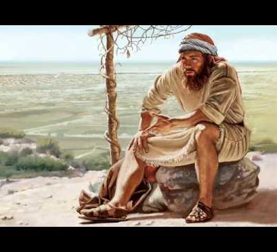
Jonah 4:5
Jonah, on the “Outs”

Slide 2
Review
1. Review: Anger arises from displeasure, can reveal a difference between God and man, can lead to drama and despair.

Slide 3
In verse 5 we find Jonah on the “outs”. He is out of:
A. Sync– out of tune with God and God’s mission. (Isa 55:1-13)

Slide 4
In verse 5 we find Jonah on the “outs”. He is out of:
A. Sync– out of tune with God and God’s mission. (Isa 55:1-13)
B. Service-Out of the city where God is working. There is a tremendous amount of work...

Slide 5
In verse 5 we find Jonah on the “outs”. He is out of:
A. Sync– out of tune with God and God’s mission. (Isa 55:1-13)
B. Service-Out of the city where God is working. There is a tremendous amount of work...
C. Sorts—Angry, Miserable! (Prov 19:3)

Slide 6
In verse 5 we find Jonah on the “outs”. He is out of:
A. Sync– out of tune with God and God’s mission. (Isa 55:1-13)
B. Service-Out of the city where God is working. There is a tremendous amount of work...
C. Sorts—Angry, Miserable! (Prov 19:3)
D. Society—He chooses to be isolated. (Isa 65:5, Jude 1:19)

Slide 7
In verse 5 we find Jonah on the “outs”. He is out of:
A. Sync– out of tune with God and God’s mission. (Isa 55:1-13)
B. Service-Out of the city where God is working. There is a tremendous amount of work...
C. Sorts—Angry, Miserable! (Prov 19:3)
D. Society—He chooses to be isolated. (Isa 65:5, Jude 1:19)
E. Spiritual Families—He has no place in the world, but refuses the place God has for him (1Jn 1:1-4).

Slide 8
Personal Application
A. Understand I have no place in this world because I died.

Slide 9
The machinations of the lost world are still there, they are just not for us anymore.

Slide 10
Personal Application
B. Understand I do have a place in God’s mission to make disciples.

Slide 11
Personal Application
Understand that involvement in God’s Mission is the source of fulfillment for believers because self-actualization for the Christian is not finding my place or getting my way in this world, but rather, having escaped this world and its ways, finding my place with God, in His Kingdom.

