Slide 1
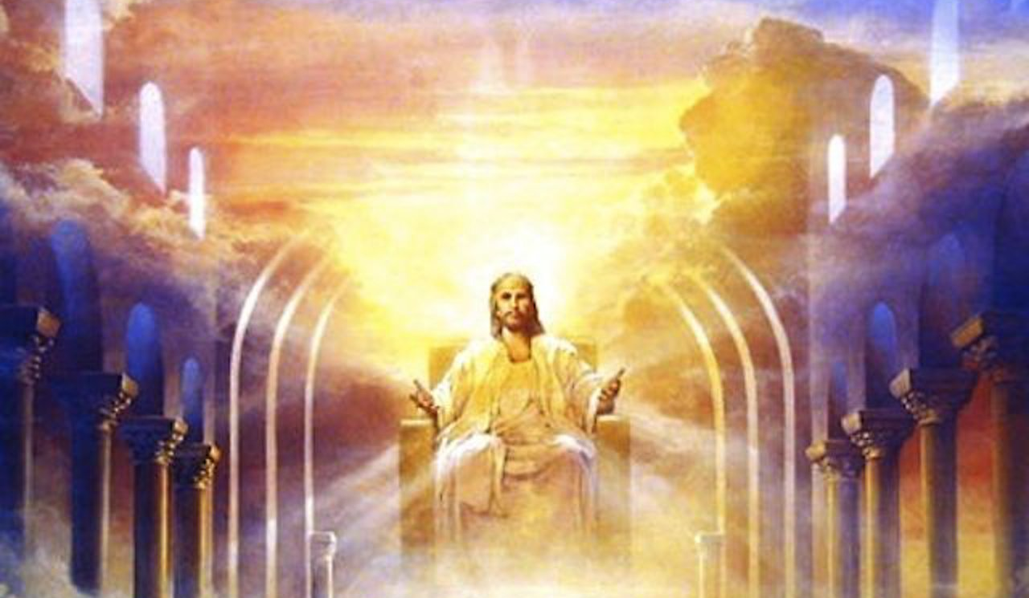
Romans 2:6-16: God’s Courtroom
What? Are we saved by works?

Slide 2
Romans 2:6-16: God’s Courtroom
No, we are judged by what we do with the truth, not by what we do otherwise.

Slide 3
Romans 2:6-16: God’s Courtroom
These verses continue what we covered last week in 2:1-6: Any person who has done the things they know are wrong (because they judge it as wrong when others do it) are w/o excuse before God.

Slide 4
Romans 2:6-16: God’s Courtroom
Well-doing in verse 7 is explained by the contrast in V.8.
All will obey the truth or unrighteousness. Obeying the truth = Faith. 2 Th 1:8, Rom 1:17-18, 6:17.

Slide 5
Romans 2:6-16: God’s Courtroom
A. The Law (V.12-15) With or without it , based on what people do.

Slide 6
Romans 2:6-16: God’s Courtroom DC
B. The Gospel: (V.16) Remember Paul is the Apostle to the Gentiles. His gospel is the measure of righteousness for the church age.

Slide 7
Romans 2:6-16: God’s Courtroom
4. The Courtroom: Judge: God (by Jesus) 2:16, Jn 5:22, Acts 17:30-31). Defendants: Humanity 2:11

Slide 8
Romans 2:6-16: God’s Courtroom
Indictment (charges): 10 crimes of unrighteousness and ungodliness. Rom 1:18-27.

Slide 9
Romans 2:6-16: God’s Courtroom
Witnesses:
Conscience (Rom 1:19) and Nature (Rom 1:20).

Slide 10
Romans 2:6-16: God’s Courtroom
Witnesses:
Since all are exposed to these two witnesses, all are exposed by them.

Slide 11
Romans 2:6-16: God’s Courtroom
Verdict: ____________.

