Slide 1

LWC DBM Series
Week 1

Slide 2

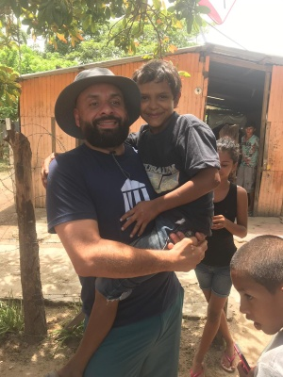

Slide 3
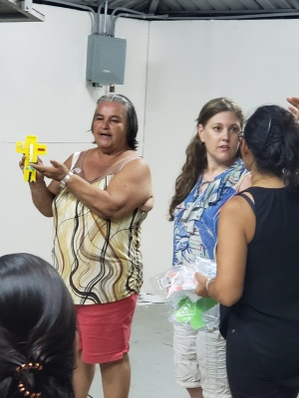

Slide 4
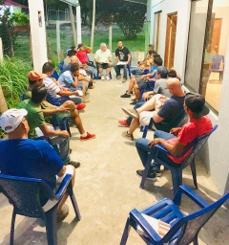

Slide 5
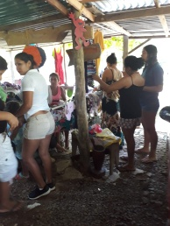

Slide 6
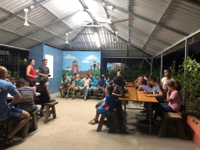

Slide 7
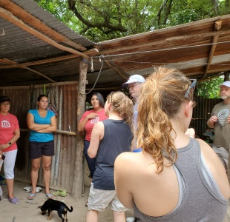

Slide 8
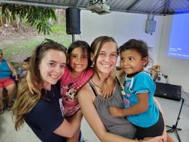

Slide 9
Week 1: Mission and Vision: Planting Bible Studies: Matt 28:16-20.
16 Then the eleven disciples went away into Galilee, into a mountain where Jesus had appointed them.
17 And when they saw him, they worshipped him: but some doubted.
18 And Jesus came and spake unto them, saying, All power is given unto me in heaven and in earth.
19 Go ye therefore, and teach all nations, baptizing them in the name of the Father, and of the Son, and of the Holy Ghost:
20 Teaching them to observe all things whatsoever I have commanded you: and, lo, I am with you alway, even unto the end of the world. Amen.

Slide 10
Week 1: Mission and Vision: Planting Bible Studies: Matt 28:16-20.
16 Then the eleven disciples went away into Galilee, into a mountain where Jesus had appointed them.
17 And when they saw him, they worshipped him: but some doubted.
18 And Jesus came and spake unto them, saying, All power is given unto me in heaven and in earth….
…and, lo, I am with you alway, even unto the end of the world. Amen.
They were where they were supposed to be.

Slide 11

Week 1: Mission and Vision: Planting Bible Studies: Matt 28:16-20.
16 Then the eleven disciples went away into Galilee, into a mountain where Jesus had appointed them.
17 And when they saw him, they worshipped him: but some doubted.
18 And Jesus came and spake unto them, saying, All power is given unto me in heaven and in earth….
…and, lo, I am with you alway, even unto the end of the world. Amen.
They were where they were supposed to be.

Slide 12
Week 1: Mission and Vision: Planting Bible Studies: Matt 28:16-20.
19 Go ye therefore, and teach all nations, baptizing them in the name of the Father, and of the Son, and of the Holy Ghost:
20 Teaching them to observe all things whatsoever I have commanded you: and, lo, I am with you alway, even unto the end of the world. Amen.
GOING
EVANGELISM
JOINING THE CHURCH
DISCIPLESHIP

Slide 13
Week 1: Mission and Vision: Planting Bible Studies: Matt 28:18-20.
1. Extends the Local church (MBT and LWC) into our communities. (Go…)
2. Makes owning the mission possible and practical. (ye…)
3. Makes owning the fruit possible and practical. (teach…)
4. Prepares growing leaders and enables established leaders. (teach…)
5. Prepares people to plant churches. This is how LFLS got started.
Extends the Local church (MBT and LWC) into our communities. (Go…)

Slide 14
Week 1: Mission and Vision: Planting Bible Studies: Matt 28:18-20.
1. Extends the Local church (MBT and LWC) into our communities. (Go…)
2. Makes owning the mission possible and practical. (ye…)
3. Makes owning the fruit possible and practical. (teach…)
4. Prepares growing leaders and enables established leaders. (teach…)
5. Prepares people to plant churches. This is how LFLS got started.
Extends the Local church (MBT and LWC) into our communities. (Go…)
2. Makes owning the mission possible and practical. (ye…)

Slide 15
Week 1: Mission and Vision: Planting Bible Studies: Matt 28:18-20.
1. Extends the Local church (MBT and LWC) into our communities. (Go…)
2. Makes owning the mission possible and practical. (ye…)
3. Makes owning the fruit possible and practical. (teach…)
4. Prepares growing leaders and enables established leaders. (teach…)
5. Prepares people to plant churches. This is how LFLS got started.
Extends the Local church (MBT and LWC) into our communities. (Go…)
2. Makes owning the mission possible and practical. (ye…)
3. Makes owning the fruit possible and practical. (teach…)

Slide 16
Week 1: Mission and Vision: Planting Bible Studies: Matt 28:18-20.
1. Extends the Local church (MBT and LWC) into our communities. (Go…)
2. Makes owning the mission possible and practical. (ye…)
3. Makes owning the fruit possible and practical. (teach…)
4. Prepares growing leaders and enables established leaders. (teach…)
5. Prepares people to plant churches. This is how LFLS got started.
Extends the Local church (MBT and LWC) into our communities. (Go…)
2. Makes owning the mission possible and practical. (ye…)
3. Makes owning the fruit possible and practical. (teach…)
4. Prepares growing leaders and enables established leaders. (teach…)

Slide 17
Week 1: Mission and Vision: Planting Bible Studies: Matt 28:18-20.
1. Extends the Local church (MBT and LWC) into our communities. (Go…)
2. Makes owning the mission possible and practical. (ye…)
3. Makes owning the fruit possible and practical. (teach…)
4. Prepares growing leaders and enables established leaders. (teach…)
5. Prepares people to plant churches. This is how LFLS got started.
Extends the Local church (MBT and LWC) into our communities. (Go…)
2. Makes owning the mission possible and practical. (ye…)
3. Makes owning the fruit possible and practical. (teach…)
4. Prepares growing leaders and enables established leaders. (teach…)
5. Prepares people to plant churches. This is how LFLS got started.

Slide 18
The vision: LWC members will DO OUR PART TO FULFILL THE Great commission by Extending the reach of MBT by establishing supported Bible studies around the metro.

