Slide 1

LWC 1-19-20
Romans 15:8-21

Slide 2
Review

Slide 3
Review: Renew our minds re: how we look at and treat each other.
Precedent
Perfect Word
Process
Pattern
Possession

Slide 4

15:13 Now the God of hope fill you with all joy and peace in believing, that ye may abound in hope, through the power of the Holy Ghost.
Romans 15:13

Slide 5
1Co 13:13 And now abideth faith, hope, charity, these three; but the greatest of these is charity.
Rom 8:24 For we are saved by hope: but hope that is seen is not hope: for what a man seeth, why doth he yet hope for?
Rom 5:2 By whom also we have access by faith into this grace wherein we stand, and rejoice in hope of the glory of God.
Rom 5:4 And patience, experience; and experience, hope:
Rom 5:5 And hope maketh not ashamed; because the love of God is shed abroad in our hearts by the Holy Ghost which is given unto us.
Rom 15:13 Now the God of hope fill you with all joy and peace in believing, that ye may abound in hope, through the power of the Holy Ghost.
2Co 3:12 Seeing then that we have such hope, we use great plainness of speech:

Slide 6
Paul’s Exhortation to Live an Abundant Life.
Vs 13: Note: This is a prayer to the God of Hope, Being filled with all joy and peace comes from believing (Rom 15:4, Ps 119:49). The result is that we abound in hope.

Slide 7
For whatsoever things were written aforetime were written for our learning, that we through patience and comfort of the scriptures might have hope.
Romans 15:4

Slide 8
ZAIN. Remember the word unto thy servant, upon which thou hast caused me to hope.
Ps 119:49

Slide 9
Seeing then that we have such hope, we use great plainness of speech:
2Co 3:12

Slide 10
Whereby are given unto us exceeding great and precious promises: that by these ye might be partakers of the divine nature, having escaped the corruption that is in the world through lust.
And beside this, giving all diligence, add to your faith virtue; and to virtue knowledge;
2Pe 1:4-5

Slide 11
And the things that thou hast heard of me among many witnesses, the same commit thou to faithful men, who shall be able to teach others also.
2Ti 2:2

Slide 12
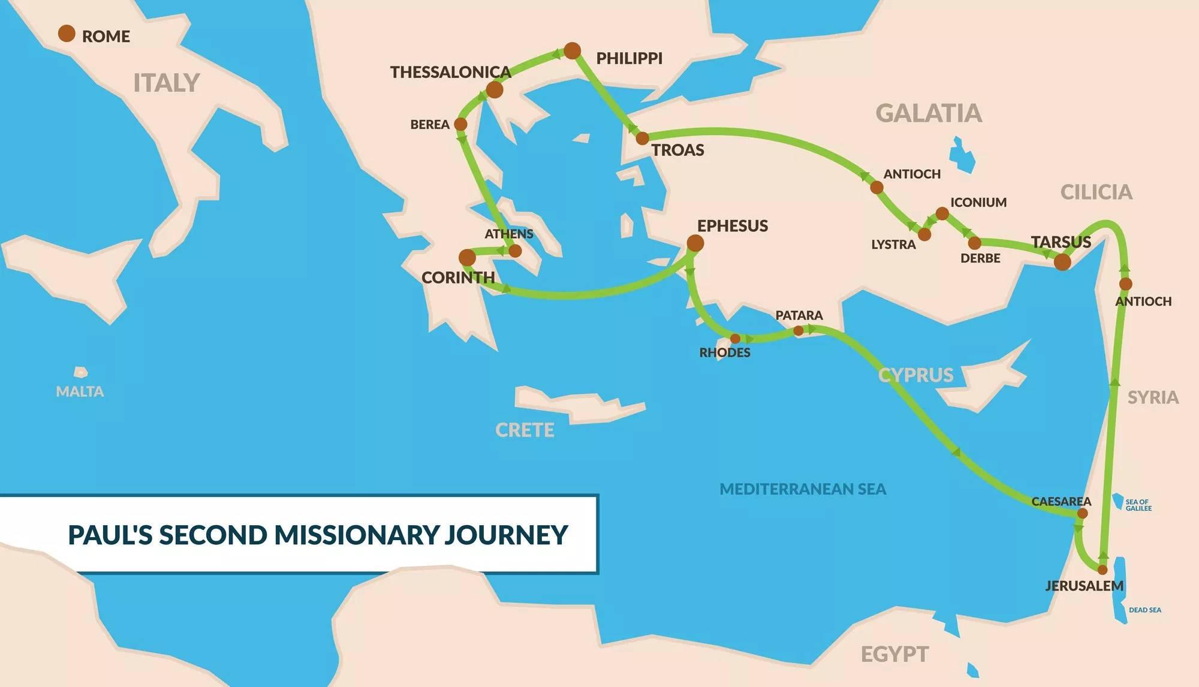

Slide 13
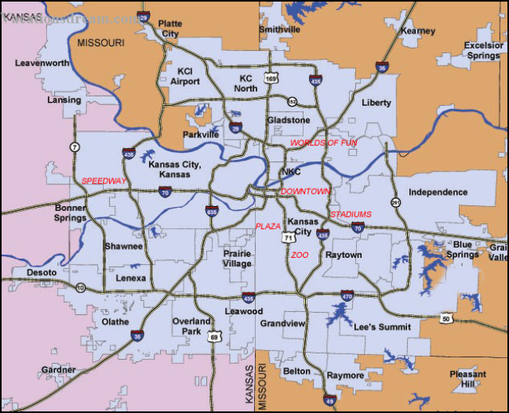

Slide 14
Pray Requests for our Bible Studies:
Pray for Fruit: Visitors, Salvations and Discipleship. (Jn 15:16, Col 1:6)
Pray for Anointing: Spiritual empowerment to do the work of the Lord. (Ps 90:16-17, Ps 127:1)
Pray for Protection: The Devil is at work! (1 Pe 5:8, Job 2:2)
Pray for our Witness: Outreach, invitation, and evangelism needs to be deliberate, structured, and natural. (Eph 6:18-20, Jn 4:29, Rev 22:17)
Pray for our Walk: Ministry that matters is an overflow. We invite others in, not tell others what to do. Only a personal walk in the light allows us to bring other to the light. (Mark 2:14, 1 Co 11:1, Philippians 3:17);
Pray for our Heritage and your place in it: Stay in the place of protection and blessing (2 Ki 2:13-14, 1 Co 11:1)

