Slide 1
Review:
Blessed is the man to whom the Lord will not impute sin.

Slide 2
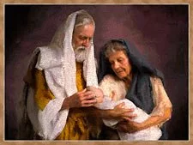
Father Abraham
Rom 4:16 Therefore it is of faith, that it might be by grace; to the end the promise might be sure to all the seed; not to that only which is of the law, but to that also which is of the faith of Abraham; who is the father of us all,

Slide 3
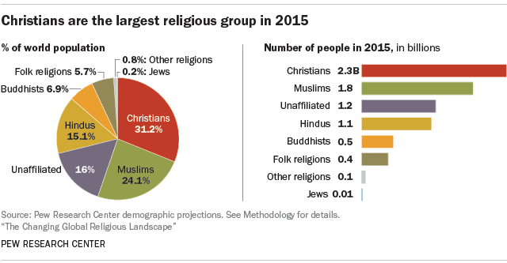
The Father of the Faithful

Slide 4
Intro: Father Abraham:
· About 55% of the world’s population look to Abraham as the Father of their Faith. This includes Christians, Muslims, and Jews.

Slide 5
Intro: Father Abraham:
· About 55% of the world’s population look to Abraham as the Father of their Faith. This includes Christians, Muslims, and Jews.
· “Faith” doesn’t mean the same thing to everyone. Same vocabulary, different dictionary!

Slide 6
Intro: Father Abraham:
· About 55% of the world’s population look to Abraham as the Father of their Faith. This includes Christians, Muslims, and Jews.
· “Faith” doesn’t mean the same thing to everyone. Same vocabulary, different dictionary!
* For Bible believers Faith is not a synonym of “religion”. It means “believing God”. (Rom 4:3, 9)

Slide 7
Verses 9-17:
To be a child of Abraham is to be a child of faith.

Slide 8
Verses 9-12: The blessedness of imputed righteousness is not just for the “circumcision” (the Jews, see Acts 10:45)
* Abraham was imputed righteousness before he was circumcised. (Gal 3:17-18)

Slide 9
Verses 9-12: The blessedness of imputed righteousness is not just for the “circumcision” (the Jews, see Acts 10:45)
* Abraham was imputed righteousness before he was circumcised. (Gal 3:17-18)
* Circumcision is a sign of something. It is not the something.

Slide 10
Verses 9-12: The blessedness of imputed righteousness is not just for the “circumcision” (the Jews, see Acts 10:45)
* Abraham was imputed righteousness before he was circumcised. (Gal 3:17-18)
* Circumcision is a sign of something. It is not the something.
* The something is righteousness imputed through faith. Abraham is the father of the faithful.

Slide 11
Verses 13-15: The Blessing of imputed righteousness is not by the law. (V. 13-17)
* The promise was to Abraham, not to those who fulfill the law. (V. 13)

Slide 12
Verses 13-15: The Blessing of imputed righteousness is not by the law. (V. 13-17)
* The promise was to Abraham, not to those who fulfill the law. (V. 13)
* Faith and works are exclusive (V.14). So no “Chrislam”

Slide 13
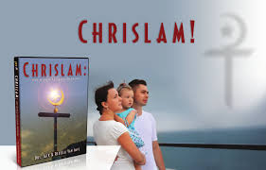
a growing abomination

Slide 14
Verses 13-15: The Blessing of imputed righteousness is not by the law. (V. 13-17)
* The promise was to Abraham, not to those who fulfill the law. (V. 13)
* Faith and works are exclusive (V.14). So no “Chrislam”
* The law reveals sin, which results in wrath, not promise.

Slide 15
Verses 16-17:
· The promises are sure, because they are not something earned by God’s people, but rather something imputed by God.

