Slide 1

what do you mean when you say…
”God’s Word”
An Introduction to Why the Bible is Holy

Slide 2
What many think about the bible
The bible is NOT myth or fairy tale

Slide 3
What many think about the bible
The bible is NOT myth or fairy tale
The bible is NOT a series of good moral stories

Slide 4
What many think about the bible
The bible is NOT myth or fairy tale
The bible is NOT a series of good moral stories
The bible is NOT written by men

Slide 5
What many think about the bible
The bible is NOT myth or fairy tale
The bible is NOT a series of good moral stories
The bible is NOT written by men
The bible is NOT complicated and can be read by anyone
“It is shallow enough so that the most timid swimmer may enjoy it’s waters
without fear, and yet deep enough for the most expert swimmer to
enjoy it without touching the bottom” - John Watson

Slide 6
What is the Bible?
The Bible was written by 40 different authors over a period of 1600 years.
They came from 20 different occupations and lived in ten different countries
They were separated by 6,000 miles while writing in 3 different languages
There are 2,930 characters in the Bible that lived in 1,551 places
The Bible, in whole or in part, has been translated into over 2,000 languages and dialects

Slide 7
What is the Bible?
If you do not know where to FIND the words of God, you do not know where to find God, and if you do not KNOW the word of God you don’t know God, and when you do not know God you do not know how to LIVE for GOD
Hosea 4:6

Slide 8
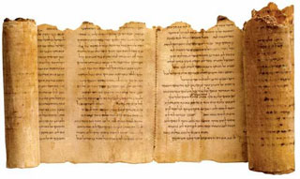
What does the bible say about itself?

Slide 9
Stage 1: God's Words Revealed (Revelation)
God speaks with Authority (Gen 1:3; Mark 4:39-41)
Gen 1:3 And God said, Let there be light: and there was light.
Mark 4:39-41 And he arose, and rebuked the wind, and said unto the sea, Peace, be still. And the wind ceased, and there was a great calm. And he said unto them, Why are ye so fearful? how is it that ye have no faith? And they feared exceedingly, and said one to another, What manner of man is this, that even the wind and the sea obey him?

Slide 10
Stage 1: God's Words Revealed (Revelation)
God speaks with Authority (Gen 1:3; Mark 4:39-41)
God speaks directly to people (Jeremiah 36:1)
God speaks through Jesus' testimony (John 12:47-50)
God speaks through others' testimonies (1 John 1:1-5)
1 John 1:5-7
This then is the message which we have heard of him, and declare unto you, that God is light, and in him is no darkness at all.⁶ If we say that we have fellowship with him, and walk in darkness, we lie, and do not the truth:⁷ But if we walk in the light, as he is in the light, we have fellowship one with another, and the blood of Jesus Christ his Son cleanseth us from all sin.

Slide 11
Stage 2: God's Words Inspired (Inspiration)
God places His word in man (Isa. 59:21)
God's words are direct and clear (Jeremiah 36:1-3)
God's words are living (Hebrews 4:12)
God inspires all scripture (2 Timothy 3:16-17, 2 Peter 1:19-21)
2 Tim 3:16-17
All scripture is given by inspiration of God, and is profitable for doctrine, for reproof, for correction, for instruction in righteousness: That the man of God may be perfect, throughly furnished unto all good works.

Slide 12
Stage 3: God's Words Written Down (Inscripturation)
God writes down His words directly (Exodus 32:15-16)
God records history (1 Corinthians 10:11)
God writes down His words through scribes (Jeremiah 36:4)
Jeremiah 36:4 Then Jeremiah called Baruch the son of Neriah: and Baruch wrote from the mouth of Jeremiah all the words of the LORD, which he had spoken unto him, upon a roll of a book.

Slide 13
Stage 4: God's Words Copied and Distributed (Transmission)
God's words are copied from medium to medium (Luke 16:27-31)
^{Luke} 16:27-31 Then he said, I pray thee therefore, father, that thou wouldest send him to my father's house:²⁸ For I have five brethren; that he may testify unto them, lest they also come into this place of torment.²⁹ Abraham saith unto him, They have Moses and the prophets; let them hear them.³⁰ And he said, Nay, father Abraham: but if one went unto them from the dead, they will repent.³¹ And he said unto him, If they hear not Moses and the prophets, neither will they be persuaded, though one rose from the dead.

Slide 14
Stage 4: God's Words Copied and Distributed (Transmission)
God's words are copied from medium to medium (Luke 16:27-31)
God's words are distributed through locality and culture (Romans 3:1-2)
God's words are distributed through time (Romans 15:4)
God's words are accessible (2 Timothy 2:15)
2 Timothy 2:15 Study to shew thyself approved unto God, a workman that needeth not to be ashamed, rightly dividing the word of truth

Slide 15
Stage 5: God's Words Established (Canonization)
God has founded His word from the beginning and settled it forever (Psalm 119:89, 152, 160; John 10:35)
Psalm 119:89 LAMED. For ever, O LORD, thy word is settled in heaven.
Psalm 119:152 Concerning thy testimonies, I have known of old that thou hast founded them for ever.
John 10:35 If he called them gods, unto whom the word of God came, and the scripture cannot be broken;

Slide 16
Stage 5: God's Words Established (Canonization)
God has founded His word from the beginning and settled it forever (Psalm 119:89, 152, 160; John 10:35)
God commands for His words to not be added to or diminished from (Deuteronomy 4:2; Proverbs 30:6; Matthew 15:8-9; Revelation 22:18-19)
Revelation 22:18 For I testify unto every man that heareth the words of the prophecy of this book, If any man shall add unto these things, God shall add unto him the plagues that are written in this book: And if any man shall take away from the words of the book of this prophecy, God shall take away his part out of the book of life, and out of the holy city, and from the things which are written in this book.

Slide 17
Stage 6: God's Words Translated (Translation)
God's words can be declared in multiple languages simultaneously (Genesis 31:47; Luke 23:38; Acts 2:4-11; Revelation 9:11; )
God translates His words (Daniel 5:25-28; Matthew 27:46 / Mark 15:34; John 1:41; Revelation 16:16)
God's words will be received of every kindred, tongue, people and nation (Revelation 5:9; 14:6)
Jesus commands His church to teach all His commandments to all nations (Matthew 28:18-20)
Matthew 28:18-20 And Jesus came and spake unto them, saying, All power is given unto me in heaven and in earth. Go ye therefore, and teach all nations, baptizing them in the name of the Father, and of the Son, and of the Holy Ghost: Teaching them to observe all things whatsoever I have commanded you: and, lo, I am with you alway, even unto the end of the world. Amen.

Slide 18
Stage 7: God's Words Preserved (Preservation)
God preserves His words, even when physically destroyed (Exodus 32:19; 34:1, 4; Jeremiah 36:27-32)
^{Jeremiah} 36:²⁷ Then the word of the Lord came to Jeremiah, after that the king had burned the roll, and the words which Baruch wrote at the mouth of Jeremiah, saying,²⁸ Take thee again another roll, and write in it all the former words that were in the first roll, which Jehoiakim the king of Judah hath burned.²⁹ And thou shalt say to Jehoiakim king of Judah, Thus saith theLord; Thou hast burned this roll, saying, Why hast thou written therein, saying, The king of Babylon shall certainly come and destroy this land, and shall cause to cease from thence man and beast?³⁰ Therefore thus saith the Lord of Jehoiakim king of Judah; He shall have none to sit upon the throne of David: and his dead body shall be cast out in the day to the heat, and in the night to the frost.³¹ And I will punish him and his seed and his servants for their iniquity; and I will bring upon them, and upon the inhabitants of Jerusalem, and upon the men of Judah, all the evil that I have pronounced against them; but they hearkened not.³² Then took Jeremiah another roll, and gave it to Baruch the scribe, the son of Neriah; who wrote therein from the mouth of Jeremiah all the words of the book which Jehoiakim king of Judah had burned in the fire: and there were added besides unto them many like words.

Slide 19
Stage 7: God's Words Preserved (Preservation)
God preserves His words, even when physically destroyed (Exodus 32:19; 34:1, 4; Jeremiah 36:27-32)
God keeps His words forever (Psalms 12:6-7; Isaiah 40:8; Matthew 24:35 / Mark 13:31; 1 Peter 1:24-25)
God keeps His words in His children forever (Isaiah 59:21)
God preserves the power of His words (Luke 16:17)
God punishes those who attack His word (Revelation 22:18-19)

Slide 20
After all that God has done to protect his words and deliver them to your hands…what is necessary for you to understand it? God’s Mind
1 Cor 2:14 Which things also we speak, not in the words which man's wisdom teacheth, but which the Holy Ghost teacheth; comparing spiritual things with spiritual. But he that is spiritual judgeth all things, yet he himself is judged of no man. For who hath known the mind of the Lord, that he may instruct him? But we have the mind of Christ.

Slide 21
Holy spirit as teacher

Slide 22
Teaching: can’t do it if no one is learning
Before we get to talking about our teacher, lets discuss learning.
If you google the definition of learning you will come to:
the acquisition of knowledge or skills through experience, study, or by being taught.
Synonyms include: enlightenment ,illumination, edification

Slide 23
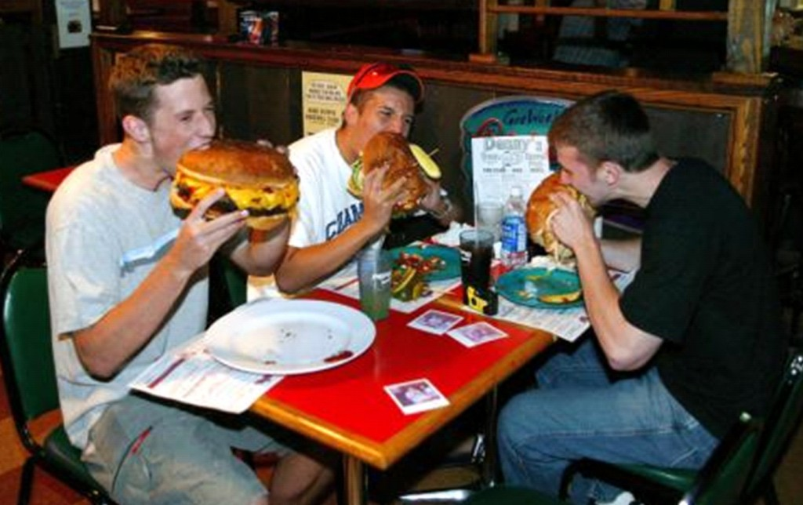
learning is like the digestive system
The first phase is ingestion:
- the physical and mechanical process of taking in food, breaking it down into smaller pieces, mixing it with saliva, and swallowing.

Slide 24
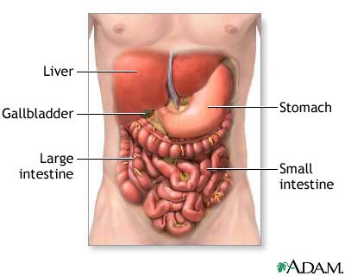
Digestive system cont…
The second phase is digestion
Now the broken down, small pieces of food and saliva have reached the stomach. Here they mix with stomach acids, digestive enzymes, and bacteria. Food turns from a solid into a think paste and moves into the small intestines.

Slide 25
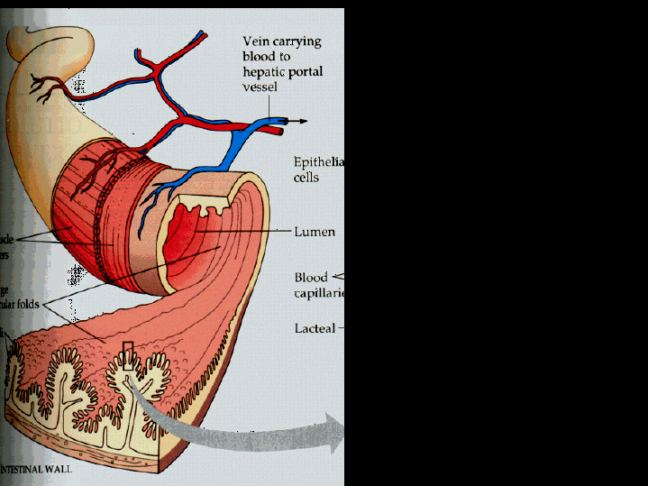
Digestive system cont…
The third phase is absorption
Now that food is broken down into particles, our bodies can absorb the nutrients needed for energy, growth, cellular repair. Nutrients are absorbed by the intestines and delivered to parts of the body that need them.

Slide 26
Learning is just like our digestive system
Ingestion= Studying, being taught, classroom time, the taking in of new material one is to learn
The taking in of large chunks of information.
Digestions = Meditating on materials taught or studied, practicing the use of information such as homework, reviewing.
The act of breaking down information into more manageable/useful pieces
Absorption = application and understanding of materials ingested and digested, or studied and meditated on
The ability to functionally apply and use information learned.

Slide 27
Learning comes in different forms
There are 4 types of learners
Visual
Auditory
Read/write
Kinesthetic

Slide 28
Can we study the bible the same way we study for school?
Take in information ?
Meditate on it ?
Try hard and apply what I learned ?

Slide 29
Holy spirit as teacher
1 Cor 2:9 But as it is written, Eye hath not seen, nor ear heard, neither have entered into the heart of man, the things which God hath prepared for them that love him.
1. We can not see, hear, or apply Gods word for all that it is through our flesh.

Slide 30
Holy spirit as teacher
10 But God hath revealed them unto us by his Spirit: for the Spirit searcheth all things, yea, the deep things of God.
2. God has prepared to reveal certain deep truths by his Spirit to those that love Him.

Slide 31
Holy spirit as teacher
11 For what man knoweth the things of a man, save the spirit of man which is in him? even so the things of God knoweth no man, but the Spirit of God.
3. Our Natural Man, our flesh, cannot know the things of God.
Similar to Ingestion of food. We can take in facts about God and never be spiritually nurished.

Slide 32
Holy spirit as teacher
12 Now we have received, not the spirit of the world, but the spirit which is of God; that we might know the things that are freely given to us of God.
4. At salvation we received the spirit of God. The spirit of God teaches us the things freely given to us of God.

Slide 33
Holy spirit as teacher
13 Which things also we speak, not in the words which man's wisdom teacheth, but which the Holy Ghost teacheth; comparing spiritual things with spiritual.
5. The Holy Ghost teacheth by comparing spiritual things with spiritual.

Slide 34
Holy spirit as teacher
14 But the natural man receiveth not the things of the Spirit of God: for they are foolishness unto him: neither can he know them, because they are spiritually discerned.
6. If you study the things of God like a natural man you will walk away with head knowledge and pride. It will not be absorbed and change you from the inside.

Slide 35
The THINGs of GOD
Natural Man
-Receiveth not
- They are foolish
- He can’t know them
- Unable to spiritually discern
Spiritual Man
- God hath prepared them for us
- Revealed to us by his spirit
- We can know them
- We have THE spiritual discerner in us

Slide 36
All things
John 14:26 But the Comforter, which is the Holy Ghost, whom the Father will send in my name, he shall teach you all things, and bring all things to your remembrance, whatsoever I have said unto you.
8. The Holy Ghost shall teach you all things and bring all things to remembrance.

Slide 37
Spiritual man vs unspiritual (carnal)
Walks in the Spirit
Walks in the word
We can choose to live as an UNSPIRITUAL MAN.
We can walk in the flesh.
Choosing to walk in the world.
Studying is done in vain, builds head knowledge and pride.
We can choose to live like the world and grieve the spirit. Eph 4: 27-30
We can be stiffnecked and live like the Pharisee’s. Act 7:51
OUR WALK WITH THE LORD WILL SUFFER. WE WILL HAVE SPIRITUAL INDIGESTION.

Slide 38
MY Responsibility to learn
You MUST CHOOSE TO LEARN
1 John 2:27 But the anointing which ye have received of him abideth in you, and ye need not that any man teach you: but as the same anointing teacheth you of all things, and is truth, and is no lie, and even as it hath taught you, ye shall abide in him.
Anoint: set apart, consecrate, hallow, treat as sacred, observe as holy
9. The Holy Spirit is enough to teach you all things.

Slide 39
MY Responsibility to learn
FOLLOW THE GUIDE
John 16:13 Howbeit when he, the Spirit of truth, is come, he will guide you into all truth: for he shall not speak of himself; but whatsoever he shall hear, that shall he speak: and he will shew you things to come.
The Spirit of truth will guide usinto all truth.
We must be regularly exposed to truth in order for the Spirit to Guide us in it.

Slide 40
MY Responsibility to learn
2 Tim 2:15 Study to shew thyself approved unto God, a workman that needeth not to be ashamed, rightly dividing the word of truth.
This is a very clear command. We are to study and rightly divide.

Slide 41
Spirit driven digestion and Learning
Ingestion: My responsibility
Studying the bible, cooperate bible study, Discipleship, teaching through Sunday school and church
Digestions: C0-responsibility
We can meditate and review materials.
The Holy Spirit will compare spiritual things to spiritual.
Absorption: Involuntary on my part, Only through the Holy Spirit
Understanding and application at the spiritual level can never be done out of my will power, flesh, or natural self. The Holy Spirit grows me from the inside out through time in his truth.
The same as I can will nutrients into my cells, I can’t will God’s word into my spirit.

