Slide 1

The Prevailing Power of Pleading Prayer!
1 Samuel 1:27 For this child I prayed; and the LORD hath given me my petition which I asked of him:

Slide 2
Dysfunctional family dynamics.

Slide 3
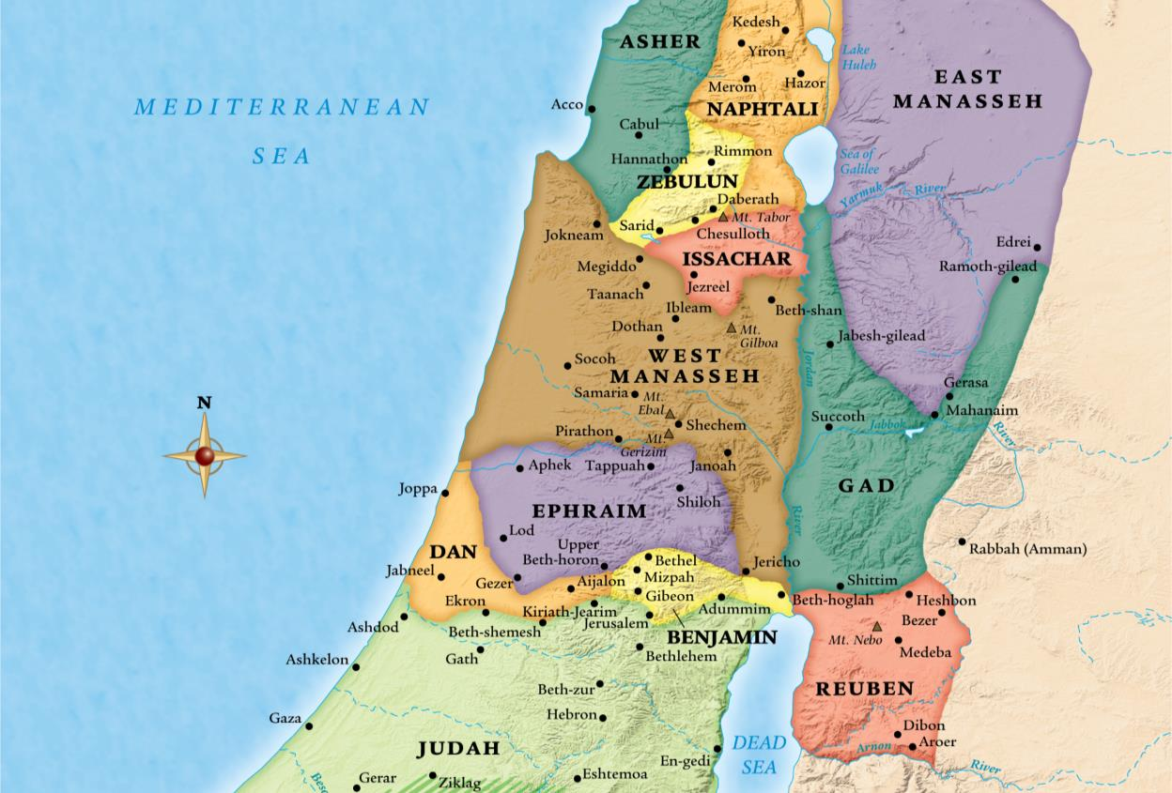
story setting

Slide 4
Dysfunctional family dynamics.
Elkanah = “God Created”
Hannah = “Grace” “Favor with God.”
Multiple wives makes for a mess.

Slide 5
Genesis 2:24 Therefore shall a man leave his father and his mother, and shall cleave unto his wife: and they shall be one flesh.
Mark 10:6-9 But from the beginning of the creation God made them male and female. 7 For this cause shall a man leave his father and mother, and cleave to his wife; 8And they twain shall be one flesh: so then they are no more twain, but one flesh. 9 What therefore God hath joined together, let not man put asunder.

Slide 6
Marriage by God’s design:
One man and one woman for life!

Slide 7

Polygamy has never brought blessing!

Slide 8
James 4:8a Draw nigh to God, and he will draw nigh to you.

Slide 9
God can make praise to His name (2:1-10)
– even out of your life’s mess!

Slide 10
Dysfunctional family dynamics.
Family problem: Barrenness.
Hannah had no child – A sign of no blessing from God.

Slide 11
Psalm 127:3 Lo, children are an heritage of the LORD: and the fruit of the womb is his reward.
Genesis 30:1 And when Rachel saw that she bare Jacob no children, Rachel envied her sister; and said unto Jacob, Give me children, or else I die.

Slide 12
Dysfunctional family dynamics.
Hannah’s adversity in her physical family.
Peninnah = “Pearl” “to turn!” = rival. See vs 6-8!
She was working to turn Elkanah’s heart from Hannah.

Slide 13
2 Corinthians 10:12 For we dare not make ourselves of the number, or compare ourselves with some that commend themselves: but they measuring themselves by themselves, and comparing themselves among themselves, are not wise.

Slide 14
1 Peter 5:8 Be sober, be vigilant; because your adversary the devil, as a roaring lion, walketh about, seeking whom he may devour:

Slide 15
Note on depression: the struggle is real.
There are real reasons for it.

Slide 16
1 Peter 5:5b-7 …be clothed with humility: for God resisteth the proud, and giveth grace to the humble. 6 Humble yourselves therefore under the mighty hand of God, that he may exalt you in due time: 7 Casting all your care upon him; for he careth for you.

Slide 17
The Power of Pleading Prayer.
Notice Hannah’s vow.
Don’t miss the picture.
This is a request for a supernatural birth!
Her dedication of Samuel
to the Lord.

Slide 18
The Power of Pleading Prayer.
Hannah’s adversity in her spiritual family.
Eli gave Hannah the beat down when she was seeking hard after God. Why?
He was carnal.
1 Sam 4. He was a terrible father (1 Sam 2) and a glutton (1 Sam 4.)
He doesn’t love the things of God – so he’s condemning those that do!

Slide 19
Proverbs 15:1 A soft answer turneth away wrath: but grievous words stir up anger.

Slide 20
Faith is the Victory!
Vs 17 KEY: Leaders - Bless the faith of your brethren.
Vs 18: Notice Hannah’s faith!
Her prayer was answered in her heart long before she ever received anything! Did she leave prayer with a baby?
Contentment is key!

Slide 21
Philippians 4:11-13 Not that I speak in respect of want: for I have learned, in whatsoever state I am, therewith to be content. 12 I know both how to be abased, and I know how to abound: every where and in all things I am instructed both to be full and to be hungry, both to abound and to suffer need. 13 I can do all things through Christ which strengtheneth me.

Slide 22
Faith gets down!

Slide 23
1 John 5:14-15 And this is the confidence that we have in him, that, if we ask any thing according to his will, he heareth us: 15 And if we know that he hear us, whatsoever we ask, we know that we have the petitions that we desired of him.

Slide 24
The Prevailing Power of Pleading Prayer!
1 Samuel 1:27 For this child I prayed; and the LORD hath given me my petition which I asked of him:

